Slide 1
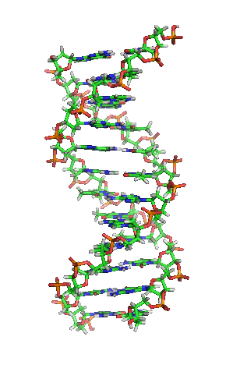
Use of the Illumina Bovine3K BEAD chip in dairy genomic evaluation

Slide 2
Introduction
To increase the adoption of genomic testing, a low density test was developed.
Genomic evaluations using genotypes from the Illumina Bovine3K BEAD chip became available in September 2010.
Official genomic evaluations based on 3K genotypes were released in December 2010.
Approximately 3,700 new 3K genotypes are submitted monthly for evaluation.

Slide 3
Number of New Genotypes
6000
42,512
5000
4000
3000
77,553
2000
1000
0
09/10
10/10
11/10
12/10
01/11
02/11
03/11
04/11
05/11
06/11
07/11
50K and HD
3K
Totals as of July 2011

Slide 4


Sex Distribution August 2010
Males
61%
Females
39%
All genotypes

Slide 5
Sex Distribution July 2011
Males
42%
Females
58%
All genotypes

Slide 6
3K Sample Characteristics
93% of 3K genotypes are from females
3K Sample types include:
    Hair (79%)
    Blood (10%)
    Nasal (10%)
    Semen (1%)

Slide 7
Parent-Progeny conflicts
For animal
  Pedigree incorrect
  Genotype unreliable (3K)
For SNP
  SNP unreliable
  Clustering needs adjustment
  Parent 10212002101201211001020100100
  Progeny 10202010100200221001120120220
Notes:
7

Slide 8
Parent Progeny Conflicts 50K
30000
25000
20000
Number of Genotypes
15000
10000
5000
0
0
0.1
0.2
0.3
0.4
0.5
Conflicts (%)

Slide 9
Detecting Unreliable 3K Genotypes
18000
16000
14000
12000
10000
Number of Genotypes
Accept
Unreliable Genotype (Reject)
8000
6000
4000
2000
0
0
0.2
0.4
0.6
0.8
1
1.2
1.4
1.6
1.8
2.0
2.4
2.8
3.2
Conflicts (%)

Slide 10
Maternal Grandsire (SNP)
1200
1000
800
Number of Genotypes
600
400
200
0
7 9 11 13 15 17 19 21 23 25 27 29
Percent Conflicts
Maternal Grandsire
2nd Most related male >5 yrs
The difference between the true maternal grandsire and
the 2nd most related male ranged from 0.0% to 15.5%.

Slide 11
Maternal Grandsire (haplotype)
New method for maternal grandsire validation and discovery by haplotype subtraction
Remove the contribution of the confirmed genomic sire by subtracting his known haplotypes (group of SNP, generally inherited together) from the progeny.
Count the remaining haplotype (contribution from the dam) matches between the animal and MGS in question
Count is low = Error; Count is High = Ancestor is detected

Slide 12
Maternal Grandsire (haplotype)
To test, 71 Brown Swiss animals had MGS blanked on their pedigree.
62 out of 71 (87%) were able to be recovered correctly.
Why could we not find them all?
    The difference between the true MGS and the 2nd animal was too small
    Different relative had fewer conflicts

Slide 13
Integration into Evaluation
3K genotypes are imputed from 2,614 SNP to 42,503 SNP used in evaluation of 50K genotypes.
Reliability is discounted to recognize errors associated with imputation.
The average 3K genomic evaluation reliability is 5 points lower than 50K evaluations.

Slide 14
Imputation & Pedigree
The average imputed call rate for 3K genotypes is 95.2% and ranges from 71.0% - 97.0%
Animals that have a low imputed call rate are those who have unknown pedigree or no genotyped relatives
Proportion with 1+ genotyped parents
  50K – 94.5%
  3K – 84.2%

Slide 15
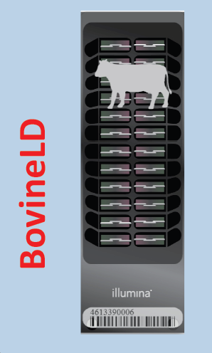
Conclusions
The 3K chip has been successful in extending genotyping to a larger portion of the cow population.
The evaluation system has been modified to accommodate the characteristics of a low density chip.
Improvements in imputation
will increase accuracy.
New BovineLD chip (6K)

Slide 16
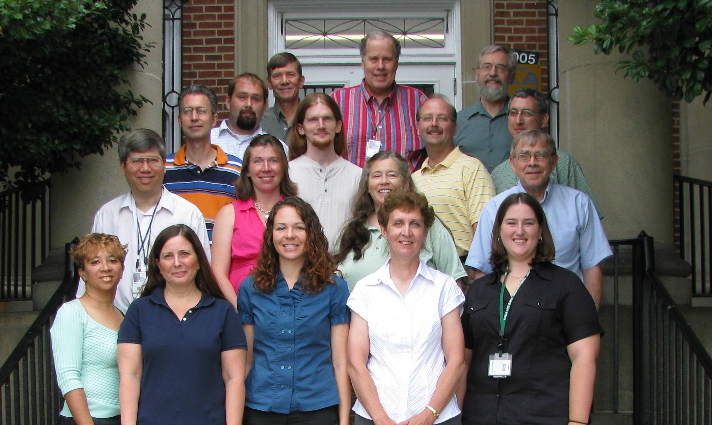
Thank You!

