Slide 1
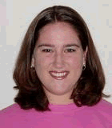
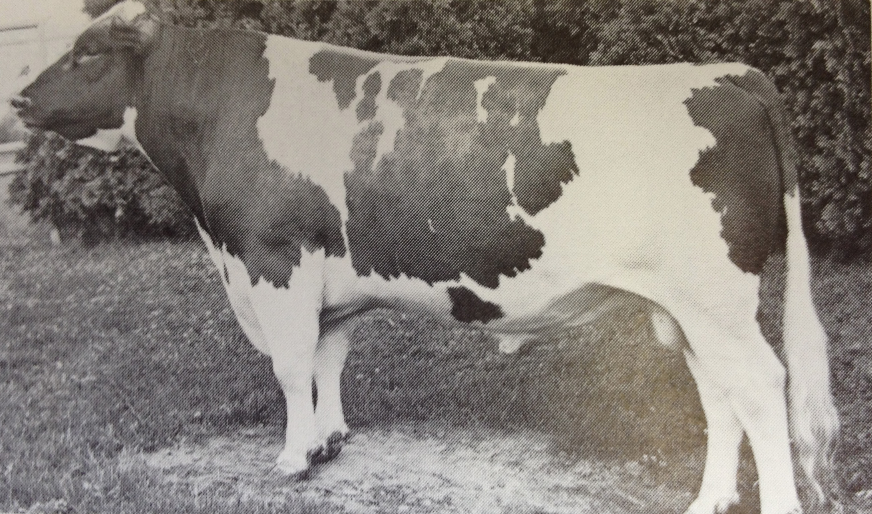
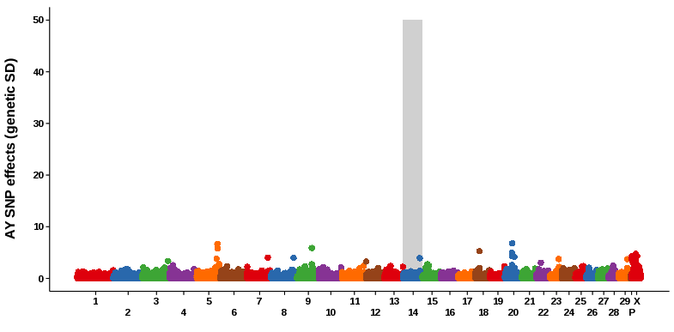
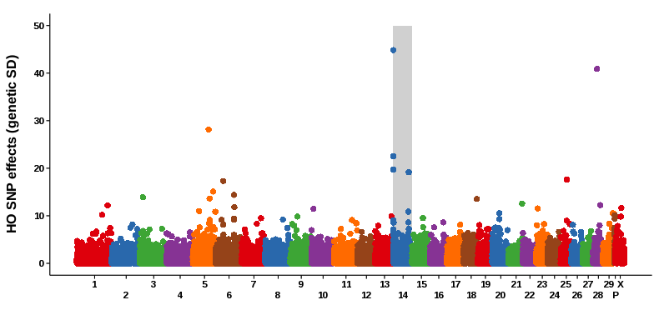
Genomic evaluation of Ayrshire dairy cattle and new haplotypes affecting fertility and stillbirth in Holstein, Brown Swiss and Ayrshire breeds
T.A. Cooper*, G.R. Wiggans, P.M. VanRaden, J. L. Hutchison, J. B. Cole, and D. J. Null
Animal Improvement Programs Laboratory, Agricultural Research Center, USDA, Beltsville, MD 20705-2350
T206
INTRODUCTION
Genomic evaluation of dairy cattle in the US has been available for Holstein, Jersey and Brown Swiss since 2009. As of February 2013, there were 1,100 genotyped Ayrshires in the North American database including 646 bulls with traditional evaluations allowing for the evaluation of this breed.
Four new haplotypes, two in Holstein, one in Brown Swiss, and one in Ayrshire, appear to be simple recessives that should be reported to breeders for use in selection and mating.
RESULTS (continued)
Current effects of new haplotypes on fertility and stillbirth
Breed | Haplotype | Chromosome | Expected Homozygotes | Observed Homozygotes | Conception Carrier Matings | Conception Decrease (%) | Stillbirth Carrier Matings | Stillbirth Increase (%)
Holstein | HH4 | 1 | 1 | 0 | 103,451¹ | -3.0¹ | N/A | N/A
Holstein | HH5 | 9 | 6 | 1² | 5,025 | -3.5 ± 0.6 | 1,115 | 0.7 ± 0.7
Brown Swiss | BH2 | 19 | 29 | 0 | 964 | 0.3 ± 1.5 | 1,307 | 2.6 ± 1.3
Ayrshire | AH1 | 17 | 14 | 0 | 483 | -4.4 ± 2.5 | N/A | N/A
DATA & METHODS
Gains in reliability due to genomics were determined by comparing parent averages and genomic evaluations from August 2008 to December 2012 daughter performance for bulls born on or after January 1, 2000 who received a traditional evaluation by December 2012. The number of bulls tested ranged between 147 and 180 bulls by trait.
Breed specific SNP were determined by comparing the allele frequencies of Ayrshire genotyped animals to allele frequency found in Holstein, Jersey and Brown Swiss.
Haplotypes affecting fertility were identified by investigating areas of the genome with a lack of expected homozygous haplotypes (VanRaden et al., 2011).
Losses in fertility were investigated by looking at the carrier sire by carrier maternal grandsire matings within each breed.
¹ The reported HH4 carrier matings and conception decrease are from French data (Fritz et al., 2013).
² A genotyped embryo was homozygous and was implanted, but no pregnancy was detected 28 days later.
Current frequencies and primary source of new haplotypes
Haplotype | Ancestor | Birth Year | Carrier Frequency (%)
HH4 | FRA4486041658 Besne Buck | 1986 | 0.7
HH5 | CAN264804 Thornlea Texal Supreme | 1957 | 5.0
BH2 | USA144488 Rancho Rustic My Design | 1963 | 20.5
AH1 | USA117936 Selwood Betty’s Commander | 1953 | 26.1
RESULTS
SELWOOD BETTY'S COMMANDER (b. 1953) Photo: North Eastern Breeders Association
Observed reliabilities (REL) in August 2008 for traditional parent averages and genomic evaluations* of young bulls without daughter information, coefficients of determination (R² × 100) between August 2008 evaluations and December 2012 daughter deviations deregressed from traditional evaluations, coefficients (b) for regression of January 2012 daughter deviations on August 2008 genomic evaluations, and bias in genomic evaluation by trait
DISCUSSION and CONCLUSION
The average gain in reliability over parent average for all traits was 8.2. The highest gains were found in milk yield (16.6), protein yield (16.9) and stature (16.2).
SNP with the largest effects vary between Ayrshire and Holstein. These evaluations were calculated based on the North American population and may not be suitable to all red dairy cattle because linkage disequilibrium probably differs by population.
There are 12 SNP in Ayrshire that can be used for breed determination because they are nearly monomorphic (>90%) in Ayrshire and have fewer than 30% of animals homozygous for that allele in Holstein, Jersey and Brown Swiss. There are fewer breed determining SNP in Ayrshire than in Holstein, Jersey and Brown Swiss, mostly due to the similarity of Ayrshire and Holstein.
The frequency of HH4 carriers is 7.2% in France (Fritz et al., 2013) and could also be high in other countries that used many sons of Jocko Besne, a prominent carrier.
The effect of BH2 on stillbirth is similar in size to the previously known defect Spinal Muscular Atrophy (SMA).The fertility losses from HH5 were estimated to all occur before 60 days of gestation; no estimates for HH4 and AH1 are yet available.
 |  | August 2008 REL (%) |  |  | R²
Trait** | N† | Parent Average | Genomic Evaluation | Gain | Parent Average | Genomic Evaluation | b | Bias***
Milk (kg) | 180 | 35.0 | 51.6 | 16.6 | 0.15 | 0.28 | 1.05 ± 0.13 | -87.8 ± 39.1
Fat (kg) | 180 | 35.0 | 49.0 | 14.0 | 0.22 | 0.32 | 1.01± 0.11 | -2.8 ± 1.5
Protein (kg) | 180 | 35.0 | 51.8 | 16.9 | 0.29 | 0.42 | 1.17 ± 0.10 | -3.7 ± 1.0
NM ($) | 180 | 31.5 | 45.1 | 13.6 | 0.14 | 0.23 | 1.26 ± 0.17 | -50.3 ± 33.2
PL (mo) | 171 | 26.1 | 30.3 | 4.2 | 0.07 | 0.10 | 1.16 ± 0.27 | -0.3 ± 0.4
SCS | 180 | 30.5 | 33.5 | 3.0 | 0.20 | 0.22 | 1.01 ± 0.14 | 0.0 ± 0.0
DPR (%) | 147 | 27.9 | 28.0 | 0.1 | 0.15 | 0.15 | 1.01 ± 0.20 | 0.0 ± 0.2
Final Score | 175 | 26.2 | 26.1 | -0.1 | 0.13 | 0.13 | 1.00 ± 0.19 | -0.1 ± 0.1
Stature | 177 | 31.3 | 47.5 | 16.2 | 0.23 | 0.36 | 1.03 ± 0.10 | -0.3 ± 0.1
*Includes SNP and polygenic effects estimated from the August 2008 predictor population (genotyped animals with traditional evaluations) and August 2008 traditional parent averages.
** NM = net merit, PL = productive life, DPR = daughter pregnancy rate and SCS=Somatic Cell Score.
***January 2013 daughter deviation – August 2008 genomic evaluation.
†Number of validation bulls (received traditional evaluation by January 2013)
Genomic REL – parent average REL.
REFERENCES
Fritz S, Capitan A, Djari A, Rodriguez SC, Barbat A, et al. 2013. Detection of haplotypes associated with prenatal death in dairy cattle and identification of deleterious mutations in GART, SHBG and SLC37A2. PLoS ONE 8(6): e65550.
Schwarzenbacher, H., Fuerst, C., Fuerst-Waltl, B. and Dolezal, M. 2012. A genome-wide search for harmful recessive haplotypes in Brown Swiss and Fleckvieh cattle. Proc. EAAP annual meeting, Bratislava.
VanRaden, P.M., Olson, K.M., Null, D.J., and Hutchison, J.L. Harmful recessive effects on fertility detected by absence of homozygous haplotypes. J. Dairy Sci. 94(12):6153–6161. 2011.
VanRaden, P.M., Null, D.J., Olson, K.M., and Hutchison, J.L. Reporting of haplotypes with recessive effects on fertility. Interbull Bull. 44:117–121. 2011.
ACKNOWLEDGMENTS
The authors thank Jacques Chesnais and Nicolas Caron (The Semex Alliance, Canada) for information on the homozygous HH5 embryo and for genotyping the earliest source ancestor, Hermann Schwarzenbacher (ZuchtData EDV-Dienstleistungen GmbH, Austria) for information on BH2, Dan Gilbert (New Generation Genetics) for informing us of the Austrian research, and Didier Boichard for information on HH4.
Ayrshire Milk SNP Effects
Holstein Milk SNP Effects
http://aipl.arsusda.gov

