Slide 1
Practical Implications for Genetic Modeling in the Genomics Era

Slide 2
Goals of modeling
Accurately predict future phenotypes
Define traits and edit raw data
Decide what environmental factors, genetic effects, and interactions to include
Estimate variances, covariances, distributions
Remove biases and improve stability
Add impact with validation and education

Slide 3
The genomics era
Year | Breeding program | Data sources added
< 1937 | Mass selection | Own phenotype
1937-1962 | Means of relatives | Daughters, dams
1962-1989 | Sire models | Herd-year-season
1989-present | Animal models | Full pedigrees
1995-present | MACE models | Foreign daughters
2009-present | Genomic models | Marker genotypes
2013-future | Biologic models | Causal mutations

Slide 4
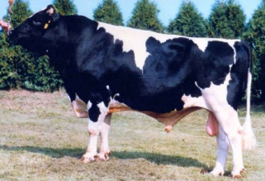
Growth of markers and animals
Year | Markers | Animals | Research partners
1991-2004 | 367 | 1,415 | USDA, Illinois, Israel (DNA from USA, CAN)
2007-2009 | 38,416 | 16,646 | USDA, Missouri, Canada, Illumina
2011-2013 | 636,967 | 161,341 | Added Italy, United Kingdom, HD genotypes
2012-2015 | 61,013 | 952,338 | Added Interbull (BSW) and Denmark (JER)
2015-future | 39,700,000 | 1,577 | Worldwide exchange in Melbourne, Australia

Slide 5
Sources of genomic information
Marker genotype arrays (SNP chips)
Imputed genotypes, imputed dam genotypes
Haplotypes or single- or multi-SNP regression
DNA sequences (whole, low depth, targeted)
Bioinformatic or across-species prior info
Future: dominance, epistatis, imprinting, epigenetics, new mutations, transgenics

Slide 6
New evaluation programs: Dec 2014
Replaced animal model programs used since 1989. New options include:
Multi-trait models, multiple class and regress variables, factors and weights differ by trait, random regressions, include foreign data, parallel processing
Developed for transition to single-step model (genotypes, phenotypes, pedigree)
Approx. G⁻¹ for >1 million genotypes?
Notes:
Renumber factors in same program

Slide 7
Current computation: multi-step
Steps | Time (hours) | Proc-essors | Memory (Gbytes)
Extract data and pedigree | 10 | 7 | 1
Inbreeding and heterosis | 8 | 2 | 5
Traditional EBVs, 8 traits | 24 | 8 | 40
Imputation (using priors) | 48 | 20 | 75
Genomic EBVs, 27 traits | 10 | 27 | 54
Compare G to A matrix | 6 | 20 | 75
Distribute final results | 5 | 1 | 1
Total | 111
Weekly (new animals only) | 1.4 | 10 | 50

Slide 8
Single-step GBLUP
Legarra-Ducrocq (2012) algorithm applied to USA Jersey yield traits by VanRaden (2012)
OK for JE, but did not converge for HO
Misztal et al (2014) algorithm applied to USA Jersey yield traits by Yutaka Masuda in 2015
Very similar results for JE, now can also process HO using approximate G⁻¹
Expect good CPU time, but more memory

Slide 9
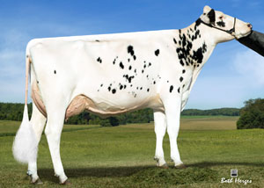
Animal model adjusts for
PTA rather than GPTA of mates
Top bulls mated only to top genomic females
PTA rather than GPTA of herdmates
Can underestimate recent genetic trend
PTA rather than GPTA of parents and progeny
Dams credited only for highly selected sons
Top heifers not milked, used as ET donors

Slide 10
% ET daughters, % genotyped mates

Slide 11
Future bias from mates – young bulls
Genomic PTA – traditional PTA of mates of top 50 NM$ bulls born in 2010-2012
Trait | Mean | Min | Max
NM$ | 5 | 0 | 11
Protein | 0 | 0 | 1
Prod Life | .1 | .0 | .1
Dtr Preg Rate | .1 | .0 | .1
SCS | .00 | -.01 | .00
Final Score | -.02 | -.08 | .00
Udder Depth | -.01 | -.04 | .02

Slide 12
Current biases small because…
Newly proven bulls get 1,000’s of daughters
Prior assumed E(MS) = 0 has little effect
Many herds use both young and proven bulls
Gives accurate estimate of genetic trend
Dams get many daughters before son data
Few daughters were culled on genomics

Slide 13
Previous and future biases
Previous biases have been reduced:
Polygenic effect added (2010), cow PTA adjustments (2010), DGV weight reduced (2012, 2013), PL correlations reduced (2012)
Heritability of yield traits reduced (2014)
Future biases will need to be reduced:
Genomic pre-selection of progeny or mates
Early daughters not from random sampling

Slide 14
Options to validate / choose models
Compute predictions, wait for future data
Truncate data, test predictions on recent data
Cross-validate using random data subsets
REML estimates of variance (using G or A?)
ANOVA type I and III mean square tests
Akaike or Bayesian information criterion

Slide 15
2013 NM$ vs. PA to predict 2015
Young bulls with 0 daughters in 2013 and > 100 daughters in 2015

Slide 16
Rapid generation turnover
Validation truncates 4 years of data, previously 1 generation of bulls
Few cows were genotyped before 2011
Truncating fewer years does not validate later-lactation performance
Calves are now 2 generations away from phenotyped animals, embryos are 3 generations away (pedigree next 2 slides)

Slide 17
Pedigree of sire of embryo (HOUSA73431994)
777K 777K
50K - - -
50K 50K
50K 50K
777K 777K
50K - - -
3K 777K
50K 50K
777K 777K
50K Imputed
Imputed 50K
50K Imputed
50K 777K
50K 50K
50K 777K
77K - - -
777K 777K
50K Imputed
Imputed 50K
50K Imputed
50K 777K
50K 50K
3K 777K
9K 50K
50K 777K
50K 50K
50K 777K
50K Imputed
777K 777K
50K - - -
Imputed 777K
50K

Slide 18
Pedigree of dam of embryo (HOCAN108535184)
777K 50K
50K - - -
50K 777K
50K Imputed
777K 777K
50K 50K
Imputed 777K
50K - - -
777K 50K
777K - - -
Imputed 777K
50K - - -
777K 777K
Imputed Imputed
Imputed 777K
77K 50K
777K 50K
777K - - -
Imputed 777K
50K - - -
777K 777K
Imputed - - -
Imputed 777K
77K 50K
777K 777K
777K 50K
50K 777K
50K - - -
50K 50K
50K 50K
50K 777K
50K

Slide 19
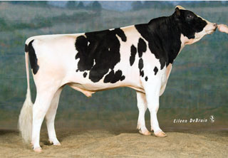
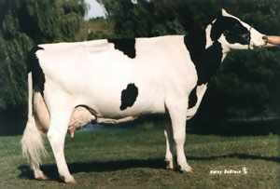
Pedigree or genomic mating?
Computer mating programs assign mates with fewer ancestors in common to reduce pedigree inbreeding
Such programs can instead assign mates with fewer alleles in common to reduce genomic inbreeding
Relationships of each genotyped female to genotyped AI males available since Aug 2014
Dominance effects tested, not yet distributed
Pedigree relationships
Genomic relationships

Slide 20
Should reference populations include
Very old bulls? (10,000 more HO to genotype)
Important for small populations, but less valuable with much recent data
Phenotyped cows? (now >150,000)
Useful for medium to highly heritable traits
Foreign bulls? (>20,000 EuroGenomics bulls)
Improve low h² traits if correlations high

Slide 21
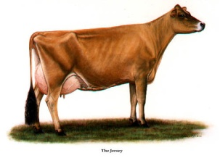
Multitrait genomics
Multiple traits, but often single-trait genomics
Marker effects in different breeds are correlated
Improve small breed accuracy using larger breeds
Foreign genomic information could outweigh domestic data (GxE or GxG)
Low genetic correlations because of environment or poor ties between domestic and foreign animals
Use MT instead of ST equations

Slide 22
REL gains from adding foreign bulls
 | Reference bulls |  | Average REL - RELpa
Breed | Domestic | Foreign | Domes-tic only | Foreign ST | Foreign MT
HO¹ | 7,125 | 3,245 | 21.9 | 24.6 | 24.5
BS² | 741 | 732 | 8.5 | 11.7 | 13.1
JE³ | 2,720 | 996 | 18.0 | 20.0 | N/A
AY⁴ | 161 | 305 | N/A | 8.2 | N/A
¹ Canadian, Italian, and United Kingdom HO bulls (2008 cutoff)
² Swiss, German, and Austrian BS bulls (2008 cutoff, before InterGenomics)
³ Danish JE bulls (2009 cutoff)
⁴ Canadian AY bulls (2009 cutoff)

Slide 23
Genetic by environment interactions
Tested adding 2 different interactions into US evaluations (random regressions)
Temperature humidity index: state or seasonal differences in heat stress
Herd level: production compared to national averages for year and breed
Small gains for predicting performance in other countries or for future records (see poster of Jan Wright)

Slide 24
Nonadditive genomic effects
Dominance effects fairly easy to model
1 extra equation / marker (multi-step model)
A x A can be modeled for < 50,000 cows
Inbreeding depression could be modeled as genomic instead of pedigree effect
Crossbreeding and all-breed models possible
See Tabatha Cooper’s 2015 Interbull report

Slide 25
Main goal of modeling is still…
Improve additive genetic net merit of the population (Hazel, 1943)
Use the information in breeding decisions

Slide 26
Trend in Net Merit $

Slide 27
Conclusions
Models convert raw genotype, phenotype, and pedigree data into useful predictions
Rapid data growth (animals x variants) can make previous algorithms quickly obsolete
Imputation provides more data than can be used routinely, so variants must be selected
Choosing and validating models is difficult with changing breeding programs

Slide 28
Conclusions
Statistical adjustments have reduced biases and improved REL, but new biases can occur
Single-step GBLUP with approximate G⁻¹ has potential to further reduce biases
Sequence variants will gradually replace random markers
Genomic modeling makes many more traits and effects worth predicting

Slide 29
Acknowledgments
Mel Tooker, Jan Wright, and Chuanyu Sun contributed to the computation and graphics.
The Council on Dairy Cattle Breeding (CDCB) provided the data under USDA Nonfunded Cooperative Agreement 58-1245-3-228N.
This research was part of USDA-ARS project 1265-31000-096-00, “Improving Genetic Predictions in Dairy Animals Using Phenotypic and Genomic Information.”

Slide 30
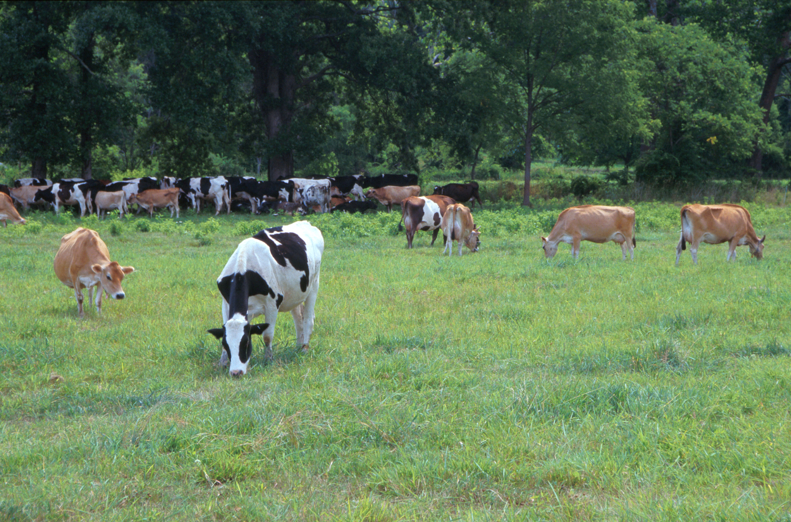
Questions?
AIP web site:
http://aipl.arsusda.gov
Holsteins, Jerseys, and crossbreds graze on American Farm Land Trust’s
Cove Mountain Farm in south-central Pennsylvania
Source: ARS Image Gallery, image #K8587-14; photo by Bob Nichols

