Slide 1
Assignment of polled status using single nucleotide polymorphism genotypes and predicted gene content

Slide 2
Introduction
Polled cattle have improved welfare and increased economic value
The best way to increase allele frequency over the long term is by index selection
Requires known status for all animals
Estimate gene content (GC) for all non-genotyped animals
Notes:
2
2
- Adding polled to a selection index is the
best way to increase its allele frequency
This requires polled status for all animals
Use SNP info from genotyed animals to
estimate gene content for non genotyped
animals

Slide 3
Biology of polled
2 mutations in the region spanning 1.7 to 1.9 Mbp on BTA1 cause polled (Medugorac, 2012; Rothammer et al., 2014)
The Celtic mutation includes a deletion and an insertion
Present in Jerseys, low frequency in Holsteins
Probably present in most polled Brown Swiss
The Friesian mutation involves a duplication
Present in both Holsteins and Jerseys
Notes:
3
3
There are 2 different mutations that result
in polled, Celtic and Friesian

Slide 4
Inheritance of polled
Polled (P) dominant over horned (p)
P allele at low frequency in US dairy cattle
A polled haplotype has been identified for Brown Swiss (BS), Holstein (HO), and Jersey (JE)
Notes:
4
4
Jerseys have the highest frequency for
polled

Slide 5
Frequency of polled & horned haplotypes
Breed | f(PP) | f(Pp) | f(pp)
Brown Swiss | <0.001 | 0.007 | 0.992
Holstein | <0.001 | 0.014 | 0.985
Jersey | <0.001 | 0.043 | 0.956
Source: http://aipl.arsusda.gov/reference/recessive_haplotypes_ARR-G3.html
Notes:
5
5
Jerseys have the highest frequency for
polled

Slide 6
Assignment of polled haplotypes
HO and JE laboratory tests for polled used as input
BS polled status is pulled from the name
US and Canadian bulls with ≥100 daughters and not designated as polled assumed to be horned (pp)
Polled status was imputed for all other genotyped animals using these data (VanRaden et al., 2011)
Notes:
6
6

Slide 7
Polled status for genotyped animals
An animal is heterozygous if it has either mutation
An animal is homozygous if both haplotypes contain polled
Consistent with -P and -PP coding in all breeds
Notes:
7
7

Slide 8
Number of polled & horned animals
 | Bulls |  | Cows
Breed | Polled | Horned | Polled | Horned
Brown Swiss | 132 | 15,290 | 25 | 3,358
Holstein | 4,623 | 134,436 | 9,586 | 615,384
Jersey | 827 | 15,213 | 3,804 | 79,368
Notes:
8
8
Jerseys have the highest frequency for
polled

Slide 9
Polled status for non-genotyped animals
Gene content (GC) is the number of polled haplotypes in an animal's genotype
Pedigrees were cut off at 1990
Computed using records from genotyped relatives (Gengler et al., 2008)
GC are real-valued and range between 0 and 2
Notes:
9
9

Slide 10
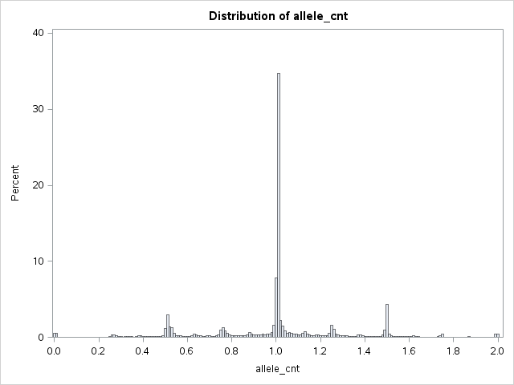
Gene content for DGAT1 in Jerseys
MAF = 0.479
AA
Aa
aa

Slide 11
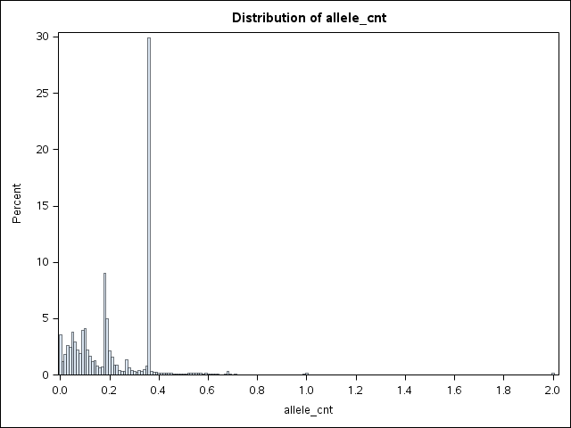
Gene content for polled in Jerseys
f(P) = 0.022
pp
Pp
PP

Slide 12
Validation of Jersey polled gene content
Polled status from recessive codes and animal names compared to GC for 700 non-genotyped JE with known status.
92% (n = 68) of pp animals correctly assigned GC near 0
Pp animals had GC near 0 (37%, n = 227) and near 1 (63%; n = 385)
All PP animals (n = 11) assigned GC of ~1.
Notes:
Underestimating animals not overestimating

Slide 13
Reasons for variation in gene content
The expectation for GC is near 1 for heterozygotes
GC can be <1 if many polled ancestors have unknown status or when pedigree is unknown
In those cases GC may be set to twice the allele frequency, which is low for polled
Some animals with “-P” in the name may actually be PP, not Pp

Slide 14
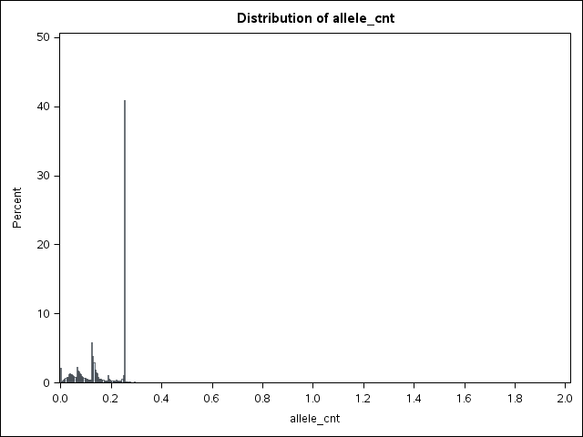
Gene content for polled in Holsteins
f(P) = 0.007
pp
Pp
PP

Slide 15
Validation of Holstein polled gene content
Polled status from recessive codes and animal names compared to GC for 5,061 non-genotyped HO with known status.
97% (n = 4,378) of pp animals correctly assigned GC near 0
Pp animals had GC near 0 (63%, n = 347) and near 1 (37%; n = 202)
All PP animals (n = 5) assigned GC of ~1.

Slide 16
Addition of polled to the Net Merit index
$11.79 and $10.73 for costs of dehorning and polled genetics, respectively (Widmar et al., 2013)
Haplotype count multiplied by $11.26 for genotyped animals
Gene content multiplied by $11.26 for non-genotyped animals
Rank correlations with 2014 NM$ compared for bulls and cows

Slide 17
Economic value of polled animals
 | Polled |  |  | Horned
Genotype | PP | Pp |  | pp
Copies of polled haplotype | 2 | 1 |  | 0
% polled offspring | 100 | 50 |  | 0
Average value of offspring | 2 x $11.26 | 1 x $11.26 |  | 0 x $11.26
Total gain from polled | $22.52 | $11.26 |  | $0.00

Slide 18
JE Bull ranks
Haplotype |  |  | NM$ +
Status | Name | NM$ rank | Polled rank
Pp | KASH-IN SHOOTOUT{5}-P-ET | 17 | 9
Pp | DUTCH HOLLOW DILLAN-P | 58 | 47
Pp | D&E CRITIC VERN-P-ET | 138 | 106
Pp | SR IRWIN SHAGGY-P | 168 | 147
Pp | SEXING DAVID GOLDFRAPP-P-ET | 187 | 162
PP | HILLVIEW ECLIPSE KEY LINGO-PP | 402 | 396
PP | SPRUCE-H CHRIS-PP-ET | 416 | 406

Slide 19
HO Bull ranks
Haplotype |  |  | NM$ +
Status | Name | NM$ rank | Polled rank
Pp | VIEW-HOME POWERBALL-P-ET | 288 | 253
Pp | DANGIE S-SIRE JAX P-TW | 314 | 272
Pp | COMPASS-TRT LAYTON-P-ET | 448 | 388
Pp | HERMANVLL HARPOON-P-ET | 460 | 398
Pp | PINE-TREE HOMERUN-P-ET | 491 | 437
PP | PINE-TREE ORTON-PP-ET | 1199 | 1109
PP | PINE-TREE ERNHRT PLUS-PP-ET | 1229 | 1144
PP | RICH-MAR-LLC BRISTOL-PP-ET | 1295 | 1219
PP | CAUDUMER POWER PLAY | 1346 | 1266
PP | OCEAN PP-ET | 1411 | 1330

Slide 20
Discussion
It is computationally feasible to compute GC so that single-gene traits can be included in selection indices
It is difficult to increase the frequency of polled animals using plausible economic values because f(P) is very low
This strategy can be used with other traits, such as haplotypes affecting fertility

Slide 21
Another approach
Gene editing may be useful for polled:
Identify a high-NM$ horned bull
Clone it
Use a TALEN or CRISPR to knock out the polled gene (deactivate horns)
Sell lots of semen
This strategy could be used to produce many elite polled bulls.

Slide 22
Conclusions
Increasing polled frequency slow without a sudden, substantial increase in value (e.g., change in consumer preference)
Adding polled to selection indices a long term (slow) solution
Gene editing to produce high-genetic merit polled bulls a short term (fast) solution

Slide 23
Acknowledgments
The Council on Dairy Cattle Breeding provided the data used in this study under USDA Nonfunded Cooperative Agreement 58-1245-3-228N.
This research was supported by USDA-ARS project 1265-31000-101-05, “Improving Genetic Predictions in Dairy Animals Using Phenotypic and Genomic Information.”

Slide 24
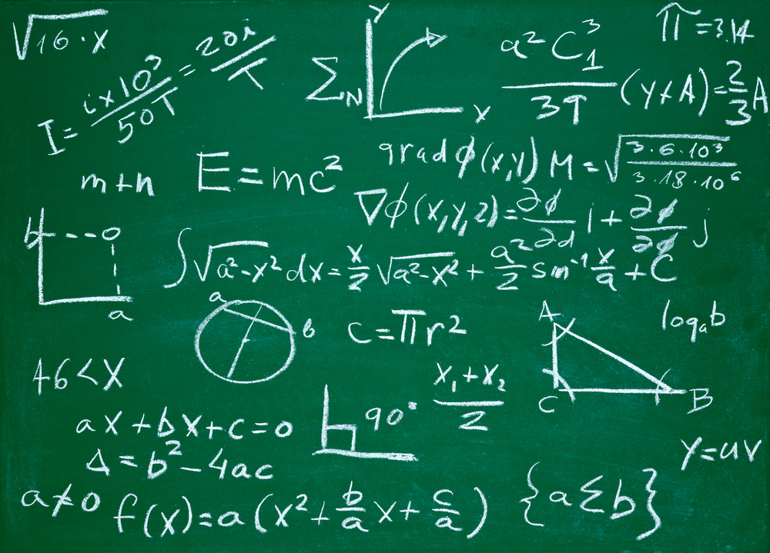
Questions?
http://gigaom.com/2012/05/31/t-mobile-pits-its-math-against-verizons-the-loser-common-sense/shutterstock_76826245/

