Slide 1
Phenotypic and genotypic impact of milk components and bodyweight composite on dry matter intake
Sajjad Toghiani *¹, Paul VanRaden¹ , Kristen Parker Gaddis², Mike VandeHaar³, and Robert Tempelman³
¹ USDA-ARS, Animal Genomics and Improvement Laboratory, Beltsville, MD, USA
² Council on Dairy Cattle Breeding, Bowie, MD, USA
³ Department of Animal Science, Michigan State University, East Lansing, MI, USA
* sajjad.toghiani@usda.gov

Slide 2
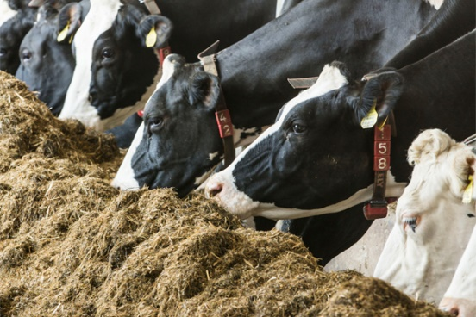
Backgrounds
Improvement in feed efficiency in dairy industry matters
Farm profitability
Environmental management
Dry matter intake (DMI)
Key factor to Measure feed efficiency
Main quantity in dairy nutrition research
Develop breeding objectives for breeding programs
Feed efficiency, methane emissions

Slide 3
Why feed efficiency is important?
Feed costs represent the largest operating cost in dairy production
Since 1990, feed efficiency was intended to initiate as a breeding objective
Collecting feed intake data was and still is expensive and difficult
These data are almost exclusively recorded in research herds
A small increase in the number of records
Larger datasets are required for accurate estimation of genetic parameters for feed intake in dairy cattle
Using information from multiple data sources

Slide 4
Calculating feed cost for NM$ index
Since 1994, expected feed costs associated with production traits have been deducted from the NM$ index (Dado et al. 1994)
Since 2000, BWC as a proxy of body weight (BW) has also been involved in the NM$ index to calculate expected feed costs.
In the NM$ revision 2021 document, the feed costs assumed for production traits and BW were updated and revised based on analyses of U.S. feed intake data.
The document of Lifetime Net Merit (NM$) - revision 2021 is available through this link below:
www.ars.usda.gov/ARSUserFiles/80420530/Publications/ARR/nmcalc-2021_ARR-NM8.pdf

Slide 5
Objectives
Use feed intake data from U.S. dairy research herds
To develop a set of mixed models for predicting DMI from phenotypic and genomic regression of key energy sink traits
To estimate the maintenance cost and feed cost of milk components associated with DMI for each given model

Slide 6
U.S. Feed efficiency database
Feed efficiency Project
USDA-NIFA grant $5M (2010-2015)
CDCB-FFAR grant $2M (2019-2024)
Main U.S. research herds
Univ. of Wisconsin (WI)
Univ. of Florida (FL)
Michigan State Univ. (MI)
Iowa State Univ. (IA)
USDA-AGIL (MD)
Data collection
Mid-lactation (50-200 days in milks)
Recording period of 28 and 42-days
Dry matter intake (DMI)
Milk yield and components
Body weight and BCS
Data processing
Quality Data checked
CDCB and contributing institutions
Data joint with associated cooperator database
Pedigree, Birth date, Calving dates, Parity, etc.

Slide 7
Mixed Models for Dry Matter Intake (DMI)
DMI records used from 6,338 lactations of 5,094 U.S. Holstein cows
Implementing mixed models through SAS PROC MIXED
Common fixed effects
Overall mean
Days in milk
Age-Parity
Body weight change
Common random effects
Herd-year
Experimental trial
Residual effect
Phenotypic Model
Phenotypic regression (Kg)
Milk yield
Fat yield
Protein yield
Metabolic body weight
Genomic Model
Genomic regression (GEBV)
Milk yield
Fat yield
Protein yield
BWC
Sire’s genomic Model
Sire’s genomic regression (GEBV)
Milk yield
Fat yield
Protein yield
BWC
Extended genomic Model
Genomic regression (GEBV)
Milk yield
Fat yield
Protein yield
Stature
Strength
Body depth
Dairy form
Rump width

Slide 8
Feed cost for yield components
Method | Marginal feed cost ($)/ 100 kg standardized milk | DMI (kg) required per unit of component output
 |  | Milk | Milk S.E. | Fat | Fat S.E. | Protein | Protein S.E.
Phenotypic regression | 6.47 | 0.007 | ±0.008 | 2.82 | ±0.13 | 5.32 | ±0.31
Genomic regression | 16.77 | 0.076 | ±0.03 | 10.82 | ±0.60 | 7.88 | ±1.34
Sire Genomic regression × 2 | 11.37 | 0.043 | ±0.05 | 6.43 | ±1.14 | 6.66 | ±2.35
NM$ 2018 | 16.95 | 0.225 | -- | 5.42 | -- | 7.50 | --
NM$ 2021 | 11.52 | 0.120 | -- | 5.00 | -- | 6.00 | --
Theoretical (Dado et al. 1994) | 12.43 | 0.112 | -- | 4.42 | -- | 8.17 | --
ECM (National Research Council, 2001) | 9.14 | 0.122 | -- | 4.82 | -- | 2.85 | --
Each method gave differing feed costs for milk components, especially for fat yield.
Phenotypic regression indicates much more feed requires to produce protein than Fat.
Genomic regression shows the opposite result which producing fat requires more feed than protein.
All regression models showed much less DMI requires to produce milk fluid compared to other methods.

Slide 9
Maintenance cost per year
Methods | Maintenance (pounds DMI/pound BW) | Standard error
NM$ 2018 value | 1.7 | …
NRC 2001 value | 2.7 | …
NRC 2021 value | 3.4 | …
Phenotypic regression | 5.8 | ±0.18
Genomic regression | 6.3 | ±0.42
Sire genomic regression | 5.9 | ±0.72
NM$ 2021 value | 4.5 | …
Estimates from CDCB data give much higher maintenance cost compared to NRC values
When regressing DMI on phenotypic, genomic and sire’s genomic body size predictors
Relative emphasis assigned against BWC in NM$ 2021 (- 9.4%) vs. NM$ 2018 (-5.3%)

Slide 10
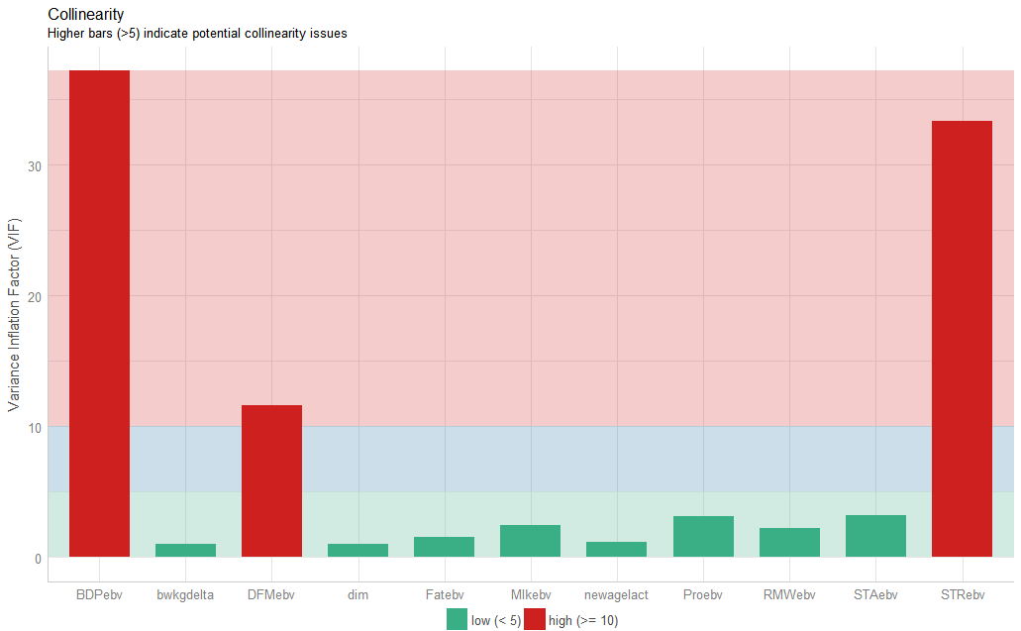
DMI prediction using 5 type traits forming BWC
Including genomic BWC is significant for predicting DMI, Directly associated with maintenance cost
Replacing BWC predictor with 5 type traits forming this index is valuable to test for predicting DMI
Multicollinearity Diagnostic checked because of possible high correlation between type trait predictors
Body depth has the largest VIF score, leading to unstable estimate and high S.E.
DMI (kg/day) required per unit of component output
Type traits | estimates (S.E.)
Stature | 0.04 (±0.07)
Strength | 0.75 (±0.24)
Body depth | -0.17 (±0.26)
Dairy form | 0.02 (±0.12)
Rump width | 0.03 (±0.06)

Slide 11
DMI prediction using 4 type traits forming BWC
Body depth removed from the set of 5 type traits due to highly VIF score.
Strength was the most significant predictor associated with DMI, agreeing with the current BWC formula
Although including only BWC in the mixed model was statistically significant, dissecting BWC to its 4 type trait components shows smaller AIC indicating the best fitted model.
DMI (kg/day) required per unit of each type trait
Type traits | Multicollinearity Diagnostic
 | Before | After
 | Estimates (S.E.)
Stature | 0.04 (±0.07) | 0.04 (±0.07)
Strength | 0.75 (±0.24) | 0.60 (±0.07)
Body depth | -0.17 (±0.26) | --
Dairy form | 0.02 (±0.12) | -0.05 (±0.05)
Rump width | 0.03 (±0.06) | 0.04 (±0.06)

Slide 12
BW prediction using type traits forming BWC
All 5 type traits included in BW model as predictors shown statistically significant.
Body depth predictor removed from the model after detecting with highly VIF score (> 30).
Strength and dairy form were the most important trait associated with BW, after removing body depth.
The importance and direction of coefficients used for strength and dairy form traits in BWC formula for HOL breed, supported by the estimates of both traits and their relationship with BW.
BW (kg) required per unit of each type trait
Type traits | Multicollinearity Diagnostic
 | Before | After
 | Estimates (S.E.)
Stature | 7.96 (±1.12) | 7.82 (±1.12)
Strength | 46.91 (±3.79) | 29.30 (±1.19)
Body depth | -20.52 (±4.19) | --
Dairy form | -4.16 (±1.86) | -12.34 (±0.82)
Rump width | 2.05 (± 1.01) | 3.40 (±0.98)
Weights (%) from BWC formula
Type traits | Holstein and other Breeds | Jersey and Brown Swiss
Stature | 23 | 28
Strength | 72 | 28
Body depth | 8 | --
Dairy form | -47 | -35
Rump width | 17 | 9

Slide 13
Conclusions
Phenotypic regressions of DMI on milk components were much less than corresponding genomic regressions.
For 100 kg of standardized milk with 3.5% fat and 3.0% protein,
Estimated feed costs of genomic regression were 2.6 times more than phenotypic regression
The average annual maintenance cost from estimates using phenotypic, genomic, and sire genomic regressions
2X more than published NRC values in 2001 and 2021
3.5X more than the assumed NM$ 2018 value.
Dairy producers will benefit when using an index in favor of selecting cows
Smaller body size
Higher feed efficiency (Negative or low RFI)
Higher milk production

Slide 14
Acknowledgments
USDA-ARS project 8042-31000-002-00, “Improving Dairy Animals by Increasing Accuracy of Genomic Prediction, Evaluating New Traits, and Redefining Selection Goals”
CDCB and its industry suppliers for data
Feed intake funding
Agriculture and Food Research Initiative Competitive Grant #2011-68004-30340 from USDA National Institute of Food and Agriculture
Foundation for Food and Agriculture Research (FFAR)

