Slide 1
History of Genomic Evaluations in The United States

Slide 2
Genomic prediction
Main idea: improve future traits by selection
Look at animal’s own measurable traits (used for hundreds or thousands of years)
Use pedigrees and phenotypes to compute estimates of genetic merit (done officially by USDA 1937-2008)
New idea: Why not look directly at the DNA?

Slide 3
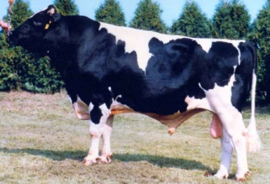
Growth of markers and animals
Year | Markers | Animals | Research partners
1991-2004 | 367 | 1,415 | USDA, Illinois, Israel (DNA from USA, CAN)
2007-2009 | 38,416 | 16,646 | USDA, Missouri, Canada, Illumina
2011-2013 | 636,967 | 161,341 | Added Italy, United Kingdom, high density
2012-2015 | 61,013 | 1,000,000 | Added Interbull (BSW) and Denmark (JER)
2015-future | 39,700,000 | 1,577 | Worldwide exchange in Australia

Slide 4
Value of Incoming Data
Data Received in 2014 | Annual Value
Phenotypes from DHI
4 million cows x $1.25 / cow / mo | $60 million
Genotypes from CDCB
15,000 medium density x $125 | $2 million
258,000 low density x $45 | $12 million
Whole genome sequence data (2015)
200+ bulls x $1,000 (AGIL data) | $0.2 million
1,000+ bulls x $3,000 (World data) | $3 million

Slide 5
Central DNA storage since 1992
Cooperative Dairy DNA Repository (CDDR)
ABS Global (DeForest, WI)
Accelerated Genetics (Baraboo, WI)
Alta (Balzac, AB, Canada)
Genex (Shawano, WI)
New Generation Genetics (Fort Atkinson, WI)
Select Sires (Plain City, OH)
Semex Alliance (Guelph, ON, Canada)
Taurus-Service (Mehoopany, PA)
AI companies send straws of each bull sampled
Repository maintained at USDA, Beltsville, MD

Slide 6
Total males and females genotyped
Cumulative total in database, by year

Slide 7
Compare largest 2 databases (July 2 2015)
 | 23andMe | CDCB/USDA
Genotypes | ~950,000 | 1,000,000
Countries | 55 | 48
Genotyping cost | $99 | $37 to $135
Species | Human | Cattle
Business model | Retail | Wholesale
Generations of data | Few | Many
Prediction reliability | Low | High
Reference: http://genomemag.com/davies-23andme/#.VdY722zosY1
Web sites: https://www.23andme.com/
https://www.cdcb.us/
http://aipl.arsusda.gov/Main/site_main.htm

Slide 8
Genotype Contributors
by continent
Notes:
8

Slide 9
Genotypes by continent
Continent | Genotypes | Countries
N. America | 776,473 | USA, CAN
W. Europe | 86,678 | AUT, BEL, CHE, DEU, DNK, ESP, FIN, FRA, GBR, IRL, ITA, LUX, NLD, NOR, SWE
E. Europe | 2,169 | BLR, CZE, HUN, POL, ROU, RUS, SRB, SVK, SVN
Oceania | 6,282 | AUS, NZL
L. America | 8,130 | ARG, BRA, CHL, COL, CRI, ECU, GTM, MEX, PER, URY
Asia | 772 | CHN, IND, IRN, JPN, KAZ, SAU, THA, TWN
Africa | 303 | ZAF, ZWE

Slide 10
Genotyped animals by continent
 | Pedigree Completeness (%) | North American Sires (%) | Genomic Future Inbreeding %
Continent
N. America | 86 | 94 | 6.9
W. Europe | 98 | 62 | 6.7
E. Europe | 88 | 68 | 6.2
Oceania | 94 | 61 | 6.2
L. America | 68 | 75 | 6.0
Asia | 72 | 81 | 6.3
Africa | 87 | 72 | 7.3
Notes:
Genomic and pedigree relationships of foreign animals to the domestic reference population were similar across continents. Pedigree completeness was highest for western Europe with 98% and lowest for Latin America and Asia with 72%. Differences may reflect testing only elite animals vs. testing commercial females with missing pedigrees where gains in reliability are larger. Countries of origin for sires being used by continent (Table 5) show the use of genetics worldwide. North American genetics account for 61 to 94 percent of sires by continent and average 90 percent worldwide. Breeders on
other continents are not primarily using local domestic sires, but are testing progeny of well known international sires. Statistics for western Europe include the bull exchange of Holstein bull genotypes with Italy and the United Kingdom.

Slide 11
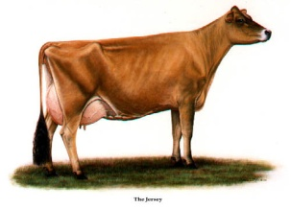
Genotypes by breed (Sept 2015)
 | Reference population |  |  | Total Genotypes
Breed | U.S. bulls | Foreign bulls¹ | U.S. cows
HO | 15,782 | 12,496 | 150,955 | 903,120
JE | 3,089 | 1,543 | 38,157 | 116,042
BS | 979 | 5,317 | 1,516 | 19,457
AY | 194 | 545 | 120 | 4,715
¹ CAN bulls included since 2008
European BS bulls since 2010
ITA and GBR HO bulls since 2011
DNK JE bulls since 2014
Notes:
Most genotypes in the database were from Holsteins, whereas other breeds may not be as closely related across continents .
Output from findhap1

Slide 12
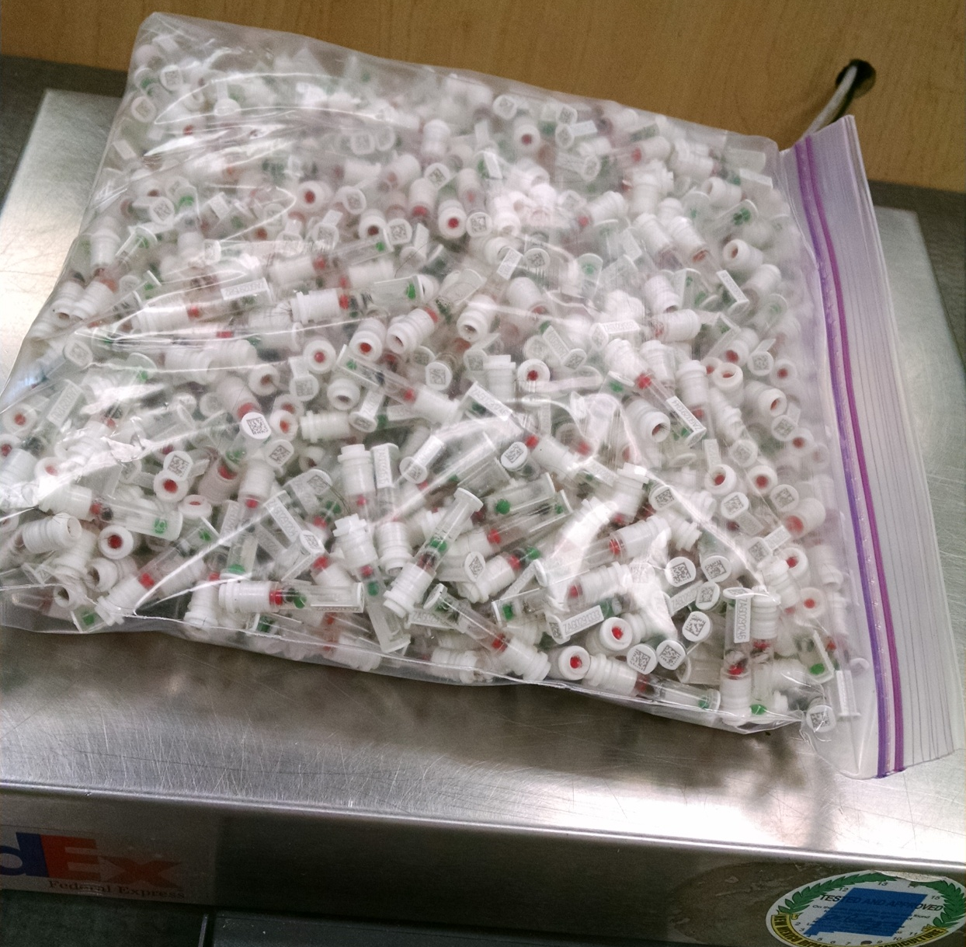
DNA samples from 1 farm, 1 day
Photo provided
by Zoetis

Slide 13
Service applies to many chips
Different companies and densities
Illumina, GeneSeek, Zoetis, European LD
3K, 7K, 8K, 10K, 11K, 18K, 20K, 26K, 50K, 77K, 139K, and 777K chips
All animals imputed to 61,013 markers
Includes best SNPs from 777K and gene tests

Slide 14
Sources of genomic information
Marker genotype arrays (SNP chips)
Imputed genotypes, imputed dams
Haplotypes or single- or multi-SNP regression
DNA sequences (whole, low depth, targeted)
Bioinformatic or across-species prior info
Future: dominance, epistatis, imprinting, epigenetics, new mutations, transgenics

Slide 15
Many other uses for genotypes
Genomic mating (value $6 million / year)
Genomic relationships provided since 2014
Ancestor discovery within breeds
Fertility defects – haplotypes and QTLs
Inheritance tracking for chromosomes
Breed composition of crossbreds

Slide 16
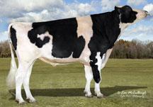
Earliest Predictions (2009)
Bull with highest predicted Net Merit in 2009 research (Nov 2004 cutoff) was Man-O-Man
Highest predicted Net Merit in Jan 2009 (1st official evaluation) was Freddie
Correlation of predicted Mendelian sampling (PTA – PA) from Nov 2004 and actual from Aug 2009 was about .5

Slide 17
2013 NM$ vs. PA to predict 2015
Young bulls with 0 daughters in 2013 and > 100 daughters in 2015

Slide 18
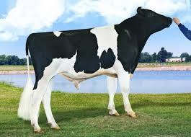
Top young bulls from Aug 2013
 | Net Merit |  |  | Progeny (2015)
Bull | 2015 | 2013 | PA 2013 | Daughters | AI Sons
Supersire | 934 | 670 | 471 | 927 | 223
Uno | 548 | 613 | 303 | 1,506 | 210
Maurice | 563 | 582 | 420 | 788 | 25
Mogul | 737 | 578 | 355 | 3,139 | 293
Gonzo | 531 | 571 | 201 | 447 | 11
Val | 662 | 569 | 368 | 370 | 3
Casual | 406 | 552 | 443 | 270 | 6
Tape | 505 | 552 | 411 | 195 | 10
Wright | 626 | 550 | 433 | 181 | 0
Denim | 587 | 546 | 500 | 3,125 | 16
Top 10 Avg | 610 | 578 | 433 | 1,095 | 80
(base adjusted values)

Slide 19
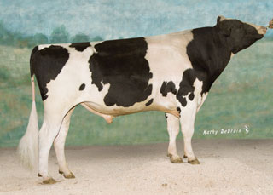
Top proven bulls from Aug 2013
 | Net Merit |  |  | Progeny (2015)
Bull | 2015 | 2013 | PA 2013 | Daughters | AI Sons
Robust | 815 | 550 | 328 | 1,670 | 109
Freddie | 504 | 532 | 290 | 18,825 | 187
Awesome | 475 | 518 | 353 | 5,059 | 0
Twist | 546 | 514 | 244 | 520 | 4
Massey | 495 | 490 | 249 | 5,585 | 77
O-Style | 428 | 477 | 366 | 8,556 | 64
ABC | 541 | 475 | 289 | 147 | 0
Manifold | 607 | 462 | 259 | 29,622 | 5
Bookem | 553 | 459 | 272 | 5,452 | 117
Domingo | 412 | 454 | 224 | 4,759 | 5
Top 10 Avg | 538 | 493 | 287 | 8,020 | 57
(base adjusted values)

Slide 20
% ET daughters, % genotyped mates

Slide 21
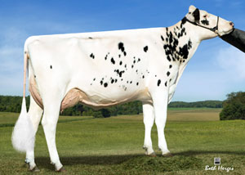
Animal model adjusts for
PTA rather than GPTA of mates
Top bulls mated only to top genomic females
PTA rather than GPTA of herdmates
Can underestimate recent genetic trend
PTA rather than GPTA of parents and progeny
Dams credited only for highly selected sons
Top heifers not milked, used as ET donors

Slide 22
Current biases small because…
Newly proven bulls get 1,000’s of daughters
Many herds use both young and proven bulls
Gives accurate estimate of genetic trend
Dams get many daughters before son data
Few daughters were culled on genomics
Single-step model could further reduce biases

Slide 23
Trend in Net Merit $

Slide 24
Trends in AIPL staff and scientists 2004 to 2016
Employees
Years (2004-2016)

Slide 25
AIPL publications on genomics
Year | Citations | Publication topics
2008 | 888 | Methods to compute predictions
2009 | 664 | Reliability of predictions
2009 | 162 | Distribution and location of effects
2009 | 81 | Selection and editing of genotypes
2011 | 128 | Evaluations with more genotypes
2011 | 96 | Past, present, future evaluations
2011 | 89 | Genome-wide association analysis
2011 | 89 | Harmful fertility haplotypes
2013 | 62 | High-density Holstein genotypes
As of August 28, 2015,
from Google Scholar

Slide 26
Conclusions
Examining DNA is an excellent idea
CDCB/USDA database slightly larger than largest human database, much more useful
Staff subtracted by USDA-AIPL since 2004 and staff added by CDCB have been about equal (no net gain in staff)
More animals and more traits continue to rapidly improve the value and accuracy of genomic predictions

Slide 27
Acknowledgments
Mel Tooker, Jan Wright, George Wiggans, John Cole, Dan Null, Jana Hutchison, Tabatha Cooper, Lillian Bacheller, Jay Megonigal, Jeff O’Connell, Chuanyu Sun, and Katie Olson contributed to the computation and graphics
The Council on Dairy Cattle Breeding (CDCB) provided the data

Slide 28
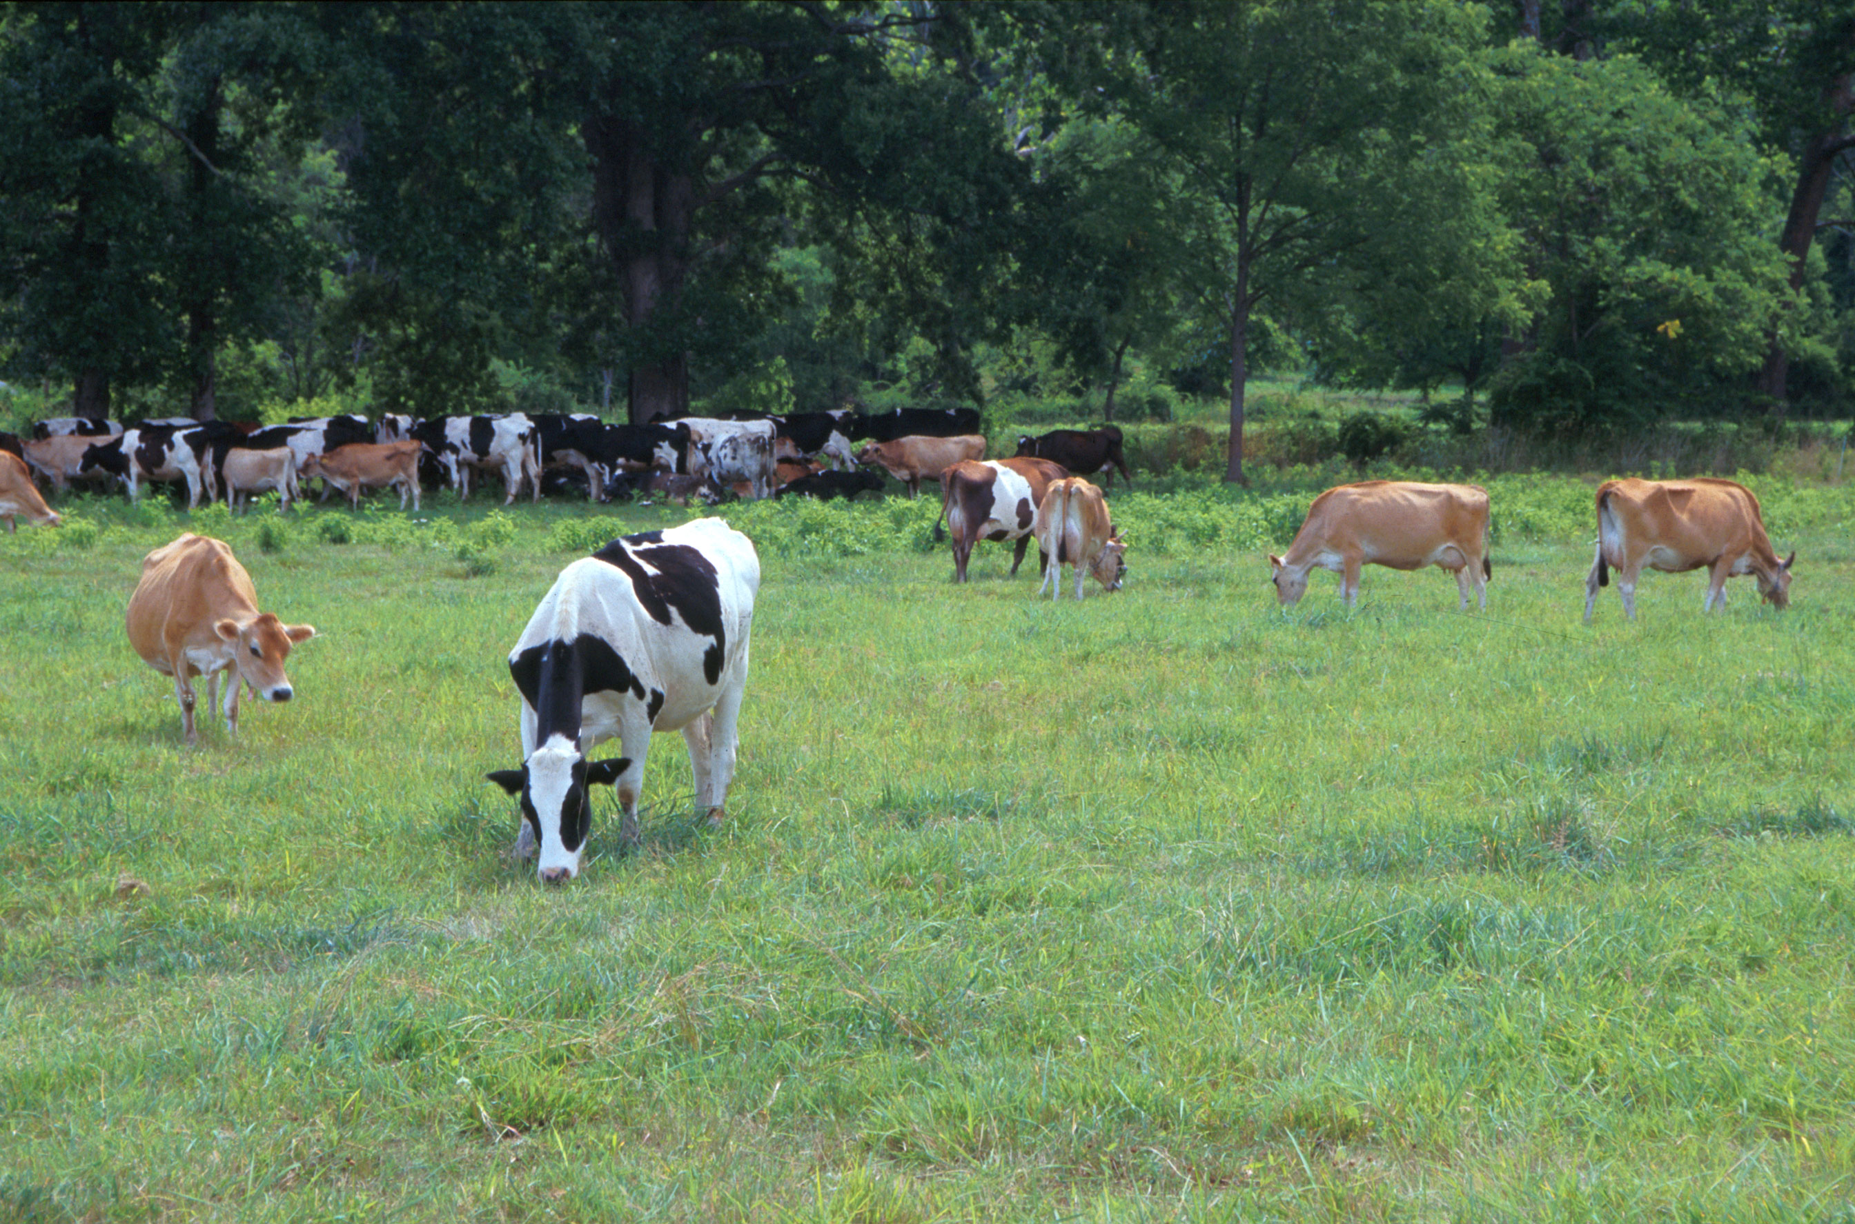
Questions?
AIP web site:
http://aipl.arsusda.gov
Holsteins, Jerseys, and crossbreds graze on American Farm Land Trust’s
Cove Mountain Farm in south-central Pennsylvania
Source: ARS Image Gallery, image #K8587-14; photo by Bob Nichols

