Slide 1
Phenotypes for novel functional traits of dairy cattle

Slide 2
Introduction

Slide 3
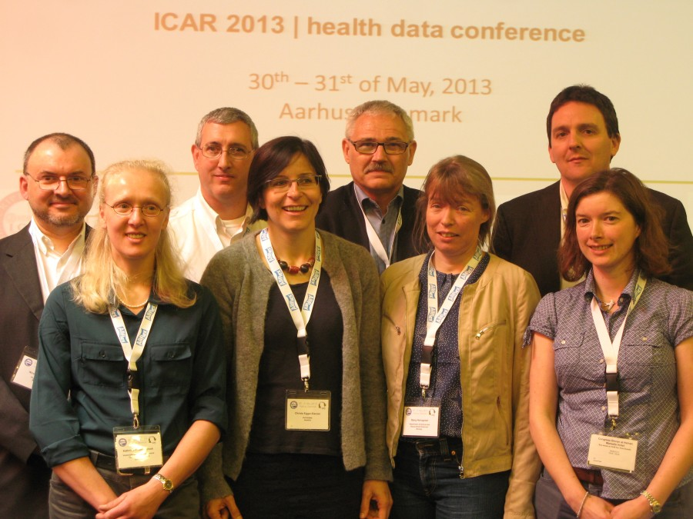
What are functional traits?
The ICAR Functional Traits Working Group currently is working on:
General health traits
Female fertility
Feet and legs problems
Udder health
Workability
Notes:
3
3

Slide 4
Why are functional traits important?
Growing emphasis on functional traits
Economically important because they impact other traits
Challenges with functional traits
Inconsistent trait definitions
Many have low heritabilities
Unclear incentives for collection
Notes:
4
4

Slide 5
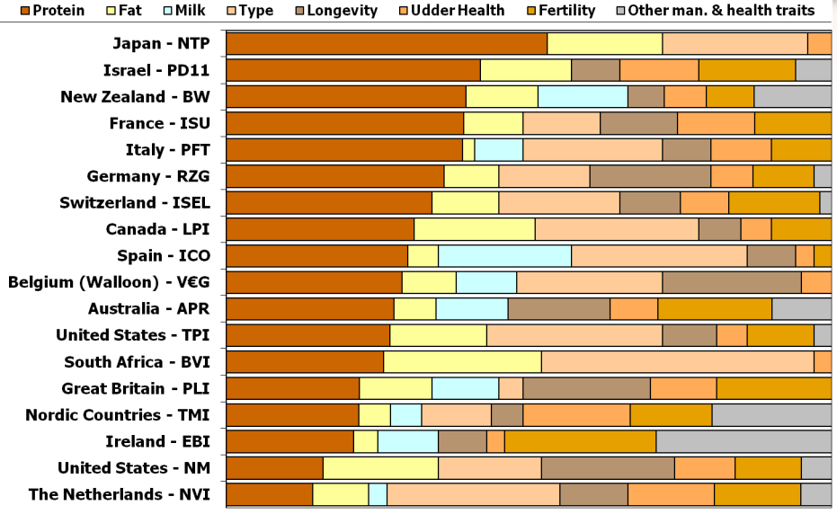
Functional traits are being used
Source: Miglior et al., 2012

Slide 6
Functional traits have low heritabilities
P = G + E
The percentage of total variation attributable to genetics is small.
CA$: 0.07
DPR: 0.04
PL: 0.08
SCS: 0.12
The percentage of total variation attributable to environmental factors is large:
Feeding/nutrition
Housing
Reproductive management
Notes:
6
6

Slide 7
What traits are commonly recorded?
Group | N | Traits included
Calving | 4 | Direct & maternal calving ease, direct & maternal stillbirth
Conformation | 19 | Stature, chest width, body depth, angularity, rump angle, rump width, rear leg set, rear leg rear view, foot angle, fore udder, rear udder height, udder support, udder depth, teat placement, teat length, rear teat placement, overall conformation score, overall udder score, overall feet & leg score
Fertility | 5 | Heifer conception rate, days to first service, cow conception rate, services per conception, and days open
Longevity | 1 | Direct longevity
Production | 3 | Milk, fat, and protein yields
Udder health | 2 | Milk somatic cell count, clinical mastitis
Workability | 2 | Milking speed, temperament
Holstein traits evaluated by the International Bull Evaluation Service (https://wiki.interbull.org/public/CoP_chapter6?action=print&rev=16).

Slide 8
Some traits are underutilized
Some traits are commonly recorded, but not often genetically evaluated
e.g., gestation length, milking speed, temperament
Breeding objectives differ across countries
Not all traits equally valuable to all people
New phenotypes can supersede old ones
Notes:
8
8

Slide 9
Lots of genotypes are available in the US
Chip | Traditional evaluation? | Animal sex | Holstein | Jersey | Brown Swiss | Ayrshire
≥50K | Yes | Bulls | 25,276 | 4,262 | 5,862 | 678
 |  | Cows | 22,094 | 1,203 | 136 | 27
 | No | Bulls | 51,122 | 4,428 | 806 | 427
 |  | Cows | 38,182 | 1,462 | 201 | 196
<50K | Yes | Bulls | 24 | 13 | 28 | 14
 |  | Cows | 48,552 | 17,246 | 757 | 4
 | No | Bulls | 35,639 | 3,935 | 243 | 43
 |  | Cows | 294,875 | 34,018 | 1,149 | 677
Imputed | Yes | Cows | 2,983 | 265 | 96 | 15
 | No | Cows | 1,394 | 50 | 99 | 16
All |  |  | 520,141 | 66,882 | 9,377 | 2,097
598,497

Slide 10
Other countries are doing genomics, too!
Country | Animals (no.)
Australia | 5,314
Denmark/Finland/Sweden | 23,961
France | 24,313
Germany | 25,624
Italy | 21,041
Netherlands | 23,047
Poland | 3,174
Switzerland (Red Holstein) | 4,194

Slide 11
Phenotypes may come from genotypes
Name | Chrome | Location (Mbp) | Carrier Freq | Earliest Known Ancestor
HH1 | 5 | 62-68 | 4.5 | Pawnee Farm Arlinda Chief
HH2 | 1 | 93-98 | 4.6 | Willowholme Mark Anthony
HH3 | 8 | 92-97 | 4.7 | Glendell Arlinda Chief, Gray View Skyliner
HH4 | 1 | 1.2-1.3 | 0.37 | Besne Buck
HH5 | 9 | 92-94 | 2.22 | Thornlea Texal Supreme
JH1 | 15 | 11-16 | 23.4 | Observer Chocolate Soldier
BH1 | 7 | 42-47 | 14.0 | West Lawn Stretch Improver
BH2 | 19 | 10-12 | 7.78 | Rancho Rustic My Design
AH1 | 17 | 65.9-66.2 | 26.1 | Selwood Betty’s Commander
For a complete list, see: http://aipl.arsusda.gov/reference/recessive_haplotypes_ARR-G3.html.

Slide 12
Why do we need new phenotypes?
Changes in production economics
Rising feed costs drive demand for increased efficiency
Technology enables collection of new phenotypes
Milking speed in AMS
Pedometry for changes in behavior
Better understanding of biology
Notes:
12
12

Slide 13
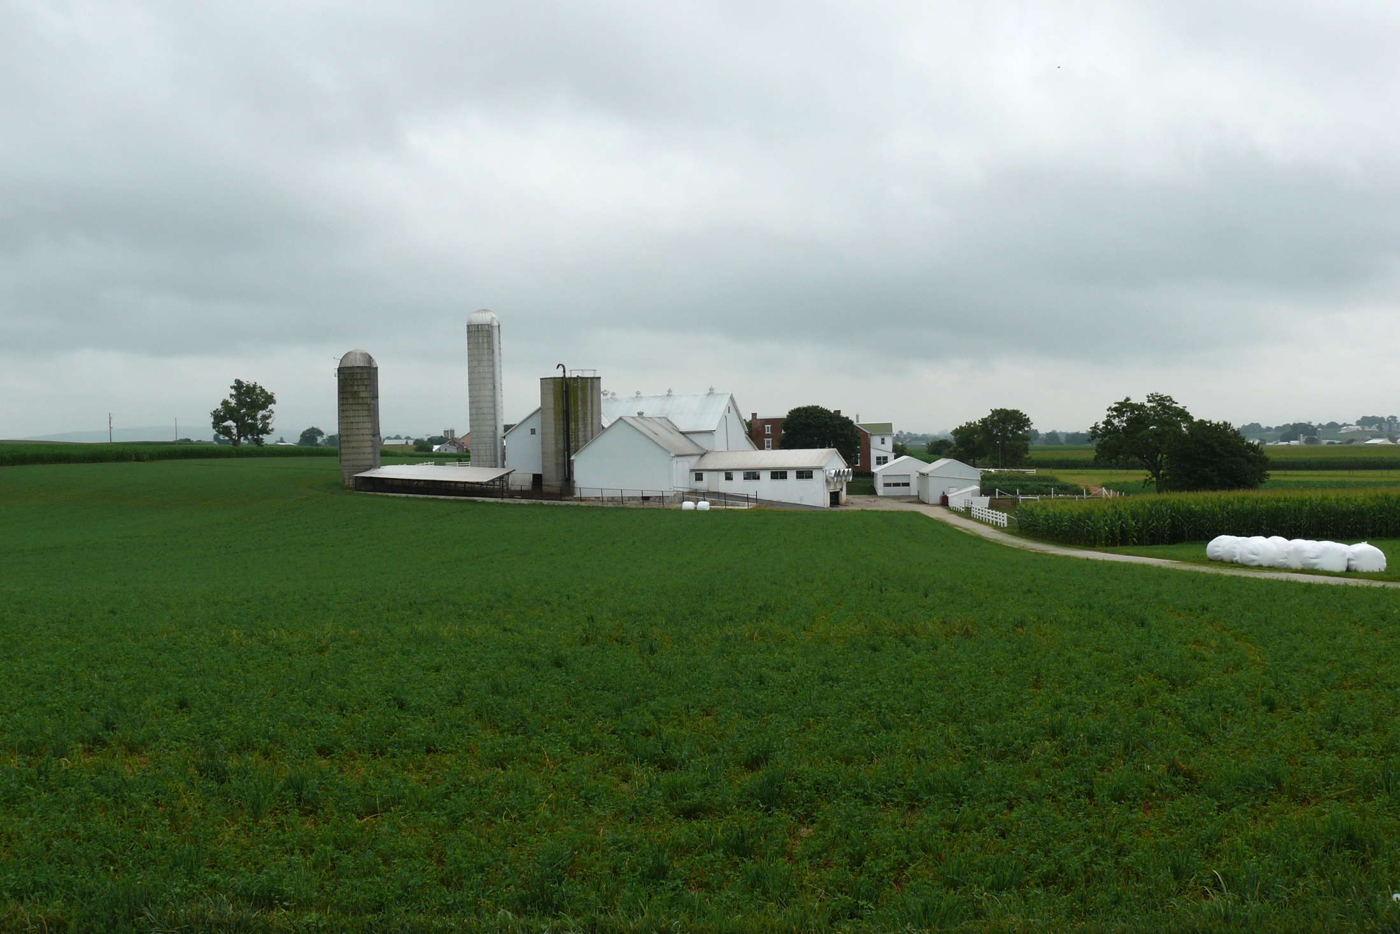
Sources of novel phenotypes
Barn: flooring type, bedding materials, density, weather data
Cow: body temperature, activity, rumination time, intake
Herdsmen/consultants: health events, foot/claw health, veterinary treatments
Parlor: yield, composition, milking speed, conductivity, progesterone, temperature
Silo/bunker: ration composition, nutrient profiles
Pasture: soil type/composition, nutrient composition
http://commons.wikimedia.org/wiki/File:Amish_dairy_farm_3.jpg

Slide 14
Novel phenotypes studied recently
Claw health (Van der Linde et al., 2010)
Dairy cattle health (Parker Gaddis et al., 2013)
Embryonic development (Cochran et al., 2013)
Immune response (Thompson-Crispi et al., 2013)
Methane production (de Haas et al., 2011)
Milk fatty acid composition (Soyeurt et al., 2011)
Persistency of lactation (Cole et al., 2009)
Rectal temperature (Dikmen et al., 2013)
Residual feed intake (Connor et al., 2013)
Notes:
14
14

Slide 15
What do current phenotypes look like?
Low-dimensionality
Usually few observations per lactation
Close correspondence of phenotypes with values measured
Easy transmission and storage
Notes:
15
15

Slide 16
What do new phenotypes look like?
High dimensionality
Ex.: MIR produces 1,060 points/obs.
Disconnect between phenotype and measurement
More resources needed for transmission, storage, and analysis

Slide 17
Who pays for new phenotypes?
Costs
Labor and materials for recording
Data transmission, storage, and processing
Benefits
Farmers provide data and consume services
Centers consume data and provide services
Notes:
17
17

Slide 18
Data collected on farms
Dairy Records Processing
Centers
Analytical
laboratories
Genetic evaluation center
National database
Milk processing
plants
Data trapped in on-
farm systems
Data on non-milk
recording farms

Slide 19
Cost of measurement vs. value
high
(milk yield)
(feed intake)
Value of phenotype
low
(conformation)
(milk progesterone)
low
high
Cost of measurement
Notes:
19
19

Slide 20
New phenotypes should add information
Novel phenotypes
include some
new information
Novel phenotypes
contain little
new information
high
Phenotypic correlation
with existing traits
Novel phenotypes
include much
new information
Novel phenotypes
contain some
new information
low
low
high
Genetic correlation with
existing traits
Notes:
20
20

Slide 21
What can farmers do with novel traits?
Put them into a selection index
Correlated traits are helpful
Apply selection for a long time
There are no shortcuts
Collect phenotypes on many daughters
Repeated records of limited value
Genomics can increase accuracy
Notes:
21
21

Slide 22
What can DRPCs do with novel traits?
Short-term – Benchmarking tools for herd management
Medium-term – Custom indices for herd management
Additional types of data will be helpful
Long-term – Genetic evaluations
Lots of data needed, which will take time
Notes:
22
22

Slide 23
What do US dairy farmers want?
National workshop in Tempe, AZ in February
Producers, industry, academia, and government
Farmers want new tools
Additional traits (novel phenotypes)
Better management tools
Foot health and feed efficiency were of greatest interest
Notes:
23
23

Slide 24
International challenges
National datasets are siloed
Recording standards differ between countries
ICAR standards help here
Farmers are concerned about the security of their data
Many populations are small
Low accuracies
Small markets
Notes:
24
24

Slide 25
Conclusions
New technology is enabling the collection of novel phenotypes
New phenotypes support increased focus on economically important aspects of dairy production
Infrastructure for moving new phenotypes from the farm to the data center is needed

Slide 26
Acknowledgments
ICAR Functional Traits Working Group
Paul VanRaden, AGIL
AFRI grant 1245-31000-101-05, “Improving Fertility of Dairy Cattle Using Translational Genomics”

Slide 27
Questions?
http://gigaom.com/2012/05/31/t-mobile-pits-its-math-against-verizons-the-loser-common-sense/shutterstock_76826245/

