Slide 1
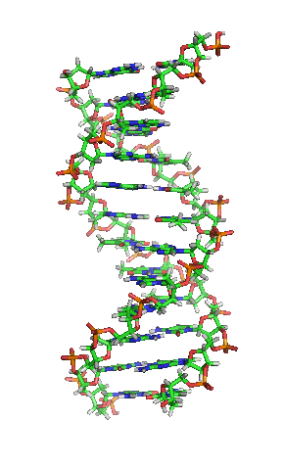

The use of SNP chips for selection of dairy cattle

Slide 2
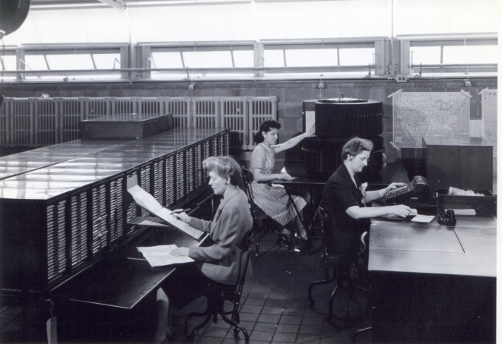
A Little History…
1908 1936 1989 1997 2009 | USDA organizes a national milk-recording program based on success in Michigan The first national sire evaluations are calculated from daughter-dam comparisons Animal model evaluations use the relationships among all cows and bulls InterBULL evaluations introduced to incorporate foreign daughter information First official genetic evaluations incorporating genomic data

Slide 3
History of genomic evaluations
Oct. 2007 BovineSNP50 BeadChip available
Apr. 2008 First unofficial evaluation released
Jan. 2009 Genomic evaluations official for
        Holstein and Jersey
Aug. 2009 Official for Brown Swiss
Sept. 2010 Unofficial evaluations from 3K chip
released
Dec. 2010 3K genomic evaluations official
Notes:
3

Slide 4
Genome Selection
“Train” system using phenotypic and genotypic data
  Large regression system
Predict genetic merit at birth by combining pedigree merit and merit predicted from SNP
Final genetic predictions are transparent to technology

Slide 5
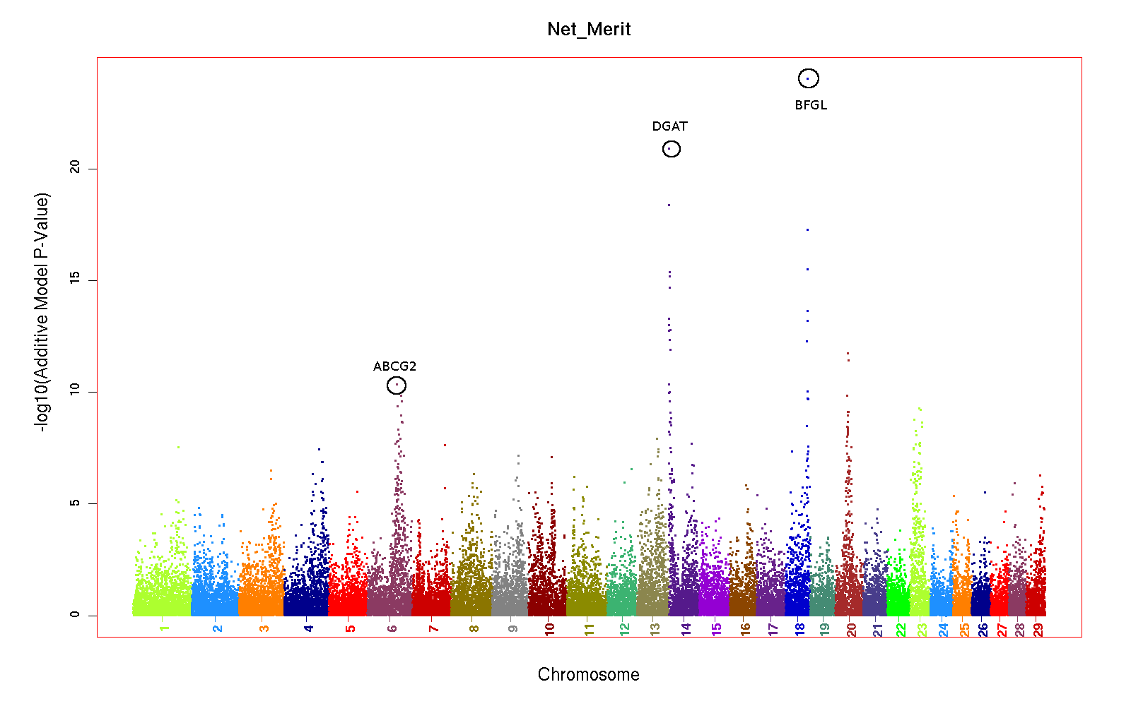
Genomic Prediction

Slide 6
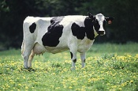
What’s a SNP genotype worth?
Pedigree information ~7 daughters
SNP information ~34 daughters for protein yield (h2 = 0,30)
SNP information ~ 31 daugthers for fertility (h2 = 0,04)

Slide 7
Reliability Gain1 by Breed
Yield traits and NM$ of young bulls
Trait | HO | JE | BS
Net merit | 23 | 9 | 3
Milk | 23 | 11 | 0
Fat | 33 | 15 | 5
Protein | 22 | 4 | 1
Fat % | 43 | 41 | 10
Protein % | 34 | 29 | 5
¹Gain above parent average reliability ~35%

Slide 8
Genotyped Holsteins
Date |  |  |  |  |  | All animals
 | Bulls | Cows | Bulls | Heifers
04-10 | 9,770 | 7,415 | 16,007 | 8,630 |  | 41,822
08-10 | 10,430 | 9,372 | 18,652 | 11,021 |  | 49,475
09-10 | 10,611 | 9,453 | 19,389 | 13,333 |  | 52,786
10-10 | 10,616 | 9,787 | 20,184 | 15,288 |  | 55,877
11-10 | 10,619 | 10,175 | 20,836 | 17,095 |  | 58,727
12-10 | 11,293 | 12,825 | 21,161 | 18,336 |  | 63,615
01-11 | 11,194 | 13,582 | 22,567 | 22,999 |  | 70,342
02-11 | 11,196 | 13,935 | 23,330 | 26,270 |  | 74,731
03-11 | 11,713 | 14,382 | 24,505 | 29,929 |  | 80,529
04-11 | 12,152 | 11,224 | 25,202 | 36,545 |  | 85,123
Traditional evaluation
No traditional evaluation

Slide 9
Training Bulls

Slide 10
50K Genotypes

Slide 11
3K Genotypes

Slide 12
April Genotypes – Holstein
2000
1500
1000
Number of Genotypes
500
0
1998-2006
2007
2008
2009
2010
2011
Birth year
3K Females
3K Males
50K Females
50K Males

Slide 13
Holstein Bulls
10000
9000
8000
7000
6000
Number of Bulls
5000
4000
3000
2000
1000
0
2000
2001
2002
2003
2004
2005
2006
2007
2008
2009
2010
2011
Birth Year
Total
10 Herds
Genotyped
Both

Slide 14
Reliabilities for young animals*
*Animals with no traditional PTA in March 2011

Slide 15
Determination of Reliability
Sum of genomic relationships with the predictor animals weighted by reliability
Call rate
Expected imputation error rate
Reliability of parent average
  Larger impact if dam not genotyped

Slide 16
Use of genomic evaluations
Determine which young bulls to bring into AI service
Use to select mating sires
Pick bull dams
Market semen from 2-year-old bulls

Slide 17
Use of 3K genomic evaluations
Sort heifers for breeding
  Flush
  Sexed semen
  Beef bull
Confirm parentage to avoid inbreeding
Predict inbreeding depression better
Precision mating considering genomics (future)

Slide 18
Results
Notes:
18

Slide 19
2009 Genomic Milk

Slide 20
2009 Traditional Milk

Slide 21
Response to Selection - Milk

Slide 22
Response to Selection - Milk

Slide 23
Response to Selection – SCS

Slide 24
Response to Selection – SCS

Slide 25
Future
Notes:
25

Slide 26
Increase in accuracy
Genotyped bulls get traditional evaluation when 5 years old
Possible genotyping of 10,000 bulls with semen in CDDR
Collaboration with more countries
Use of more SNP from HD chips
Full sequencing

Slide 27
Application to more traits
Animal’s genotype is good for all traits
Traditional evaluations required for accurate estimates of SNP effects
Traditional evaluations not currently available for heat tolerance or feed efficiency
Research populations could provide data for traits that are expensive to measure
Will resulting evaluations work in target population?

Slide 28
High density (HD) genotypes
Illumina Bovine HD BeadChip available
  777,962 SNP
  Collaborations with GBR, ITA, & CAN to provide genotypes
  Over 400 genotypes from research projects in database
Affymetrics HD
  648,855 SNP
  Optimized for genetic coverage
  NAAB negotiating plan for use
Notes:
28

Slide 29
Use of HD
Some increase in accuracy from better tracking of QTL
Potential for across breed evaluations
Requires few new HD genotypes once adequate base for imputation developed
Imputation improvements were particularly beneficial in imputing HD

Slide 30
Low-Plex Genotyping
Need cost-effective genotyping platform for application to commercial cows
  <$5 / animal
Applications:
  Parentage, traceability
  Relatedness
  Targetted panels

Slide 31
Genome Sequencing?
Whole-genome sequences on individuals will be available in the next few years
  How will we store and use those data?
Not feasible to calculate effects for 3,000,000,000 nucleotides or even 3,000,000 SNP
May be best to fine map then target genotype…

Slide 32
Exome Sequencing?
Capture and sequence coding part of genome and regulatory regions
  ~50-60 Mb
Higher likelihood of functional SNPs
Less data than complete sequence
Soon price difference irrelevant?

Slide 33
Summary
Extraordinarily rapid implementation of genomic evaluations
Young-bull acquisition and marketing now based on genomic evaluations
Genotyping of many females because of 3K chip

Slide 34


