Slide 1

Genetic improvement program for dairy cattle
100
011110
1220020012
02121110111121
10111100112110002012200222011112021012002111221100211120220
00111100101101101022001100220110112002011010202221211221012202
2010011100011220221222112021120120201002022020002122
21122011101210011121110211211002010210002200020221
2010002011000022022110221121011211101222200120111
12220020002002020201222110022222220022121111220
21002111120011011101120020222000111201101021211
1121211102022100211201211001111102111211020002
122000101101110202200221110102011121111011221
202102102121101102212200121101121101202201100
01 22200210021100011100211021101110002220021121
2 21212110002220102002222120012211212101110112
11 200201102020012222220021110 22001120
211122 10101121211 202111
2112 12112121 10120
1021 01 11220
012 10 0 21
00 2 2 11
12 0 21
1 2 12001
0 12

Slide 2
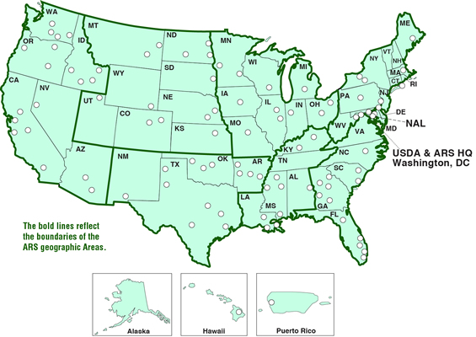


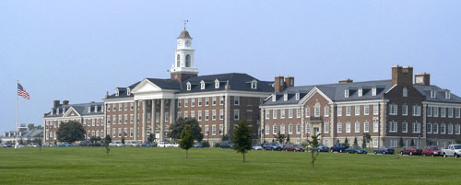
USDA-ARS-AIPL
Animal Improvement Programs Laboratory
Notes:
2

Slide 3
Dairy Cattle
9 million cows in US
Attempt to have a calf born every year
Replaced after 2 or 3 years of milking
Bred via AI
Bull semen collected several times/week. Diluted and frozen
Popular bulls have 10,000+ progeny
Cows can have many progeny though super ovulation and embryo transfer
Notes:
3

Slide 4
U.S. dairy population and milk yield

Slide 5
Dairy cattle traits evaluated by USDA
Year | Trait | Year | Trait
1926 | Milk & fat yields | 2000 | Calving ease¹
1978 | Conformation (type) | 2003 | Daughter pregnancy rate
1978 | Protein yield | 2006 | Stillbirth rate
1994 | Productive life | 2006 | Bull conception rate²
1994 | Somatic cell score (mastitis) | 2009 | Cow and heifer conception rates
¹Sire calving ease evaluated by Iowa State University (1978–99)
²Estimated relative conception rate evaluated by DRMS@Raleigh
(1986–2005)

Slide 6
Data Collection
Monthly recording
  Milk yields
  Fat and Protein percentages
  Somatic Cell Count (Mastitis indicator)
Visual appraisal for type traits
Breed Associations record pedigree
Calving difficulty and Stillbirth
Notes:
6

Slide 7
Traditional evaluations 3X/year
Yield
  Milk, Fat, Protein
Type
  Stature, Udder characteristics, feet and legs
Calving
  Calving Ease, Stillbirth
Functional
  Somatic Cell, Productive Life, Fertility
Notes:
7

Slide 8
Use of evaluations
Bulls to sell semen from
Parents of next generation of bulls
  Cows for embryo donation
Notes:
8

Slide 9
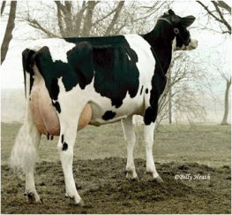
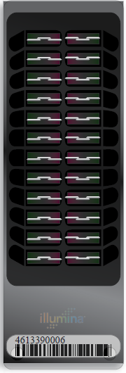
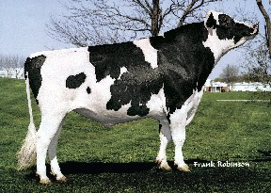
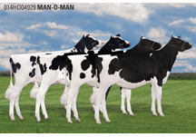
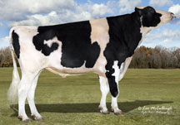
Lifecycle of bull
Parents Selected
Dam Inseminated
  Embryo Transferred to Recipient
  Bull Born
  Genomic Test
Semen collected (1yr)
Daughters Born (9 m later)
Bull Receives Progeny Test
(5 yrs)
Daughters have calves (2yr later)

Slide 10
Benefit of genomics
Determine value of bull at birth
  Increase accuracy of selection
  Reduce generation interval
  Increase selection intensity
  Increase rate of genetic gain
Notes:
10

Slide 11
Genomic evaluation program steps
Identify animals to genotype
Sample to genotyping lab
Genotype sample
Genotype to Beltsville
Calculate genomic evaluation
Release monthly
Notes:
11

Slide 12
Genomic data flow
DHI herd
DNA samples
DNA samples
genomic
evaluations
DNA laboratory
DNA samples
AI organization, breed association
genotypes
genotype
quality reports
nominations,
pedigree data
genotypes
genomic
evaluations
AIPL
Notes:
12

Slide 13
Genotyped Animals (April 2013)
Chip | Traditional evaluation? | Animal sex | Holstein | Jersey | Brown Swiss | Ayrshire
≥50K | Yes | Bulls | 21,904 | 2,855 | 5,381 | 639
 |  | Cows | 16,062 | 1,054 | 110 | 3
 | No | Bulls | 45,537 | 3,884 | 1,031 | 325
 |  | Cows | 32,892 | 660 | 102 | 110
<50K | Yes | Bulls | 19 | 11 | 28 | 9
 |  | Cows | 21,980 | 9,132 | 465 | 0
 | No | Bulls | 14,026 | 1,355 | 90 | 2
 |  | Cows | 158,622 | 18,722 | 658 | 105
Imputed | Yes | Cows | 2,713 | 237 | 103 | 12
 | No | Cows | 1,183 | 32 | 112 | 8
All |  |  | 314,938 | 37,942 | 8,080 | 1,213

Slide 14
Steps to prepare genotypes
Nominate animal for genotyping
Collect blood, hair, semen, nasal swab, or ear punch
  Blood may not be suitable for twins
Extract DNA at laboratory
Prepare DNA and apply to BeadChip
Do amplification and hybridization, 3-day process
Read red/green intensities from chip and call genotypes from clusters
Notes:
14

Slide 15
What can go wrong
Sample does not provide adequate DNA quality or quantity
Genotype has many SNP that can not be determined (90% call rate required)
Parent-progeny conflicts
  Pedigree error
  Sample ID error (Switched samples)
  Laboratory error
  Parent-progeny relationship detected that is not in pedigree

Slide 16
Parentage validation and discovery
Parent-progeny conflicts detected
  Animal checked against all other genotypes
  Reported to breeds and requesters
  Correct sire usually detected
Maternal Grandsire checking
  SNP at a time checking
  Haplotype checking more accurate
Breeds moving to accept SNP in place of microsatellites
Notes:
16

Slide 17
Parent-Progeny conflicts
Sire
Conflicts=0
*Tests=10
Conflict %=0%
 | Sire | Animal
 | A/B | A/B
* | B/B | B/B
* | A/A | A/A
 | B/B | A/B
 | A/B | B/B
 | A/B | A/B
* | A/A | A/A
 | A/B | A/A
 | B/B | A/B
* | B/B | B/B
* | B/B | B/B
 | A/B | A/B
 | B/B | A/B
* | A/A | A/A
* | B/B | B/B
 | A/B | A/B
 | A/B | A/A
* | B/B | B/B
 | A/B | A/A
 | A/B | A/A
MGS
A/B
A/B
A/A
A/B | *
A/A | *
B/B | *
A/A | *
B/B | *
B/B | *
B/B | *
A/B
A/B
A/B
B/B | *
A/B
A/A
B/B | *
A/B
A/A | *
B/B
MGS
Conflicts=3
*Tests=10
Conflict %=30.0%
Conflict %
Relationship
Notes:
17

Slide 18
Detecting Unreliable Genotypes
Unreliable Genotype (Reject)
Reject
Accept
0
0.2
0.4
0.6
0.8
1
1.2
1.4
1.6
1.8
2.0
2.4
2.8
3.2
3.6
Conflicts (%)

Slide 19
Grandsire detection
The two methods of Maternal Grandsire confirmation and discovery are:
    SNP conflict method (SNP)
      Check if animal and MGS have opposite homozygotes (duo test)
      If sire is genotyped some heterozygous SNP can be checked (trio test)
    Common haplotype method (HAP)
      After imputation of all loci, determine maternal contribution by removing paternal haplotype
      Count maternal haplotypes in common with MGS
      Remove haplotypes from MGS and check remaining against maternal great grandsire (MGGS)

Slide 20
Results by breed
 | SNP Method | HAP Method
 | MGS | MGS | MGGS
Breed | % Confirmed | % Confirmed | % Confirmed
Holstein | 95 (98) † | 97 | 92
Jersey | 91 (92) | 95 | 95
Brown Swiss | 94 (95) | 97 | 85
†50K genotyped animals only.

Slide 21
Lab QC
Each SNP evaluated for
  Call Rate
  Portion Heterozygous
  Parent-progeny conflicts
Clustering investigated if SNP exceeds limits
Number of failing SNP is indicator of genotype quality
Target fewer than 10 SNP in each category

Slide 22
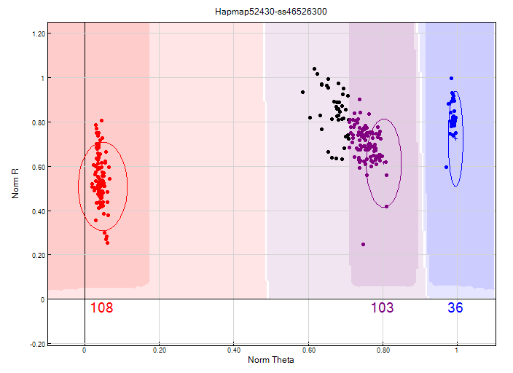
Before clustering adjustment
86% call rate

Slide 23
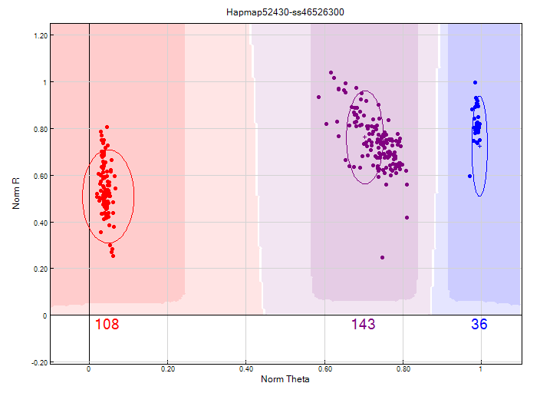
After clustering adjustment
100% call rate

Slide 24
Automated QC reporting
6160 Genotypes Processed from LAB2013021811
PASS/FAIL,Count,Description
PASS,1,Parent Progeny Conflict SNP >2%
PASS,5,Low Call Rate SNP >10%
PASS,0,HWE SNP
PASS,0,Chips w/ >20 Conflicts
PASS,0.3,No Nomination %
PASS,0,Genotype Submitted with No Sample Sheet Row

Slide 25
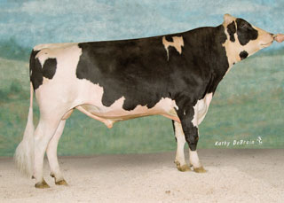
Pedigree: Parents, Grandparents, etc.
 |  | Manfred
 | O-Man
 |  | Jezebel
O-Style
 |  | Teamster
 | Deva
 |  | Dima
Notes:
We are all familiar with a traditional pedigree chart. Animal is expected to be an average of his parents.

Slide 26
O-Style Haplotypes chromosome 15

Slide 27
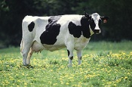
What’s a SNP genotype worth?
Pedigree is equivalent to information on about 7 daughters
For protein yield (h²=0.30), the SNP genotype provides information equivalent to an additional 34 daughters
Notes:
27

Slide 28

What’s a SNP genotype worth?
And for daughter pregnancy rate (h²=0.04), SNP = 131 daughters
Notes:
28

Slide 29
Correlation GPTAs and other Breeds’ GPTAs
Genomic evaluations are calculated for each breed separately

Slide 30
Reliability of Holstein predictions
Traitª | Bias^{b} | b | REL (%) | REL gain (%)
Milk (kg) | −64.3 | 0.92 | 67.1 | 28.6
Fat (kg) | −2.7 | 0.91 | 69.8 | 31.3
Protein (kg) | 0.7 | 0.85 | 61.5 | 23.0
Fat (%) | 0.0 | 1.00 | 86.5 | 48.0
Protein (%) | 0.0 | 0.90 | 79.0 | 40.4
PL (months) | −1.8 | 0.98 | 53.0 | 21.8
SCS | 0.0 | 0.88 | 61.2 | 27.0
DPR (%) | 0.0 | 0.92 | 51.2 | 21.7
Sire CE | 0.8 | 0.73 | 31.0 | 10.4
Daughter CE | −1.1 | 0.81 | 38.4 | 19.9
Sire SB | 1.5 | 0.92 | 21.8 | 3.7
Daughter SB | − 0.2 | 0.83 | 30.3 | 13.2
a PL=productive life, CE = calving ease and SB = stillbirth.
b 2011 deregressed value – 2007 genomic evaluation.

Slide 31
Marketed HO bulls

Slide 32
Ways to increase accuracy
Automatic addition of traditional evaluations of genotyped bulls when reach 5 years of age
Possible genotyping of 10,000 bulls with semen in repository
Collaboration with other countries
Use of more SNP from HD chips
Full sequencing – Identify causative mutations

Slide 33
Application to more traits
Animal’s genotype is good for all traits
Traditional evaluations required for accurate estimates of SNP effects
Traditional evaluations not currently available for heat tolerance or feed efficiency
Research populations could provide data for traits that are expensive to measure
Will resulting evaluations work in target population?

Slide 34
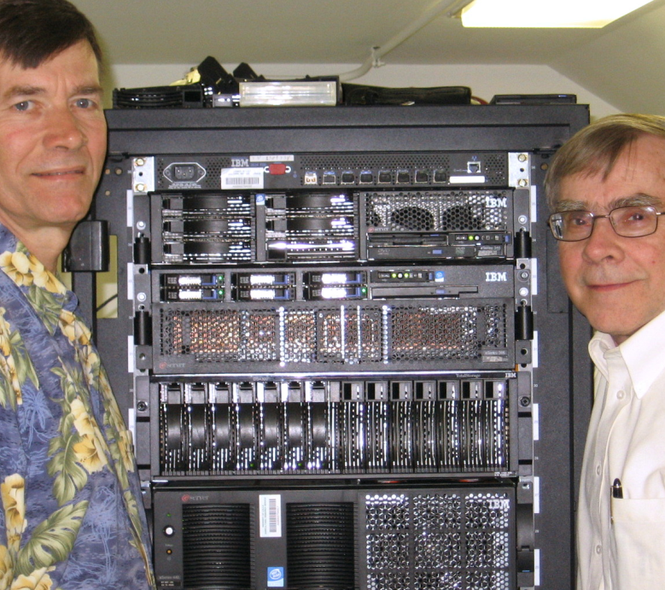
Computing environment
Computation server
  2.3–2.7 GHz CPU (32 cores, 64 threads)
  256 GB RAM
  5 TB local storage
Database server
  3.0 GHz CPU (8 cores)
  40 GB RAM
  2 TB local storage
Shared storage
  19 TB

Slide 35
Programming languages
C
  Database interface including data editing
FORTRAN
  Calculation of genetic merit estimates
SAS
  Data preparation, checking, and delivery

Slide 36
Impact on producers
Young-bull evaluations with accuracy of early 1st­crop evaluations
AI organizations marketing genomically evaluated 2-year-olds
Genotype usually required for cow to be bull dam
Rate of genetic improvement likely to increase by up to 50%
Studs reducing progeny-test programs

Slide 37
Why Genomics works in Dairy
Extensive historical data available
Well developed genetic evaluation program
Widespread use of AI sires
Progeny test programs
High valued animals, worth the cost of genotyping
Long generation interval which can be reduced substantially by genomics
Notes:
37

Slide 38
Council on Dairy Cattle Breeding
CDCB assuming responsibility for receiving data, computing, and delivering U.S. evaluations
USDA will continue research and development to improve evaluation system
CDCB and USDA employees collocated in Beltsville

Slide 39
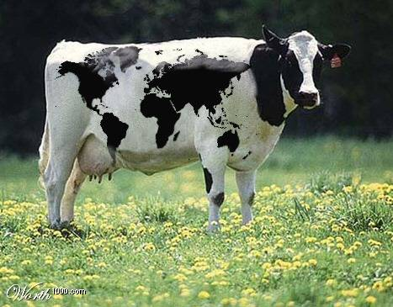
Questions?

