Slide 1
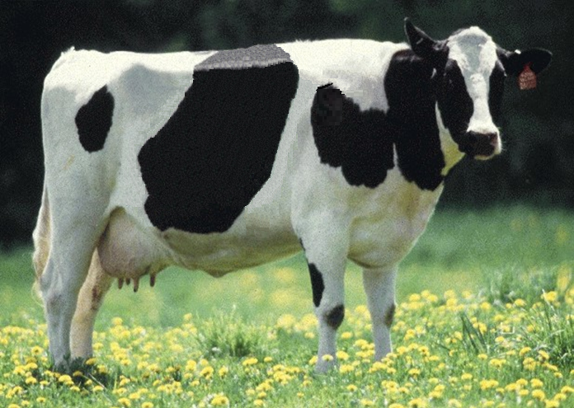
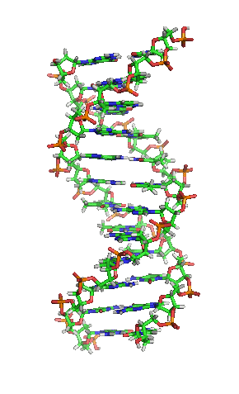
Genomic Evaluations in the United States

Slide 2
Organizational roles
Council on Dairy Cattle Breeding (CDCB) responsible for receiving data, computing, and delivering U.S. genetic evaluations for dairy cattle
Animal Improvement Programs Laboratory (AIPL) responsible for research and development to improve the evaluation system
CDCB and USDA employees co-located in Beltsville

Slide 3
Funding
CDCB evaluation calculation and dissemination funded by fee system
Based on animals genotyped
About 80% of revenue from bulls
Higher fees for herds that contribute less information
AIPL research on evaluation methodology funded by U.S. Federal government

Slide 4
Information sources for evaluations
Traditional evaluations of genotyped bulls and cows used to estimate SNP effects
Combined final evaluation
Sum of SNP effects for an animal’s alleles
Polygenetic effect
Traditional evaluation
Pedigree data used and validated by genotypes

Slide 5
Evaluation flow
Animal nominated for genomic evaluation by breed association or AI organization
Hair or other DNA source sent to genotyping lab
DNA extracted and placed on chip for 3-day genotyping process
Genotypes sent from genotyping lab to AIPL for accuracy review




Slide 6
Evaluation flow (continued)

Genotype calls modified as necessary
Genotypes loaded into database
Nominators receive reports of parentage and other conflicts
Pedigree or animal assignments corrected
Genotypes extracted and imputed to 45K
SNP effects estimated






Slide 7
Evaluation flow (continued)

Final evaluations calculated
Evaluations released to dairy industry
Download from CDCB FTP site with separate files for each nominator
Monthly release for new animals
All genomic evaluations updated 3 times each year with traditional evaluations


Slide 8
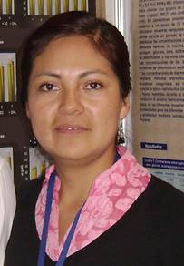
U.S. genomic evaluation team

