Slide 1
How Genomics and Collaboration Produce Results That May Surprise Us

Slide 2
Impact of genomics
More genetic progress, especially for traits with less heritability
Genotypes have found many other uses
Generation interval rapidly decreased
Young heifers are used as embryo donors
Young bull use rapidly increased: Examine top Net Merit bulls from 2 years ago that now have >100 daughters (next slide)

Slide 3
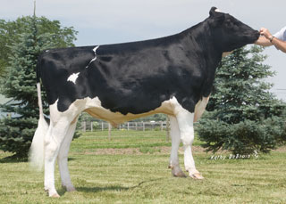
Top young bulls from Dec 2012
 | Net Merit |  |  | Progeny (2014)
Bull | 2014 | 2012 | PA 2012 | Daughters | AI Sons
Uno | 478 | 628 | 390 | 169 | 190
Gonzo | 549 | 590 | 339 | 289 | 11
Denim | 615 | 574 | 488 | 725 | 16
Tape | 504 | 574 | 389 | 109 | 10
Grafeeti | 545 | 571 | 438 | 477 | 26
Mogul | 728 | 566 | 291 | 274 | 269
Erdman | 631 | 559 | 355 | 1878 | 10
Robust | 767 | 553 | 379 | 1173 | 111
Shamrock | 565 | 548 | 403 | 4285 | 178
Saugatuck | 568 | 536 | 454 | 482 | 0
Top 10 Avg | 595 | 570 | 393 | 986 | 82
(base adjusted values)

Slide 4
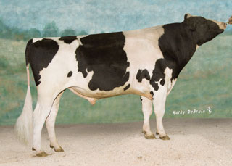
Top proven bulls from Dec 2012
 | Net Merit |  |  | Progeny (2014)
Bull | 2014 | 2012 | PA 2012 | Daughters | AI Sons
Freddie | 533 | 554 | 282 | 14,538 | 169
Awesome | 483 | 493 | 324 | 4,376 | 0
Mano | 475 | 492 | 311 | 137 | 1
O-Style | 455 | 482 | 385 | 7,293 | 64
Twist | 538 | 481 | 253 | 414 | 4
Massey | 506 | 474 | 248 | 4,122 | 50
Tread | 382 | 465 | 314 | 724 | 0
Levi | 440 | 463 | 177 | 2,857 | 14
ABC | 527 | 452 | 265 | 147 | 0
Planet | 526 | 447 | 182 | 42,214 | 338
Top 10 Avg | 487 | 480 | 274 | 7,682 | 64
(base adjusted values)

Slide 5
Growth of Markers and Animals
Year | Markers | Animals | Research partners
1991-2004 | 367 | 1,415 | USDA, Illinois, Israel
2007-2008 | 38,416 | 16,646 | USDA, Missouri, Canada, Illumina
2011-2013 | 636,967 | 161,341 | Added Italy, United Kingdom, HD genotypes
2012-2014 | 61,013 | 776,198 | Added Interbull (BSW) and Denmark (JER)
2012-2015 | 30,000,000 | >1000 | Worldwide exchange in Melbourne, Australia

Slide 6
Central DNA storage since 1992
Cooperative Dairy DNA Repository (CDDR)
ABS Global (DeForest, WI)
Accelerated Genetics (Baraboo, WI)
Alta (Balzac, AB, Canada)
Genex (Shawano, WI)
New Generation Genetics (Fort Atkinson, WI)
Select Sires (Plain City, OH)
Semex Alliance (Guelph, ON, Canada)
Taurus-Service (Mehoopany, PA)
AI companies send straws of each bull sampled
Repository maintained at USDA, Beltsville, MD

Slide 7
Value of Incoming Data
Data Received in 2014 | Annual Value
Phenotypes from DHI
4 million cows x $1.25 / cow / mo | $60 million
Genotypes from CDCB
15,000 medium density x $125 | $2 million
258,000 low density x $45 | $12 million
Whole genome sequence data (2015)
200+ bulls x $1,000 (AGIL data) | $0.2 million
1,000+ bulls x $3,000 (World data) | $3 million

Slide 8
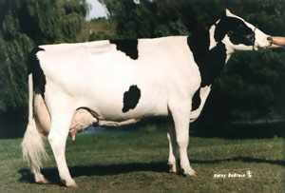
Sources of genotypes used
 | Phenotyped |  | Young
Continent | Female | Male | Female | Male | Totals
N. America | 139,955 | 24,838 | 422,898 | 90,695 | 678,386
Europe | 0 | 12,811 | 42,377 | 28,133 | 83,321
Oceania | 0 | 343 | 3,922 | 1,830 | 6,095
L. America | 0 | 7 | 7,160 | 442 | 7,609
Asia | 0 | 0 | 395 | 97 | 492
Africa | 0 | 0 | 291 | 4 | 295
Totals | 139,955 | 37,999 | 477,043 | 121,201 | 776,198
Latin America includes south and central America
Data as of December 2014
Notes:
As of March, 2014

Slide 9
Relationships (USA, Foreign Holsteins)
 | Expected Future Inbreeding |  | Pedigree Complete- | % Sires from
Continent | Genomic | Pedigree | ness | CAN | USA
N. America | 6.8 | 6.3 | 87 | 10 | 84
Europe | 7.0 | 6.4 | 98 | 16 | 54
Oceania | 6.0 | 5.9 | 89 | 16 | 44
L. America | 5.9 | 5.9 | 68 | 12 | 62
Asia | 6.2 | 6.1 | 71 | 10 | 76
Africa | 7.0 | 6.3 | 89 | 18 | 61

Slide 10
Genomic reliability by breed
 | Breed
Reliability | AY | BS | JE¹ | HO
Genomic REL (%) | 37 | 54 | 61 | 70
PA REL (%) | 28 | 30 | 30 | 30
Difference | +9 | +24 | +31 | +40
Bulls in reference | 680 | 5,767 | 4,207 | 24,547
Animals genotyped | 1,788 | 9,016 | 59,923 | 469,960
Exchange partners | CAN | Interbull, CAN | CAN, DNK | CAN, ITA, GBR
¹Jersey statistics include 2% REL gain from 1,068 DNK bulls added in January 2014, other statistics are from Dec 2013

Slide 11
Genomic reliability by trait for HO
 | Trait
Reliability | Yield | SCS | Longevity | Fertility
Genomic REL (%) | 76 | 72 | 69 | 68
PA REL (%) | 38 | 34 | 30 | 29
Difference | +38 | +39 | +39 | +39
 | Type | Stature | Ud Depth | Dtr Calf Ease
Genomic REL (%) | 75 | 77 | 77 | 60
PA REL (%) | 35 | 39 | 38 | 38
Difference | +40 | +38 | +39 | +22

Slide 12
Multitrait Genomics
Foreign genomic information could outweigh domestic data (GxE or GxG)
Low genetic correlations because of environment
(traits are really different between countries)
Poor ties between domestic and foreign animals (genetic distance)
Genetic correlations in genomic equations
Average correlation for all foreign bulls (MT)
Assume MACE EBV are correlated by 1.0 (ST)

Slide 13
Genetic correlations with USA
Trait | AUS | CAN | Trait | AUS | CAN
Milk | .77 | .94 | Udder depth | .94 | .97
Fat | .76 | .94 | Foot angle | .70 | .89
Protein | .75 | .91 | Stature | .89 | .98
SCS | .77 | .93 | Final score | .64 | .87
Longevity | .69 | .91 | Calving ease | .72 | .80
Fertility | .85 | .90 | Stillbirth | .36 | .63
Correlations estimated by Interbull in MACE

Slide 14
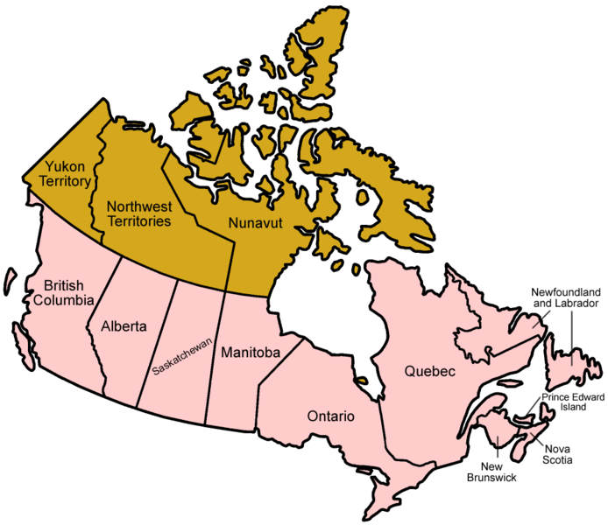
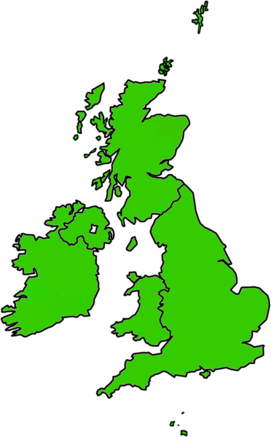
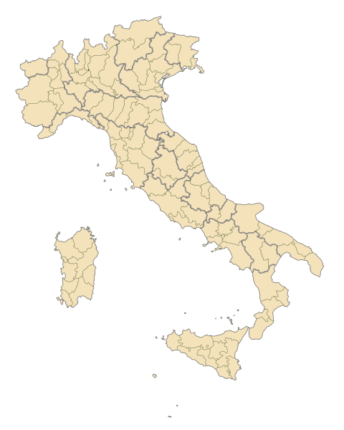
Foreign Holstein Reference Bulls 3,593 (28% of total bulls) had no U.S. daughters in 2008
CAN
1,321 bulls
GBR
247 bulls
ITA
1,677 bulls

Slide 15
REL gain over PA (HOL)
Trait | Foreign excluded | ST | MT
Average (9 traits) | 21.9 | 24.6 | 24.5
Milk | 26.6 | 28.7 | 28.6
Fat | 29.0 | 31.3 | 31.1
Protein | 20.2 | 22.5 | 22.3
Productive life | 19.5 | 21.8 | 22.2
SCS | 23.7 | 27.2 | 27.2
Daughter pregnancy rate | 17.5 | 21.3 | 21.2
Final score | 22.2 | 24.0 | 24.1
Stature | 29.4 | 34.0 | 33.9
Sire calving ease | 8.8 | 10.4 | 9.7

Slide 16
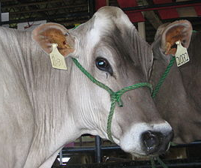
REL gain over PA (BSW)
Trait | Foreign excluded | ST | MT
Average (9 traits) | 8.5 | 11.7 | 13.1
Milk | 15.6 | 20.9 | 20.6
Fat | 10.3 | 11.4 | 12.5
Protein | 13.5 | 16.2 | 16.6
Productive life | 4.9 | 6.5 | 7.5
SCS | 5.0 | 4.2 | 6.6
Daughter pregnancy rate | 9.8 | 6.8 | 7.3
Final score | 2.7 | 9.3 | 15.7
Stature | 12.8 | 21.5 | 24.2
Sire calving ease | 1.9 | 8.7 | 6.6

Slide 17
Service applies to many chips
Different companies and densities
Illumina, GeneSeek, Zoetis, European LD
3K, 7K, 8K, 10K, 50K, 77K, and 777K chips
Imputed (nongenotyped) dams of ≥4 progeny
All animals imputed to 61,013 markers
Includes best SNPs from 777K and gene tests

Slide 18
Genotype chips
Chip Name | No. of SNP |  | Chip Name | No. of SNP
50K | 54,001 |  | GHD | 77,068
50K V2 | 54,609 |  | GP2 | 19,809
3K | 2,900 |  | ZLD | 11,410
HD | 777,962 |  | ZMD | 56,955
Affy | 648,875 |  | ELD | 9,072
LD | 6,909 |  | LD2 | 6,912
GGP | 8,762 |  | GP3 | 26,151

Slide 19
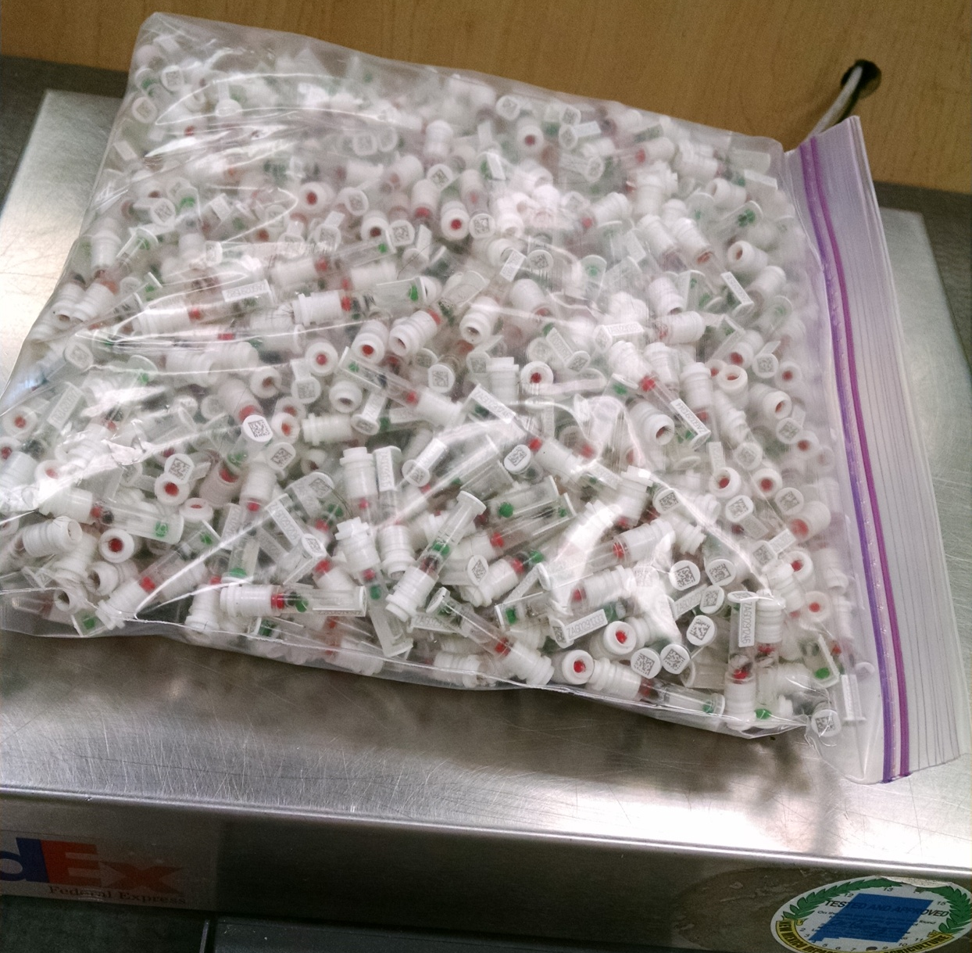
DNA samples from 1 farm, 1 day
Photo provided
by Zoetis

Slide 20
Other uses for genotypes
Ancestor discovery within breeds
Inheritance tracking for chromosomes
Mating programs
Genomic inbreeding, dominance
Fertility defects – haplotypes and QTLs
Breed composition of crossbreds

Slide 21
Ancestor discovery tests
Database also stores initial pedigree status
Farmers correct pedigrees after DNA test
Weekly and monthly predictions sent
Sire initial status summarized (actual)
Maternal grandsire (actual and simulation)
5% of MGS set to incorrect and 5% missing

Slide 22
Initial sire status and discovery
Continent | Reported | Discov-ered | Wrong | Corr-ected | Animals
N America | 93.8 | 3.7 | 6.9 | 6.3 | 588,942
Europe | 97.8 | 1.2 | 2.0 | 1.6 | 68,677
Oceania | 96.8 | 0.0 | 3.2 | 2.3 | 4,073
L America | 85.2 | 3.4 | 12.3 | 8.9 | 6,494
Asia | 78.0 | 0.2 | 16.0 | 12.0 | 467
Africa | 92.4 | 0.0 | 7.6 | 7.2 | 275
Found or fixed sires for about 10% of animals (> 50,000)
Notes:
Number of animals does not include code zero or four

Slide 23
MGS status (after corrections)
 | Animals (N) |  | Animals (%)
MGS status | Females | Males | Females | Males
Confirmed | 141,963 | 38,270 | 49 | 87
Not genotyped | 119,160 | 3,874 | 41 | 9
or missing
Unlikely | 28,267 | 1,787 | 10 | 4
Total | 289,390 | 43,931 | 100 | 100

Slide 24
Discovery of missing ancestors
 | Ancestor discovered (if genotyped)
 | Sire | MGS | MGGS
Breed | % Correct* | % Correct | % Correct
Holstein | 100 | 97 | 92
Jersey | 100 | 95 | 95
Brown Swiss | 100 | 97 | 85
* % Correct = Top ranked candidate ancestor matches the true ancestor.

Slide 25
Genotyped ancestors, actual bull(HOUSA73431994)
777K 777K
50K - - -
50K 50K
50K 50K
777K 777K
50K - - -
3K 777K
50K 50K
777K 777K
50K Imputed
Imputed 50K
50K Imputed
50K 777K
50K 50K
50K 777K
77K - - -
777K 777K
50K Imputed
Imputed 50K
50K Imputed
50K 777K
50K 50K
3K 777K
9K 50K
50K 777K
50K 50K
50K 777K
50K Imputed
777K 777K
50K - - -
Imputed 777K
50K

Slide 26
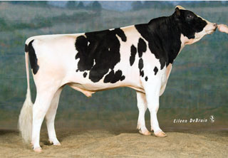
Pedigree or genomic mating?
Computer mating programs have helped breeders identify potential mates with fewer ancestors in common to reduce pedigree inbreeding
Such programs could instead help breeders to identify potential mates with fewer alleles in common to reduce genomic inbreeding
This works best if both mates are genotyped
Pedigree relationships
Genomic relationships

Slide 27
Genomic mating programs
Rapid methods now deliver genomic relationships (G) from central database to industry
Compute G for females with only marketed bulls
Compute G elements as needed by query
Compute G once, then retrieve elements as needed
Several computer methods to assign mates
Minimize pedigree or genomic relationships
Linear programming (Sun et al., 2013)
Sequentially choose least-related mates (Pryce et al., 2012)
Random mating
Include or exclude dominance effects of markers

Slide 28
Mating program results
With linear programming, genomic inbreeding was:
3% lower than with random mating
1% lower than with sequential mate selection
Genomic instead of pedigree relationships:
Added value was $32 * 184,693 calves = $5.9 million / year for Holstein females genotyped in 2013
Distributed to industry beginning August 2014
Extra benefits from predicting dominance were small

Slide 29
Fertility and stillbirth defects
Track new defects by haplotype or gene test
Holstein HH1, HH2, HH3, HH4 (Sebastien), HH5
Brown Swiss BH1, BH2 (Schwarzenbacher)
Jersey JH1, JH2, Fertility1 (LIC)
Montbeliarde MH1 and MH2 (Sebastien)
Ayrshire AH1
Track previous QTLs by haplotype or test
BLAD, Brachyspina, CVM, DUMPS, Mulefoot, SDM, SMA, Weaver, Polled, Red, etc.
Not included on early chips, but imputed from markers

Slide 30
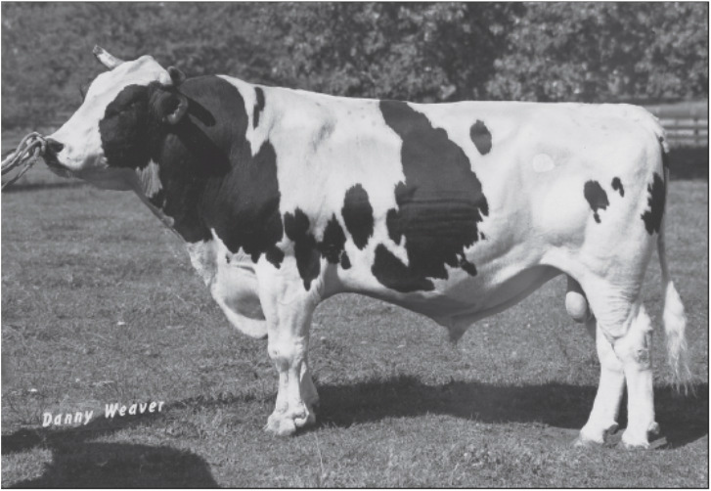
Economics of fertility defect HH1
Pawnee Farm Arlinda Chief (born 1962)
Contributed 14% of global Holstein genes
$25 billion value of increased milk yield
$0.4 billion cost of HH1 mid-term abortions
Mutation in APAF1 gene

Slide 31
Haplotype tests, then lab tests
 | Frequency |  | Lab tests¹
Genotypes | JH1 | HH1 | JH1 | HH1
Normal | 76.5 | 97.2 | 9,867 | 113,792
Carrier | 21.3 | 2.4 | 2,750 | 2,793
Homozygous | 0.0 | 0.0 | 0 | 0
No call | 2.1 | 0.4 | 276 | 464
Total | 100.0 | 100.0 | 12,893 | 117,049
¹Data from the Geneseek Genomic Profiler (GGP) and GGP-HD for causative mutations (JH1 = CWC15 and HH1 = APAF1)

Slide 32
Jay Lush, 1948 (The Genetics of Populations)
“The rapid rate at which genes have been found in each species, whenever people started to study it genetically, and the fact that in most of these species the rate of finding new genes actually seemed to increase with continued study until so many genes were known that interest in keeping stocks of each new one waned.” (p. 32)

Slide 33
What’s the best cow we can make?
A “Supercow” constructed from the best haplotypes in the Holstein population would have an EBV(NM$) of $7515

Slide 34
After the cow is perfected
Beyond genomics could be transgenics
Create traits not yet available in nature
Add or subtract genes as needed or desired
Produce higher value milk, create polled
Preserving genetic variation is a key to adapting to different definitions of perfection

Slide 35
Conclusions
Young animals with improved reliability and high merit can greatly speed genetic progress
Ancestor discovery and pedigree corrections have become a big business
Genomic mating programs are profitable
Fertility defects are easy to discover and track
Genomic predictions are more accurate for populations with more reference animals

Slide 36
Acknowledgments
Mel Tooker, Jan Wright, George Wiggans, John Cole, Dan Null, Jana Hutchison, Tabatha Cooper, Lillian Bacheller, Jeff O’Connell, Chuanyu Sun, and Katie Olson contributed to the computation and graphics
Members of the Council on Dairy Cattle Breeding (CDCB) provided the data

Slide 37
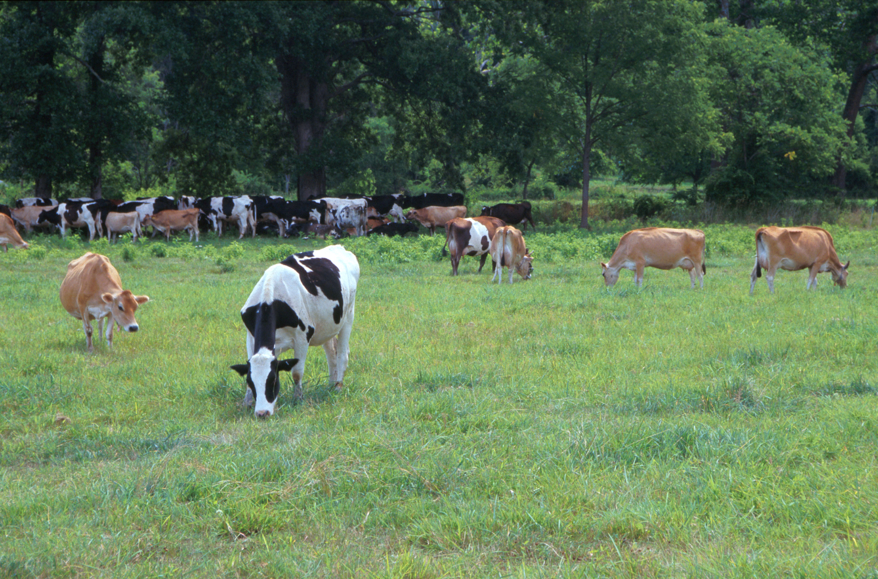
Questions?
AIP web site:
http://aipl.arsusda.gov
Holsteins, Jerseys, and crossbreds graze on American Farm Land Trust’s
Cove Mountain Farm in south-central Pennsylvania
Source: ARS Image Gallery, image #K8587-14; photo by Bob Nichols

