Slide 1
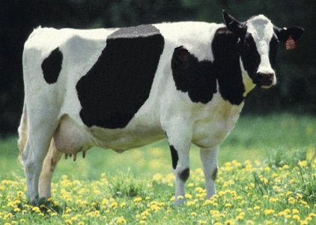
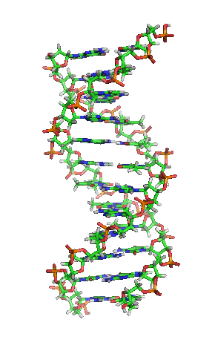
Updated guidelines for the recording, evaluation, and genetic improvement of udder health in dairy cattle

Slide 2
Introduction
A healthy udder is free from mastitis, which is the most costly disease of dairy cattle (Seegers et al., 2003)
Udder health has declined in many breeds because of unfavorable correlations with production (Ødegård et al., 2003)
Poor udder health increases costs, results in higher rates of involuntary culling, decreases revenue, and harms animal welfare
Genetic selection for improved udder health is an important part of dairy cattle breeding programs (Schutz, 1994; Heringstad et al., 2003)
Notes:
2

Slide 3
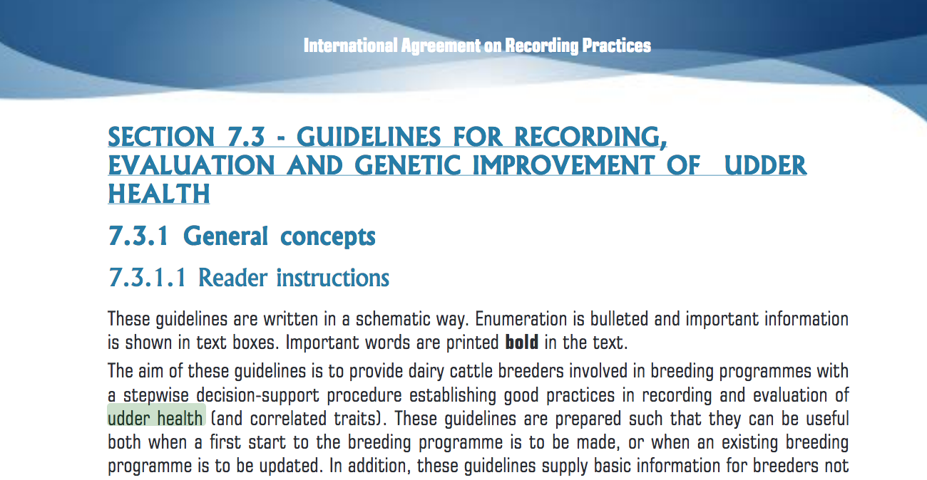
Existing ICAR guidelines

Slide 4
What do we want in guidelines?
Best practices
  What data should be recorded? Who should collect them? How?
Concision
  Include only necessary information
  Current guidelines are 27 pages…
Do not repeat work already done!

Slide 5
Udder health phenotypes
Type | Measure¹ | Reference | Type | Measure | Reference
Direct | Clinical mastitis | Bramley et al. (1996) | Indirect | Changes in SCC patterns | De Haas et al. (2008)
 | Subclinical mastitis | Bramley et al. (1996) |  | Differential SCC | Schwarz et al. (2011)
Indirect | SCC | Schukken et al. (2003) |  | Electrical conductivity | Norberg et al. (2004)
 | Milkability | Sewalem et al. (2011) |  | Lactoferrin content | Soyeurt et al. (2012)
 | Udder conformation | Nash et al. (2002) |  | Pathogen-specific mastitis
¹ The indirect measures listed in italics were added to the revised guidelines.

Slide 6
Phenotype considerations
Udder health data originate from various sources which differ considerably with respect to information content and specificity
The data source should be clearly indicated whenever information on udder health status is collected and analyzed
When data from different sources are combined, these origins must be taken into account

Slide 7
Clinical and subclinical mastitis
Clinical mastitis results in altered milk composition, and is accompanied by a painful, red, swollen udder (Bramley et al., 1996)
Subclinical infections do not change the appearance of the milk or the udder, but milk composition is altered
Subclinical mastitis is most commonly detected based on elevated SCC

Slide 8
Traits – milking speed
Milking speed data are routinely collected by milking systems and stored in on-farm computer systems
Genetic correlations of SCS with milking speed generally are moderate and antagonistic
Selection for faster milking also may reduce risk of mastitis
Where is the optimum?

Slide 9
Traits – electrical conductivity
Electrical conductivity is measured by most modern milking systems
Cows with mastitis produce milk with increased milk conductivity (Norberg et al., 2004)
Conductivity measurements at milking can be compared with previous measurements to identify changes consistent with subclinical mastitis

Slide 10
Traits – Lactoferrin content
Lactoferrin is an iron-binding glycoprotein naturally present in milk.
It also is released by neutrophils during inflammation, which is consistent with its role in host defense inflammation
Soyeurt et al. (2012) showed that MIR spectroscopy can cheaply and rapidly predict milk lactoferrin content

Slide 11
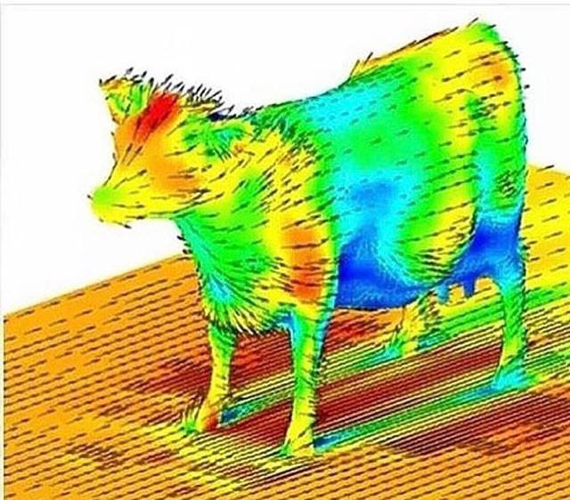
New phenotypes are regularly suggested

Slide 12
Applications – Herd management
Benchmarking supports successful farming
Comparing cows to herdmates identifies individuals performing beyond expectations
Cohort summaries permit benchmarking of farms against contemporaries
Important when milk pricing schemes include differential payment based on milk quality

Slide 13
Applications– Population health
National monitoring programs must meet the demands of authorities, consumers, and producers
Farmers benefit from increased consumer confidence in safe and responsible food
Disease surveillance is important to protect integrity of national herds

Slide 14
Applications – Genetic evaluation
Breeding values for udder health traits of marketed bulls should be published routinely
Total merit indices should include an udder health sub-index
Udder health sub-indices may include both direct and indirect predictors of udder health
A combination of direct and indirect information maximizes the accuracy of selection

Slide 15
Selection indices include many traits…
Source: Miglior et al. (2012)

Slide 16


Holstein somatic cell score (log₂)
Sires
Phenotypic base = 3.0
Cows
0.02/yr

Slide 17
Conclusions
Udder health guidelines will continue to evolve
  Technology available for monitoring cow performance will improve
  More precise phenotypes will become available for lower costs
The goal remains to provide farmers with tools for making decisions

Slide 18
Affiliations
C. Egger-Danner, ZuchtData EDV-Dienstleistungen GmbH, Vienna, Austria
A.J. Bradley,University of Nottingham, School of Veterinary Medicine and Science, Sutton Bonington Campus, Leicestershire, UK and Quality Milk Management Services Ltd, Cedar Barn, Easton Hill, Easton, Wells, Somerset, UK
N. Gengler, Agriculture, Bio-engineering and Chemistry Department, Gembloux Agro-Bio Tech, University of Liège, Gembloux, Belgium
B. Heringstad, Department of Animal and Aquacultural Sciences, Norwegian University of Life Sciences, Ås, Norway
J.E. Pryce, Department of Economic Developments, Jobs, Transport and Resources and La Trobe University, Agribio, Bundoora, VIC, Australia
K.F. Stock, IT Solutions for Animal Production (vit), Verden, Germany

Slide 19
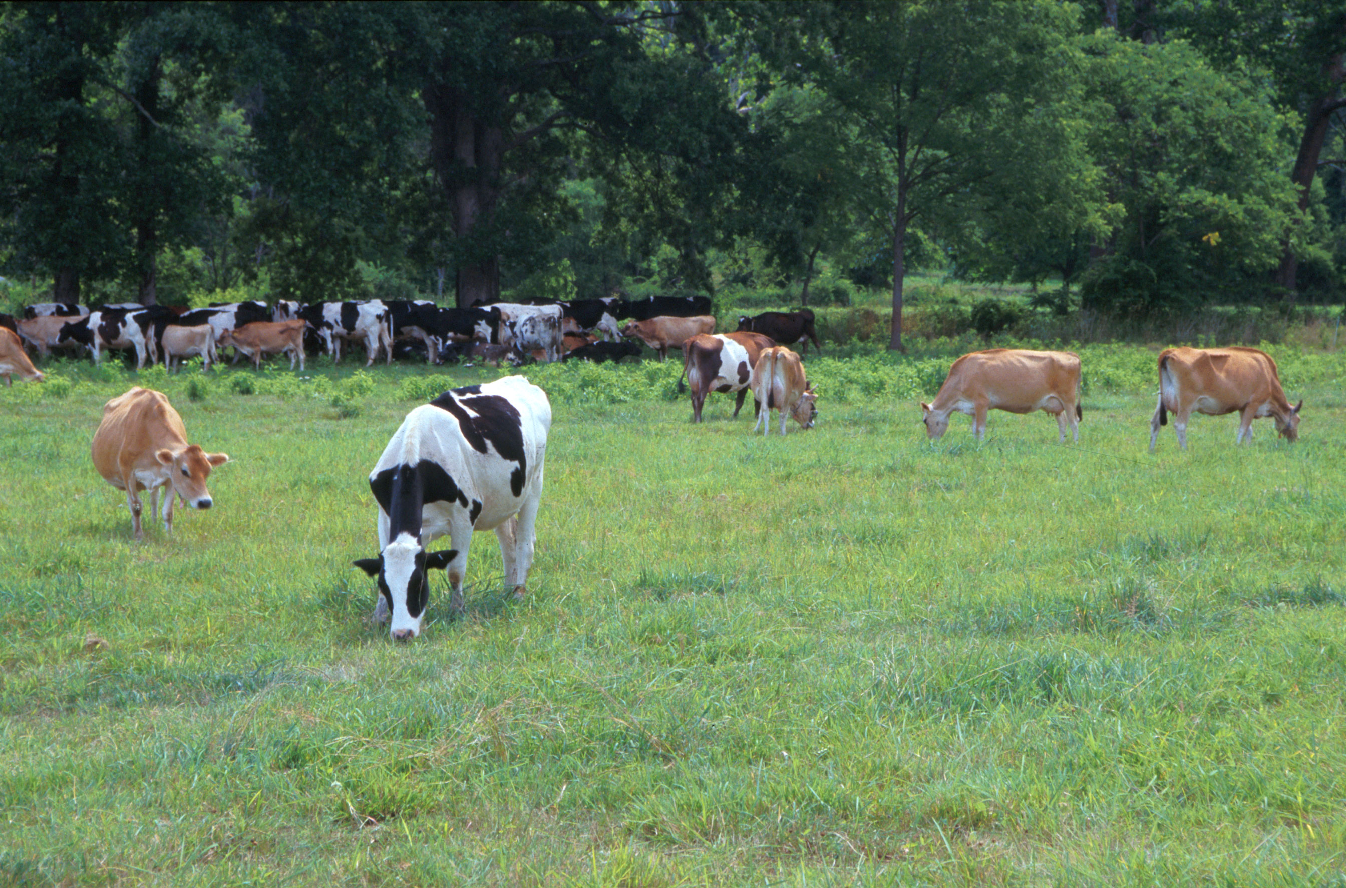
Questions?
FTWG web site:
http://www.icar.org/index.php/technical-bodies/working-groups/functional-traits-working-group/
Holstein and Jersey crossbreds graze on American Farm Land Trust’s
Cove Mountain Farm in south-central Pennsylvania
Source: ARS Image Gallery, image #K8587-14; photo by Bob Nichols

Slide 20
References - 1
Bramley, A.J., J.S. Cullor, R.J. Erskine, L.K. Fox, R.J. Harmon, J.S. Hogan, S.C. Nickerson, S.P. Oliver, K.L. Smith, & L.M. Sordillo, 1996. Current concepts of bovine mastitis. Natl. Mastitis Council 37: 1-3.
de Haas, Y., W. Ouweltjes, J. Ten Napel, J.J. Windig & G. de Jong, 2008. Alternative somatic cell count traits as mastitis indicators for genetic selection. J. Dairy Sci. 91(6): 2501-2511.
Heringstad, B., R. Rekaya, D. Gianola, G. Klemetsdal & K.A Weigel. 2003. Genetic change for clinical mastitis in Norwegian Cattle: a threshold model analysis. J. Dairy Sci. 86: 369-375.
Jorani, H., J. Philipsson & J.-C. Mocquot, 2001. Interbull guidelines for national and international genetic evaluation systems in dairy cattle: Introduction. Interbull Bull. 28: 1.

Slide 21
References - 2
Nash, D.L., G.W. Rogers, J.B. Cooper, G.L. Hargrove & J.F. Keown, 2002. Relationships among severity and duration of clinical mastitis and sire transmitting abilities for somatic cell score, udder type traits, productive life, and protein yield. J. Dairy Sci. 85(5): 1273-1284.
Norberg, E., H. Hogeveen, I.R. Korsgaard, N.C. Friggens, K.H.M.N. Sloth & P. Løvendahl, 2004. Electrical conductivity of milk: ability to predict mastitis status. J. Dairy Sci. 87(4): 1099-1107.
Norman, H.D., J.E. Lombard, J.R. Wright, C.A. Kopral, J.M. Rodriguez & R.H. Miller, 2011. Consequence of alternative standards for bulk tank somatic cell count of dairy herds in the United States. J. Dairy Sci. 94(12): 6243-6256.
Ødegård, J., G. Klemetsdal & B. Heringstad, 2003. Variance components and genetic trend for somatic cell count in Norwegian Cattle. Livest. Prod. Sci. 79(2-3): 135-144.

Slide 22
References - 3
Parker Gaddis, K.L., J.B. Cole, J.S. Clay & C. Maltecca, 2012. Incidence validation and causal relationship analysis of producer-recorded health event data from on-farm computer systems in the United States. J. Dairy Sci. 95(9): 5422-5435.
Rivas, A.L., F.W. Quimby, J. Blue & O. Coksaygan, 2001. Longitudinal evaluation of bovine mammary gland health status by somatic cell counting, flow cytometry, and cytology. J. Vet. Diagn. Invest. 13(5): 399-407.
Schukken, Y.H., D.J. Wilson, F. Welcome, L. Garrison-Tikofsky & R.N. Gonzalez, 2003. Monitoring udder health and milk quality using somatic cell counts. Vet. Res. 34(5): 579-596.
Schutz, M.M., 1994. Genetic evaluation of somatic cell scores for United States dairy cattle. J. Dairy Sci. 77(7): 2113-2129.

Slide 23
References - 4
Schwarz, D., U.S. Diesterbeck, S. König, K. Brügemann, K. Schlez, M. Zschöck, W. Wolter & C.P. Czerny, 2011. Flow cytometric differential cell counts in milk for the evaluation of inflammatory reactions in clinically healthy and subclinically infected bovine mammary glands. J. Dairy Sci. 94(10): 5033-44.
Seegers, H., C. Fourichon & F. Beaudeau, 2003. Production effects related to mastitis and mastitis economics in dairy cattle herds. Vet. Res. 34(5): 475-491.
Sewalem, A., F. Miglior & G.J. Kistemaker, 2011. Genetic parameters of milking temperament and milking speed in Canadian Holsteins. J. Dairy Sci. 94(1): 512-516.
Soyeurt, H., C. Bastin, F.G. Colinet, V.R. Arnould, D.P. Berry, E. Wall, F. Dehareng, H.N. Nguyen, P. Dardenne, J. Schefers & J. Vandenplas, 2012. Mid-infrared prediction of lactoferrin content in bovine milk: potential indicator of mastitis. Animal 6(11): 1830-1838.

