Slide 1
Improving production efficiency through genetic selection

Slide 2
Introduction
How genetic selection works
Gains due to genetic selection
Use of genomic technology
Future research opportunities

Slide 3
How does genetic selection work?
ΔG = genetic gain each year
reliability = how certain we are about our estimate of an animal’s genetic merit (genomics ⬆)
selection intensity = how selective we are when making mating decisions (management can ⬆)
genetic variance = variation in the population due to genetics (we can’t really change this)
generation interval = time between generations (genomics ⬇)

Slide 4
US dairy population and milk yield

Slide 5
Genetic evaluation advances
Year | Advance | Gain, %
1862 | USDA established
1895 | USDA begins collecting dairy records
1926 | Daughter-dam comparison | 100
1962 | Herdmate comparison | 50
1973 | Records in progress | 10
1974 | Modified contemporary comparison | 5
1977 | Protein evaluated | 4
1989 | Animal model | 4
1994 | Net merit, productive life, and somatic cell score | 50
2008 | Genomic selection | >50

Slide 6
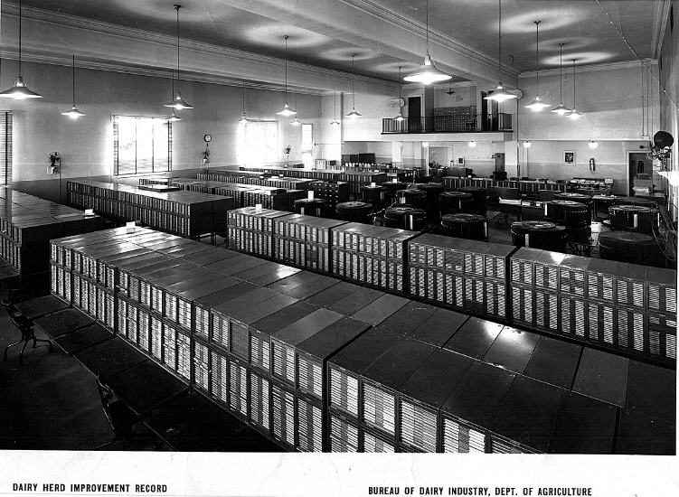
DHI Records Database, 1935

Slide 7
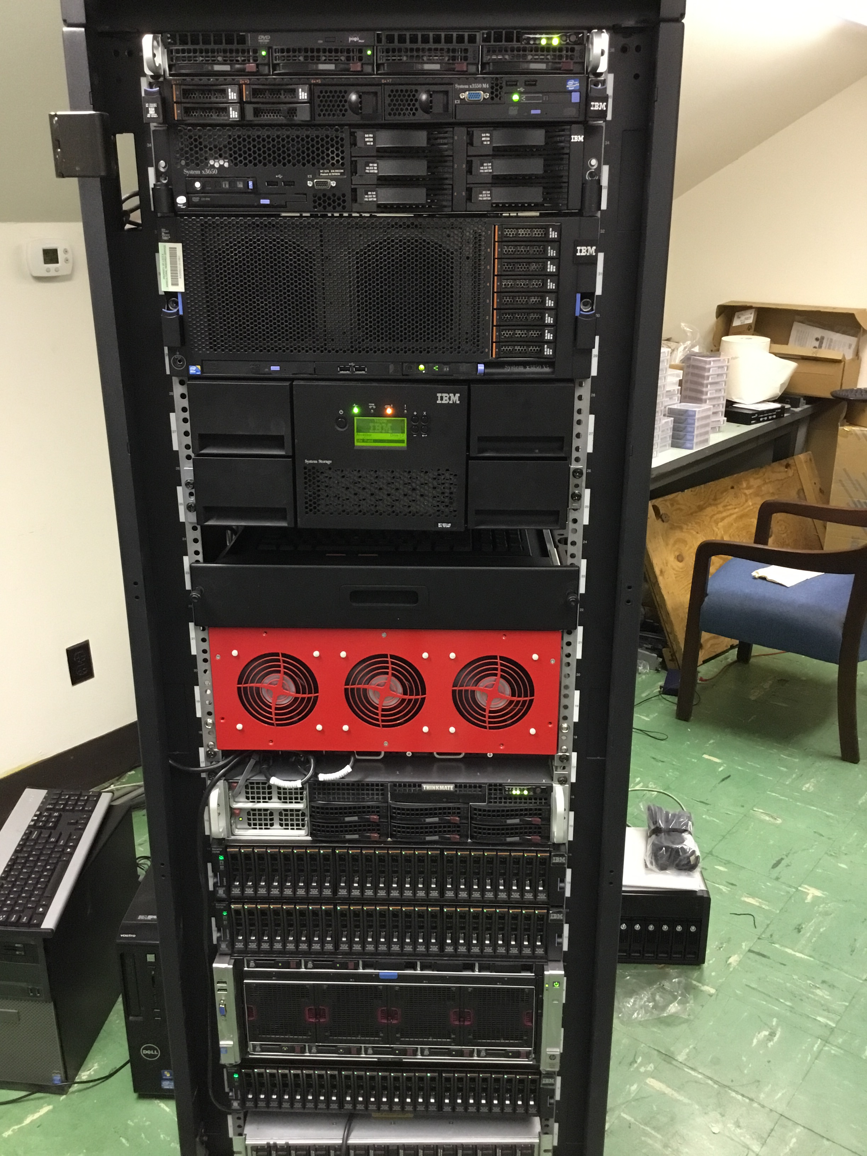
DHI Records Database, 2016

Slide 8
Animal model
1989 to present
Introduced by Wiggans and VanRaden
Advantages
Information from all relatives
Adjustment for genetic merit of mates
Uniform procedures for males and females
Best prediction (BLUP)
Crossbreds included (2007)
Genomic information added (2008)

Slide 9
Traits evaluated
Year | Trait | Year | Trait
1926 | Milk & fat yields | 2000 | Calving ease¹
1978 | Conformation (type) | 2003 | Daughter pregnancy rate
1978 | Protein yield | 2006 | Stillbirth rate
1994 | Productive life | 2006 | Bull conception rate²
1994 | Somatic cell score (mastitis) | 2009 | Cow and heifer conception rates
¹Sire calving ease evaluated by Iowa State University (1978–99)
²Estimated relative conception rate evaluated by DRMS in Raleigh, NC (1986–2005)

Slide 10
Conformation (type) traits
Stature
Strength
Body depth
Dairy form
Rump angle
Thurl width
Rear legs (side)
Rear legs (rear)
Foot angle
Feet and legs score
Fore udder attachment
Rear udder height
Rear udder width
Udder cleft
Udder depth
Front teat placement
Rear teat placement
Teat length

Slide 11
Holstein milk (kg)
Phenotypic base = 11,828 kg
Sires
79 kg/yr
Cows

Slide 12
Holstein productive life (mo)
Phenotypic base = 27.2 mo
0.2 mo/yr
Sires
Cows

Slide 13
Holstein somatic cell score (log₂)
Sires
Phenotypic base = 3.0
Cows
0.02/yr

Slide 14
Holstein daughter pregnancy rate (%)
Cows
Sires
0.1%/yr
Phenotypic base = 22.6%

Slide 15
Genomic evaluation system
Provides timely evaluations of young bulls for purchasing decisions
Increases accuracy of evaluations of bull dams
Assists in selection of service sires, particularly for low-reliability traits
High demand for semen from genomically evaluated 2-year-old bulls

Slide 16
Genotypes are abundant

Slide 17
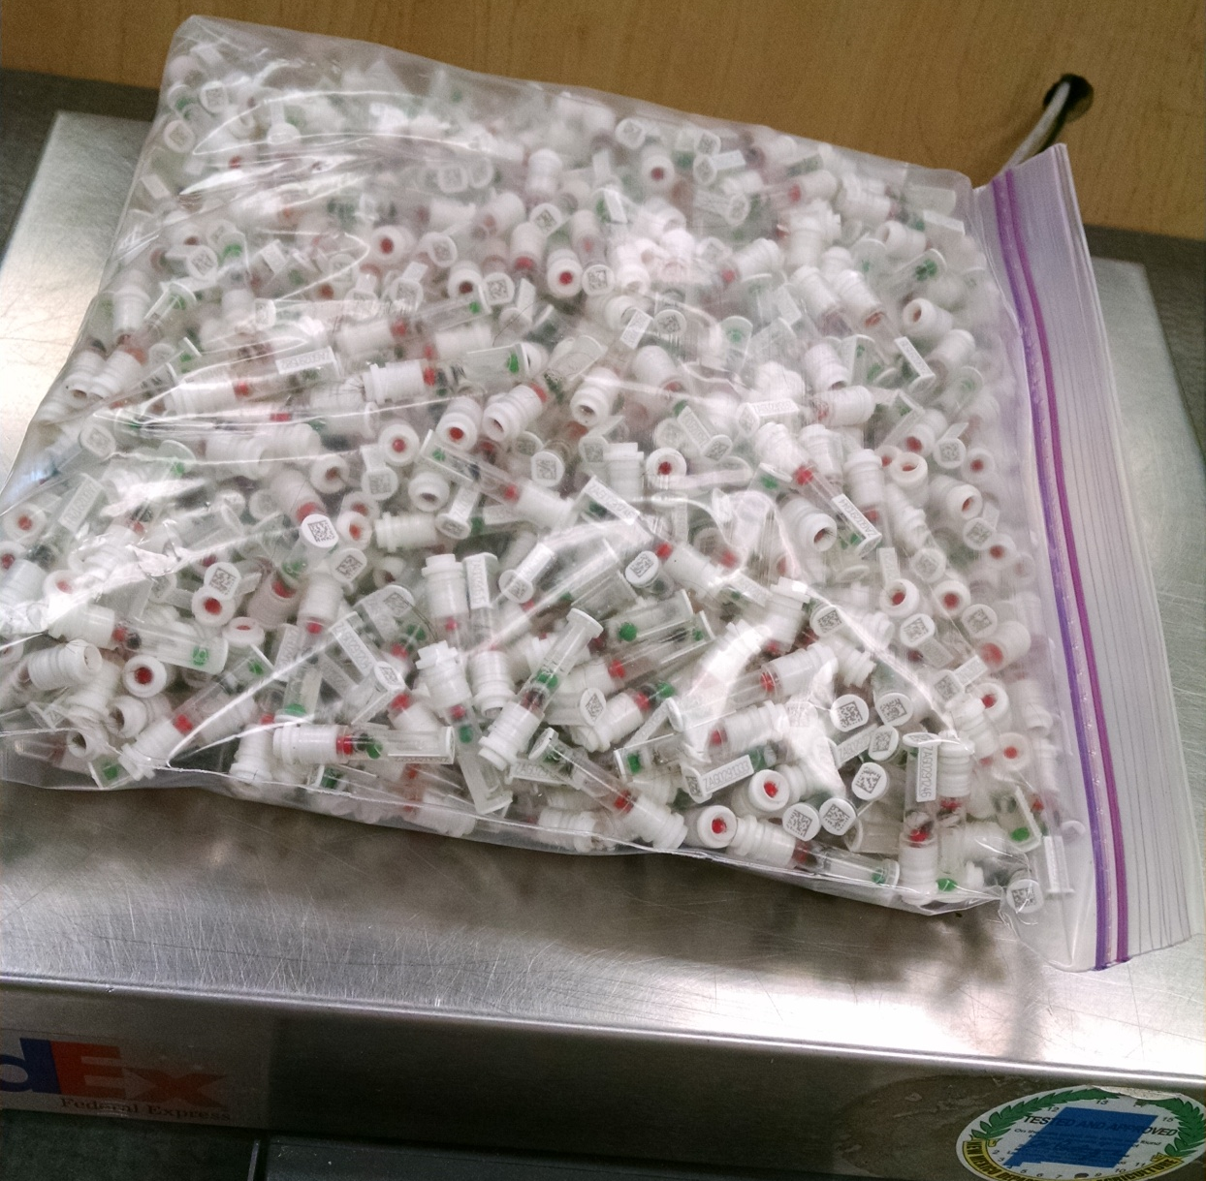
DNA samples from 1 farm, 1 day
Photo provided
by Zoetis.

Slide 18
Value of Incoming Data
Data Received in 2014 | Annual Value
Phenotypes from DHI
4 million cows x $1.25 / cow / mo | $60 million
Genotypes from CDCB
15,000 medium density x $125 | $2 million
258,000 low density x $45 | $12 million
Whole genome sequence data (2015)
200+ bulls x $1,000 (AGIL data) | $0.2 million
1,000+ bulls x $3,000 (World data) | $3 million

Slide 19
Holstein prediction accuracy
Trait | Bias* | Reliability (%) | Reliability gain (% points)
Milk (kg) | −80.3 | 69.2 | 30.3
Fat (kg) | −1.4 | 68.4 | 29.5
Protein (kg) | −0.9 | 60.9 | 22.6
Fat (%) | 0.0 | 93.7 | 54.8
Protein (%) | 0.0 | 86.3 | 48.0
Productive life (mo) | −0.7 | 73.7 | 41.6
Somatic cell score | 0.0 | 64.9 | 29.3
Daughter pregnancy rate (%) | 0.2 | 53.5 | 20.9
Sire calving ease | 0.6 | 45.8 | 19.6
Daughter calving ease | −1.8 | 44.2 | 22.4
Sire stillbirth rate | 0.2 | 28.2 | 5.9
Daughter stillbirth rate | 0.1 | 37.6 | 17.9
*2013 deregressed value – 2009 genomic evaluation

Slide 20
Genetic merit of marketed Holstein bulls
Average gain:
$85.60/year
Average gain:
$52.00/year
Average gain:
$19.77/year

Slide 21
Genotypes can be applied to many traits
An animal’s genotype is good for all traits
Traditional evaluations are required for accurate estimates of SNP effects
Traditional evaluations not currently available for heat tolerance or feed efficiency
Research populations could provide data for traits that are expensive to measure
Will resulting evaluations work in target population?

Slide 22
Four ways farmers can use genomics
Animal ID and parentage verification
Is this the animal that I think it is?
Early culling decisions
Am I raising the right animals?
Mate selection
How do I produce the best calves?
Identification of elite cows

Slide 23
Selection indices include many traits…
Source: Miglior et al. (2012)

Slide 24
…and we keep adding new ones
Trait | Relative emphasis on traits in index (%)
 | PD$ 1971 | MFP$ 1976 | CY$ 1984 | NM$ 1994 | NM$ 2000 | NM$ 2003 | NM$ 2006 | NM$ 2010 | NM$ 2014
Milk | 52 | 27 | –2 | 6 | 5 | 0 | 0 | 0 | -1
Fat | 48 | 46 | 45 | 25 | 21 | 22 | 23 | 19 | 22
Protein | … | 27 | 53 | 43 | 36 | 33 | 23 | 16 | 20
PL | … | … | … | 20 | 14 | 11 | 17 | 22 | 19
SCS | … | … | … | –6 | –9 | –9 | –9 | –10 | -7
UDC | … | … | … | … | 7 | 7 | 6 | 7 | 8
FLC | … | … | … | … | 4 | 4 | 3 | 4 | 3
BDC | … | … | … | … | –4 | –3 | –4 | –6 | -5
DPR | … | … | … | … | … | 7 | 9 | 11 | 7
HCR | … | … | … | … | … | … | … | … | 2
CCR | … | … | … | … | … | … | … | … | 1
SCE | … | … | … | … | … | –2 | … | … | …
DCE | … | … | … | … | … | –2 | … | … | …
CA$ | … | … | … | … | … | … | 6 | 5 | 5
Source: AGIL, ARS, USDA (http://aipl.arsusda.gov/reference/nmcalc-2014.htm).

Slide 25
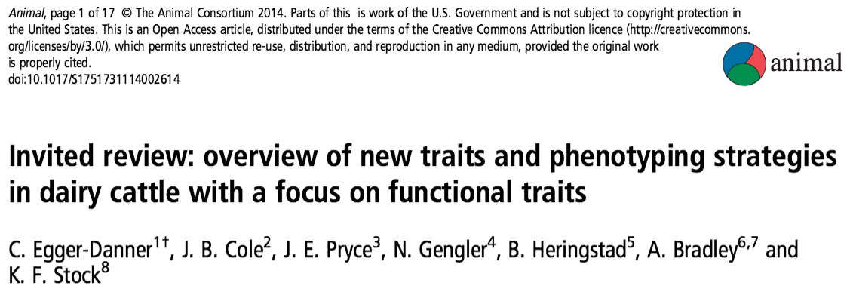
Why do we need new traits?
Changes in production economics
Technology produces new phenotypes
Better understanding of biology
Recent review by Egger-Danner et al.

Slide 26
New traits should add information
Novel phenotypes
include some
new information
Novel phenotypes
contain little
new information
high
Phenotypic correlation
with existing traits
Novel phenotypes
include much
new information
Novel phenotypes
contain some
new information
low
low
high
Genetic correlation with
existing traits

Slide 27
New traits should have value
high
(milk yield)
(feed intake)
Value of phenotype
(greenhouse gas emissions)
low
(conformation)
low
high
Cost of measurement

Slide 28
What do current phenotypes look like?
Low-dimensionality
Usually few observations per lactation
Close correspondence of phenotypes with values measured
Easy transmission and storage
Notes:
28
28

Slide 29
What do new phenotypes look like?
High dimensionality
Ex.: MIR produces 1,060 points/obs.
Disconnect between phenotype and measurement
More resources needed for transmission, storage, and analysis

Slide 30
What do we do with new traits?
Put them into a selection index
Correlated traits are helpful
Apply selection for a long time
There are no shortcuts
Collect many phenotypes
Repeated records of limited value
Genomics can increase accuracy

Slide 31
What challenges are on the horizon?
We need more frequent sampling for modern management
Samples do not need to be evenly spaced across the lactation
Some large farms do not see a value proposition in milk recording
On-farm data are growing, but not collected in a central database
Notes:
31
31

Slide 32
Challenges to genetic improvement
Research is being done on new traits
Often not turned into new products
It’s a collective action problem
Disagreement on objectives
Lack of commercial incentives
Infrastructure is not in place
This provides an opportunity for new players to enter the market
Independent validation lacking

Slide 33
There are no guarantees…
New technologies often require considerable capital investment
They sometimes fail to work or do not deliver the promised gain
Data are most useful when combined with observations from many farms
This inevitably involves risk

Slide 34
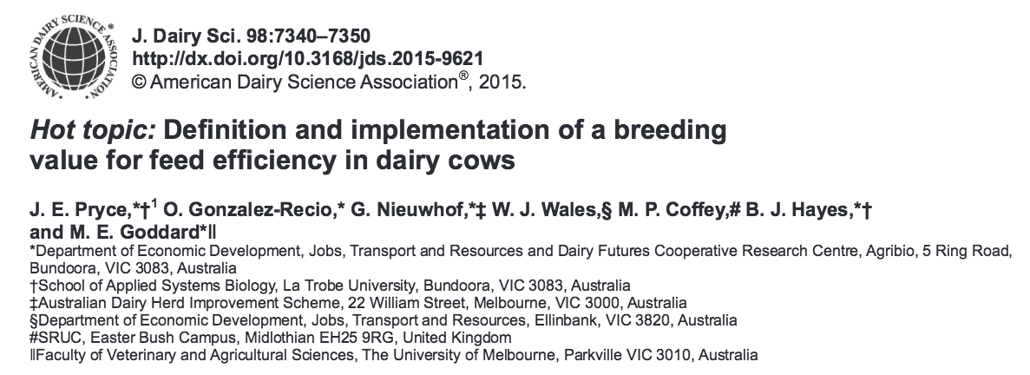
Collaboration is essential
When new traits are expensive, it takes a consortium to collect the data needed for genetic evaluation.
Notes:
34
34

Slide 35
Conclusions
Genetic and genomic selection have been very successful technologies
Modern on-farm tools produce large amounts of data
Those data can be used to improve herd management and profitability
Dairy breeders need to rise to the challenge of turning new data into decisions

Slide 36
Acknowledgments
Appropriated project 1265-31000-096-00, "Improving Genetic Predictions in Dairy Animals Using Phenotypic and Genomic Information", ARS, USDA
CNPq “Science Without Borders” project 301025/2014-2
Kristen Gaddis, Dan Null, Paul VanRaden, and George Wiggans
Council on Dairy Cattle Breeding

Slide 37
Disclaimer
Mention of trade names or commercial products in this presentation is solely for the purpose of providing specific information and does not imply recommendation or endorsement by the US Department of Agriculture.

Slide 38
Questions?
http://gigaom.com/2012/05/31/t-mobile-pits-its-math-against-verizons-the-loser-common-sense/shutterstock_76826245/

