Slide 1
Current and Future Evaluation Changes

Slide 2
April changes
HO genotypes from Switzerland
Genomic evaluation of Guernseys
Mutations in HCD and in BH2
HCR edits and adjustments
Breed base representation (BBR) for crossbreds

Slide 3
Breed check markers
Breed determining SNP introduced in 2010
200 SNPs monomorphic in 1 breed and have fewer than 30% of animals homozygous for that allele in another breed
Initially used to identify misidentified samples
Later, used to exclude crossbreds from genomic evaluation because purebred equations did not apply accurately
Currently, about 10,000 crossbreds excluded with cost of genotyping about $400,000

Slide 4
Predicting breed as a “trait”
Reference population is purebred, proven bulls
Variable to predict (Y) is breed of animal
Holstein bulls are coded 100% HO, 0% JE, and 0% BS, for example
Animal Breed | Holstein percent | Jersey percent | Brown Swiss %
HO | 100 | 0 | 0
JE | 0 | 100 | 0
BS | 0 | 0 | 100

Slide 5
Results from 2010 (Katie Olson)
Means and standard deviations to predict breed of the validation (young animals) data set
Breed /SNP set | 43 K | 3 K | 600
Holstein (N = 14,794) | 100.0 ± 0.8 | 100.4 ± 3.1 | 100.2 ± 1.9
Jersey (N = 919) | 99.6 ± 2.8 | 97.8± 6.3 | 98.9 ± 3.6
Brown Swiss (N = 96) | 99.4 ± 2.1 | 98.9 ± 3.6 | 99.2 ± 5.1

Slide 6
GPTA for crossbreds (proposed)
Compute traditional PTAs on all-breed base
Calculate SNP effects using each pure breed’s genotypes, but on all-breed base
Apply each breed’s SNP effects (AY, BS, GU, HO, JE) to the crossbred genotypes
Combine individual breed GPTAs weighted by genomic breed composition
Convert GPTAs to within-breed base

Slide 7
Cow mortality / livability
Reasons for disposal have been reported and stored in DHI records since 1970
About 20% of cows die instead of being sold across all lactations
Death loss per lactation average 7%, higher in later, lower in earlier lactation

Slide 8
Productive Life (PL) vs. Livability (LIV)
PL measures cow’s ability to avoid dying or being culled
LIV measures cow’s ability to stay alive
LIV is a subset of PL
Cost = 1500 pounds * $.75 / pound + $50 disposal = $1200 / death

Slide 9
LIV model
Definition:
Reverse of mortality:
0 = died this lactation
100 = lived this lactation
Multiply by average lactation/cow (2.8) so to put on lifetime scale

Slide 10
LIV model (cont.)
Data:
92 million records on 32 million cows
Methodology:
Same model and software as other major traits
Similar edits as other traits
Multi-trait with overall culling per lactation, but lactation cull rate will not be reported
Heritability of 1.3 (Miller et al., 2008), genetic correlation with lactation PL of .50

Slide 11
Means and Std Dev. of PTALIV (bulls born 1990 or later, minimum 50 daus, .50 rel for PTALIV)
Breed | Mean | Std Dev | Num. bulls
AY | 0.5 | 2.0 | 246
BS | 0.1 | 2.0 | 692
GU | -0.3 | 3.5 | 182
HO | -1.1 | 2.2 | 45,840
JE | -0.2 | 1.7 | 3,893
MS | 0.7 | 1.9 | 64

Slide 12
Correlation of PTALIV with other trait PTAs (bulls born 1990 or later, minimum 50 daus, .50 rel for PTALIV)
Trait | HO | JE
Milk | .09 | -.08
Fat | .21 | .01
Protein | .16 | -.01
Prod. Life | .70 | .54
SCS | -.28 | -.07
Dau. Preg. Rate | .40 | .54
Cow Conc. Rate | .40 | .33
Heifer Conc. Rate | .28 | .32
Num. bulls | 45,840 | 3,893

Slide 13
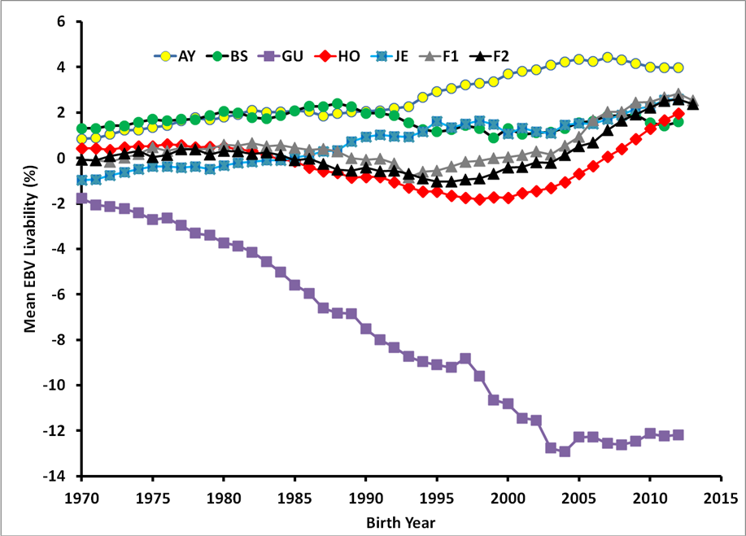
LIV genetic trends 1970-2013

Slide 14
Genetic trend in PTALIV - HO

Slide 15
Added value from more traits
Year | Traits | Added | Data | Corr | Gain
1976 | 3 | Protein | DHIA | .96 | 4%
1994 | 5 | Productive life, SCS | DHIA | .84 | 19%
2000 | 18 | Size, udder, feet / legs | Breeds | .94 | 6%
2003 | 21 | Pregnancy rate, calving ease (sire, dtr) | DHIA / NAAB | .98 | 2%
2006 | 23 | Stillbirth (sire, dtr) | NAAB | .98 | 2%
2014 | 25 | Heifer, cow conception | DHIA | .97 | 3%
2016 |  | Cow death | DHIA | > .99 | < 1%
2016 | 31 | 6 more health traits | Zoetis | .92 ?? | 21% ??

Slide 16
Health trait cases and costs?
Trait | Cases (%) / lactation | Heritability (obs / thr)³ | Cost ($) / case
Death¹ | 7 | 1.3 / 4.8 | 1,200
Mastitis² | 23 | 3.7 / 6.9 | 200
Lameness | 20 | 3.7 / 6.3 | 320
Metritis | 10 | 2.9 / 5.9 | 330
Retained Placenta | 5 | 2.6 / 7.3 | 250
Displaced Abomasum | 2 | 1.5 / 8.1 | 250
Ketosis | 5 | 2.1 / 5.9 | 200
¹Death data from USDA research
²Other trait cases and cost from Zoetis data and advertisement
³Observed scale and equivalent underlying (threshold model) heritability

Slide 17
Correlations of SCS and mastitis
Correlation | CAN | DFS | FRA | NLD
USA SCS, foreign MAST | .87 | .87 | .87 | .88
USA SCS, foreign SCS | .94 | .88 | .90 | .88
Genetic correlations estimated by Interbull, Apr 2016
Genetic correlation (SCS,MAST) estimated by Zoetis = .45

Slide 18
Genotyped mates and ET progeny

Slide 19
Future evaluation options
Single-step genomic equations
OK for JE, still not for HO
Traits already recorded
Age at first calf, gestation length, persistency, heat tolerance
Traits requiring new data
Feed efficiency, health, etc.
Sequence mutations plus markers

Slide 20
History of SNP Chips

