Slide 1
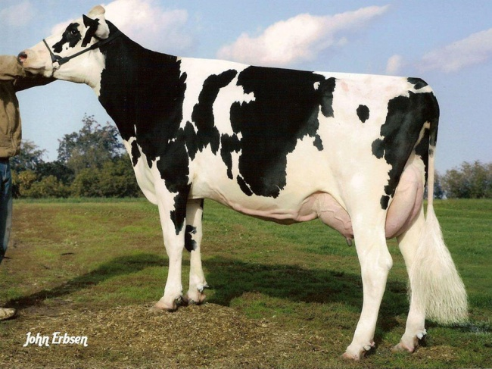
Rapid growth of genomic prediction in dairy cattle

Slide 2
Topics
Agricultural development of genetic theory
Why genomic selection took hold so fast
Dairy cattle improvement before genomics
Dairy cattle improvement after genomics
Genomic prediction methods
Current and future trends in genomics

Slide 3
Advances in genetic theory
Theory | Author | Year | Species
Single-gene inheritance | Mendel | 1865 | Peas
Multiple-gene inheritance | Fisher | 1918 | Humans
Pedigree relationship matrix | Wright | 1922 | Cattle
Mixed linear models | Henderson | 1963 | Cattle
Genomic prediction | Meuwissen | 2001 | Animals
Genomic relationship matrix | VanRaden | 2008 | Cattle
Also application
First database with 1 million genotyped individuals was
USDA/Council on Dairy Cattle Breeding in July 2015

Slide 4
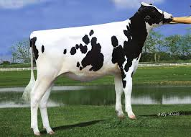
Largest genomic databases
 | Ancestry.com | 23andMe | CDCB/USDA
Genotypes | >2 million | >1 million | 1.4 million
Species | Human | Human | Cattle
Countries | ? | >55 | 53
Genotyping cost | $99 | $199 | $37–135
Delivery (weeks) | 6–8 | 6–8 | 1–2
DNA generations | Few | Few | >10
EBV reliability | None | Low | High
Reference: http://genomemag.com/davies-23andme/#.VdY722zosY1
Web sites: https://www.23andme.com/
http://dna.ancestry.com/
https://www.cdcb.us/
http://aipl.arsusda.gov/Main/site_main.htm

Slide 5
Genetics, genomics, and dairy cattle
Bulls do not express traits of interest, so selection must use data from female relatives
Cows are worth about $2,000 each, so owners collect much data for management
Phenotypes, pedigrees for half of US cows
Database and statistical methods developed and maintained by USDA and CDCB since 1908

Slide 6
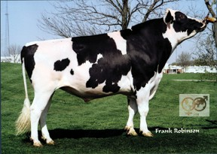
Progeny-tested bulls
O-Bee Manfred Justice
>100,000 daughters with milk yield records
60,000 in U.S. plus 40,000 in 25 other countries
1 million units of semen sold worth $30 million
About 10,000 dairy bulls/year progeny tested
Best 10–20% selected for global use

Slide 7
Example daughter traits
O-Bee Manfred Justice daughter
Average 6% more milk, protein, butterfat
Average 17% longer productive life
Average 10% more fertile
Average 50% fewer difficult births
$700 more lifetime profit than average cow

Slide 8
Changes in trait selection across time
Trait | Relative emphasis in USDA index (%)
 | PD$ 1971 | MFP$ 1976 | NM$ 1994 | NM$ 2000 | NM$ 2003 | NM$ 2014 | NM$ 2016
Milk | 52 | 27 | 6 | 5 | 0 | –1 | –1
Fat | 48 | 46 | 25 | 21 | 22 | 22 | 22
Protein | … | 27 | 43 | 36 | 33 | 20 | 20
Longevity | … | … | 20 | 14 | 11 | 19 | 14
SCS (mastitis) | … | … | –6 | –9 | –9 | –7 | –7
Udder | … | … | … | 7 | 7 | 8 | 8
Feet/legs | … | … | … | 4 | 4 | 3 | 3
Body size | … | … | … | –4 | –3 | –5 | –4
Pregnancy rate | … | … | … | … | 7 | 7 | 7
Calving | … | … | … | … | 4 | 5 | 5
Conception rate | … | … | … | … | … | 3 | 3
Livability | … | … | … | … | … | … | 7
Notes:
8
8

Slide 9
Cooperative Dairy DNA Repository
Central DNA storage for North American bulls
All major AI companies contributed DNA from their bulls to USDA in Beltsville since 1992
Genex/CRI, Select Sires, Alta Genetics, Accelerated Genetics, ABS Global, Taurus, and Semex
Their bulls sire about 80% of 9 million U.S. dairy cows plus $150 million/year of semen exported

Slide 10
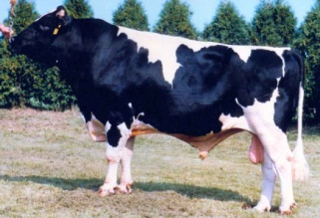
Global bulls with U.S. sires

Slide 11
Growth of markers and animals
Year | Markers | Animals | Research partners
1991–2004 | 367 | 1,415 | USDA, Illinois, Israel (DNA from USA, CAN)
2007–09 | 38,416 | 16,646 | USDA, Missouri, Canada, Illumina
2011–13 | 636,967 | 161,341 | Italy, United Kingdom, and high density added
2012–15 | 61,013 | 1,000,000 | Interbull and Denmark added
2015–future | 39,700,000 | 1,577 | Australia worldwide exchange

Slide 12
Genetic markers in genomic selection
Notes:
April 2016 CDCB used 60,671 snp. Not an actual SNP chip, but 50K and lower chips imputed up to 60K

Slide 13
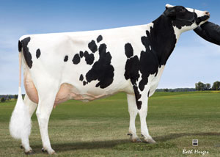
Genomic prediction
Main idea: improve future traits by selection
Look at animal’s own measurable traits (used for hundreds or thousands of years)
Use pedigrees and phenotypes to compute estimates of genetic merit (done officially by USDA 1937–2008)
2008 idea: Why not look directly at the DNA?

Slide 14
USDA evaluation history
Year | Breeding program | Data sources added
<1937 | Mass selection | Own phenotype
1937–62 | Means of relatives | Daughters, dams
1962–89 | Sire models | Herd-year-season
1989–present | Animal models | Full pedigrees
1995–present | MACE* models | Foreign daughters
2009–present | Genomic models | Marker genotypes
2013–future | Biologic models | Causal mutations
*MACE = multi-trait across-country evaluation

Slide 15
New evaluation programs (Dec. 2014)
Replaced animal model programs used since 1989
New options
Multitrait models
Multiple class and regression variables
Factors and weights differ by trait
Random regressions
Foreign data included
Parallel processing
Developed for transition to single-step model (genotypes, phenotypes, pedigree)
Approximate G^{–1} for >1 million genotypes?
Notes:
Renumber factors in same program

Slide 16
Current computation: multistep
Steps | Time (hours) | Processors | Memory (Gbytes)
Extract data and pedigree | 10 | 7 | 1
Inbreeding and heterosis | 8 | 2 | 5
Traditional EBVs, 8 traits | 24 | 8 | 40
Imputation (using priors) | 48 | 20 | 75
Genomic EBVs, 27 traits | 10 | 27 | 54
Compare G to A matrix | 6 | 20 | 75
Distribute final results | 5 | 1 | 1
Total | 111
Weekly (new animals only) | 1.4 | 10 | 50

Slide 17
Multistep genomic evaluations
Traditional evaluations (phenotype and pedigree) used as input data for genomic equations
Allele effects estimated for 60,671 markers (Z) by multiple regression, using BayesA prior variance
Polygenic effect for 10% of genetic variation not captured by markers, assuming pedigree covariance
Selection index step combines genomic info with traditional info from nongenotyped parents
Applied to 33 yield, fitness, calving, and type traits

Slide 18
Linear estimates using markers
Selection index equations for EBV
R has diagonals = (1/Reliability)–1
BLUP equations for marker effects, sum to get EBV
k = var(u)/var(m)

Slide 19
Nonlinear vs. linear regression

Slide 20
Single-step genomic evaluation
Benefits of 1-step genomic evaluation
Account for genomic pre-selection
Expected Mendelian Sampling ≠ 0
Improve accuracy and reduce bias
Include many genotyped animals
Redesign animal model software used since 1989

Slide 21
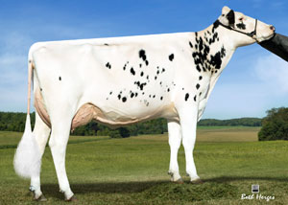
Animal model adjusts for
PTAs rather than GPTAs of mates
Top bulls mated only to top genomic females
PTAs rather than GPTAs of herdmates
Can underestimate recent genetic trend
PTAs rather than GPTAs of parents and progeny
Dams credited only for highly selected sons
Top heifers not milked, used as ET donors

Slide 22
Single-step equations
Aguilar et al. (JDS, 2010)
Model: y = Xb + Wu + e
+ other random effects not shown
Size of G and A₂₂ >1 million, increasing each year
Size of A is 60 million animals

Slide 23
Single-step GBLUP
Misztal et al. (JDS, 2014) algorithm for large data
Approximate G^{–1} can process 1 million or more genotyped animals with reasonable time and memory
Masuda et al. (JDS, 2016) applied algorithm to U.S. Holstein data
Less bias than current multistep methods
Less accuracy with >100,000 genotypes

Slide 24
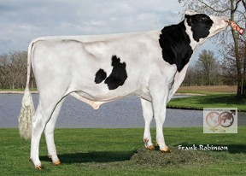
Pedigree of embryo sire (HOUSA73431994)
777K
777K
50K
—
50K
50K
50K
50K
777K
777K
50K
—
3K
777K
50K
50K
777K
777K
50K
Imputed
Imputed
50K
50K
Imputed
50K
777K
50K
50K
50K
777K
77K
—
777K
777K
50K
Imputed
Imputed
50K
50K
Imputed
50K
777K
50K
50K
3K
777K
9K
50K
50K
777K
50K
50K
50K
777K
50K
Imputed
777K
777K
50K
—
Imputed
777K
50K

Slide 25
Pedigree of embryo dam (HOCAN108535184)
777K
50K
50K
—
50K
777K
50K
Imputed
777K
777K
50K
50K
Imputed
777K
50K
—
777K
50K
777K
—
Imputed
777K
50K
—
777K
777K
Imputed
Imputed
Imputed
777K
77K
50K
777K
50K
777K
—
Imputed
777K
50K
—
777K
777K
Imputed
—
Imputed
777K
77K
50K
777K
777K
777K
50K
50K
777K
50K
—
50K
50K
50K
50K
50K
777K
50K

Slide 26
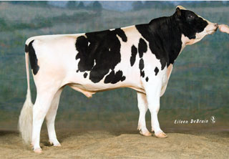
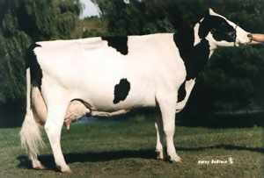
Pedigree or genomic mating?
Computer mating programs assign mates with fewer ancestors in common to reduce pedigree inbreeding
Such programs can instead assign mates with fewer alleles in common to reduce genomic inbreeding
Relationships of each genotyped female to genotyped AI males available since Aug. 2014
Dominance effects tested, not yet distributed
Pedigree relationships
Genomic relationships

Slide 27
Net merit (NM$) by chromosome Freddie – highest NM$ bull

Slide 28
What’s the best cow we can make?
A “supercow” constructed from the best haplotypes in the Holstein population would have an EBV for NM$ of $7515

Slide 29
Parent ages for marketed bulls

Slide 30
Genetic trend for Net Merit $

Slide 31
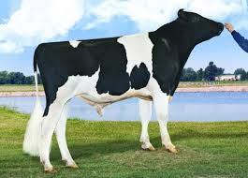
Top young bulls from April 2013 Now with > 1,000 daughters
 | NM$ |  |  |  | Progeny (2016)
Bull | 2016 | 2013 | PA 2013 |  | Daughters | AI sons
Supersire | 936 | 694 | 395 |  | 3,820 | 244
Cabriolet | 852 | 666 | 331 |  | 1,028 | 6
AltaStacked | 617 | 611 | 439 |  | 1,308 | 1
Uno | 526 | 600 | 348 |  | 4,468 | 213
Puzzle | 538 | 584 | 370 |  | 1,240 | 0
Erdman | 679 | 574 | 362 |  | 3,351 | 11
Maurice | 642 | 571 | 501 |  | 1,760 | 26
Indy | 606 | 568 | 385 |  | 1,375 | 0
Galaxy | 497 | 564 | 501 |  | 3,146 | 23
Headliner | 701 | 562 | 395 |  | 1,485 | 26
Top 10 average | 721 | 599 | 438 |  | 2,298 | 80
(base adjusted values)

Slide 32
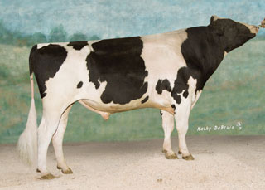
Top proven bulls from April 2013 Now with >1,000 daughters
 | NM$ |  |  |  | Progeny (2016)
Bull | 2016 | 2013 | PA 2013 |  | Daughters | AI sons
Observer | 454 | 559 | 380 |  | 6,874 | 155
Freddie | 470 | 547 | 294 |  | 22,429 | 186
Awesome | 471 | 524 | 346 |  | 5,799 | 0
O-Style | 409 | 500 | 369 |  | 9,715 | 64
Planet | 475 | 494 | 169 |  | 63,551 | 364
Massey | 513 | 477 | 237 |  | 9,707 | 82
Levi | 422 | 468 | 181 |  | 18,800 | 16
Manifold | 589 | 465 | 223 |  | 39,498 | 5
Domingo | 406 | 452 | 182 |  | 6,999 | 5
Varsity | 457 | 445 | 92 |  | 1,597 | 0
Top 10 average | 467 | 493 | 247 |  | 18,497 | 124
(base adjusted values)

Slide 33
Bull reliability comparisons by breed NM$ (April 2016)
 |  |  | Reliability* (%)
Breed | Reference (n) |  | Proven bulls | Young bulls | PA
Holstein | 30,726 |  | 88 | 75 | 34
Jersey | 4,795 |  | 86 | 68 | 35
Brown Swiss | 6,376 |  | 75 | 59 | 33
Ayrshire | 754 |  | 79 | 42 | 33
Guernsey | 451 |  | 72 | 38 | 31
*Squared correlation (EBV, true BV)

Slide 34
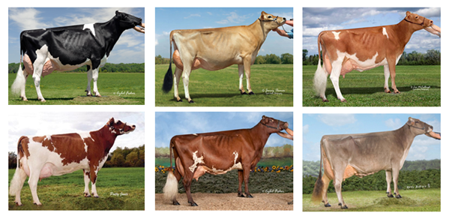
International genotype exchanges
Country exchanges with U.S. | Breed | Sex | Since
Canada | All | Both | 2009
United Kingdom, Italy | Holstein | Bulls | 2011
All Europe via Interbull | Brown Swiss | Bulls | 2012
Denmark | Jersey | Bulls | 2014
United Kingdom | Guernsey | Both | 2016
Japan, Switzerland, Germany | Holstein | Bulls | 2016

Slide 35
U.S. genomic prediction customers By region
Notes:
35

Slide 36
Genotyped animals in database, by region
Region | Genotypes | Countries
North America | 1,127,699 | USA, CAN
Western Europe | 107,474 | AUT, BEL, CHE, DEU, DNK, ESP, FIN, FRA, GBR, GRC, IRL, ITA, LUX, NLD, NOR, PRT, SWE
Eastern Europe | 2,833 | BLR, CZE, HUN, POL, ROU, RUS, SRB, SVK, SVN
Oceania | 9,984 | AUS, NZL
Latin America | 11,335 | ARG, BRA, CHL, COL, CRI, ECU, GTM, MEX, PER, URY
Asia | 2,221 | CHN, IND, IRN, JPN, KAZ, SAU, THA, TUR, TWN
Africa | 385 | KEN, ZAF, ZWE

Slide 37
Animals genotyped each year

Slide 38
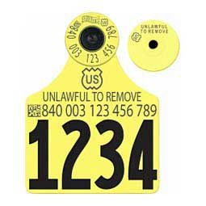
DNA sources
Calves identified by ear tags and DNA collected at birth
Sources sent to genotyping labs (2015)
Source | Samples (no.) | Samples (%)
Ear tissue | 252,468 | 64
Hair roots | 124,523 | 31
Blood | 6,893 | 2
Nasal swab | 1,903 | <1
Semen | 277 | <1
Unknown | 10,906 | 3

Slide 39
DNA samples from 1 farm, 1 day
Source:
Zoetis

Slide 40
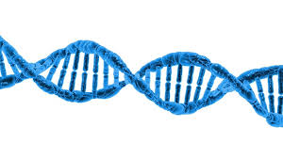
Sequence computation
Alignment reports chromosome location that best matches short (150-base) DNA segment to reference map (2.7 billion)
Often both ends of a longer segment are read and paired ends are located together
Variant calling reports if each mapped segment contains a reference or alternate allele at any site
Variants could be previously known or newly discovered

Slide 41
Previous strategies
Almost all programs do alignment and then variant calling instead of both together
Program BWA examined as a popular alignment strategy and GATK for calling
“Mapping reads to the reference is a first critical computational challenge whose cost necessitates that each read be aligned independently, guaranteeing that many reads spanning indels will be misaligned.” (DePristo et al., Nature Genetics, 2011)

Slide 42
Benefits of new strategy
Most programs align only to Dominette’s DNA
Findmap can align using all known DNA differences among and within breeds
Error rate is reduced by separating known SNPs and indels from machine read errors
Locations are mapped back to the same common reference (UMD3.1)

Slide 43
Compare BWA and findmap
Computation required | BWA/ GATK | findmap/ findvar
CPU minutes/1, 1 thread | 629.1 | 11.1
CPU minutes/1, 10 threads | 63 | 2
Memory (Gbytes), 1 thread | 4.6 | 46
Memory (Gbytes), 10 threads | 46 | 46
Variant calling CPU/1, 1 thread | 201 | 1
Accuracy (%)
Correctly placed segments overall | 90.5 | 92.9
Both ends of pair correctly placed | 87.2 | 87.6
Both ends wrong | 6.2 | 1.8

Slide 44
U.S. use of 1,000 bull genomes
Sequence genotypes from 440 Holsteins
Imputed for 27,000 reference bulls
700,000 candidate loci plus 300,000 HD SNPs
Largest 17K added to 60K routinely used
Average gain of 2.7% reliability across traits
Largest 5K added to low-density chips

Slide 45
Conclusions
Examining DNA is an excellent idea
Selecting young bulls gives much faster progress than past selection of progeny-tested bulls
More animals and more traits continue to rapidly improve the value and accuracy of genomic predictions
CDCB/USDA database is similar in size to largest human databases, but much more useful

Slide 46
Acknowledgments
This research was part of USDA-ARS project 8042-31000-101-00: “Improving Genetic Predictions in Dairy Animals Using Phenotypic and Genomic Information”
Members of the Council on Dairy Cattle Breeding, Interbull, and the 1000 Bull Genomes Project (Daetwyler et al., Nature Genetics, 2014) provided the data
Jan Wright, Mel Tooker, Tabatha Cooper, Suzanne Hubbard, George Wiggans, Derek Bickhart, John Cole, and Jeff O’Connell assisted with computation and graphics

Slide 47
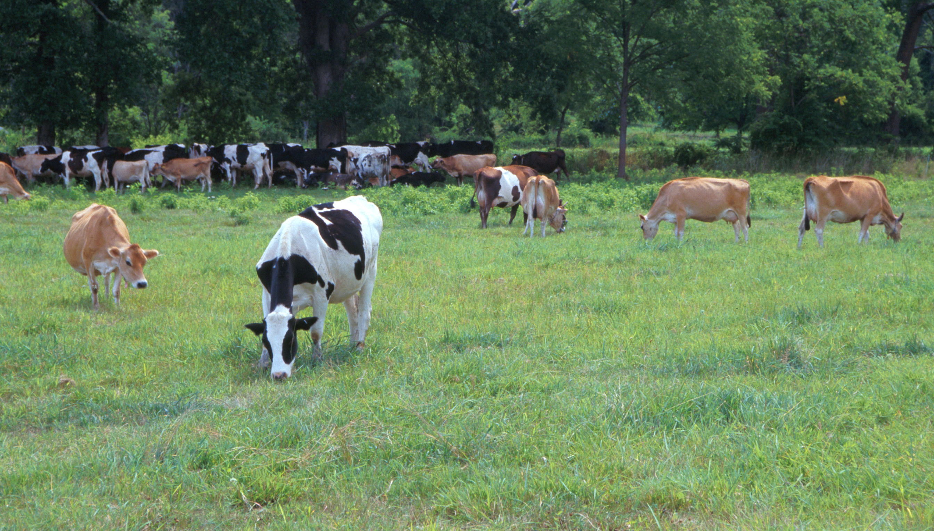
Questions?
AIP web site:
http://aipl.arsusda.gov
Holsteins, Jerseys, and crossbreds graze on American Farm Land Trust’s
Cove Mountain Farm in south-central Pennsylvania
Source: ARS Image Gallery, image #K8587-14; photo by Bob Nichols

