Slide 1
Tests of single-step GBLUP for production traits in US Holsteins
Y. Masuda¹, I. Misztal¹, P. M. VanRaden², and T. J. Lawlor³
1 University of Georgia, USA
2 AGIL, USDA, USA
3 Holstein Association USA, Inc., USA

Slide 2
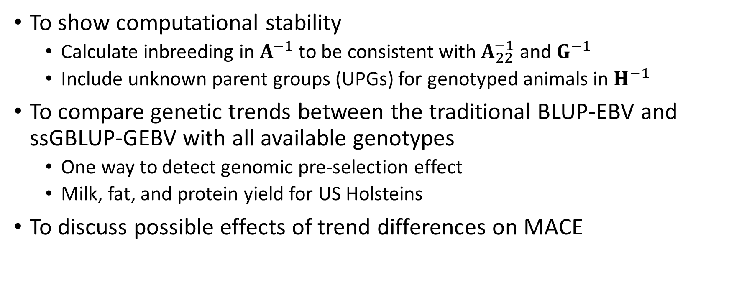
Purposes
To show computational stability
  Calculate inbreeding in $A^{−1}$ to be consistent with $A_{22}^{−1}$ and $G^{−1}$
  Include unknown parent groups (UPGs) for genotyped animals in $H^{−1}$
To compare genetic trends between the traditional BLUP-EBV and ssGBLUP-GEBV with all available genotypes
  One way to detect genomic pre-selection effect
  Milk, fat, and protein yield for US Holsteins
To discuss possible effects of trend differences on MACE

Slide 3
Data
Data | Description | Number of records
Phenotypes | Milk, fat, and protein yield from US Holsteins; from 1990 to 2015 | 50,970,954
Pedigree | 3 generations back from phenotyped cows or genotyped animals; 300 UPGs | 29,651,623
Genotypes | Both male and female; including young bulls and heifers (#SNPs = 60671) | 764,029

Slide 4
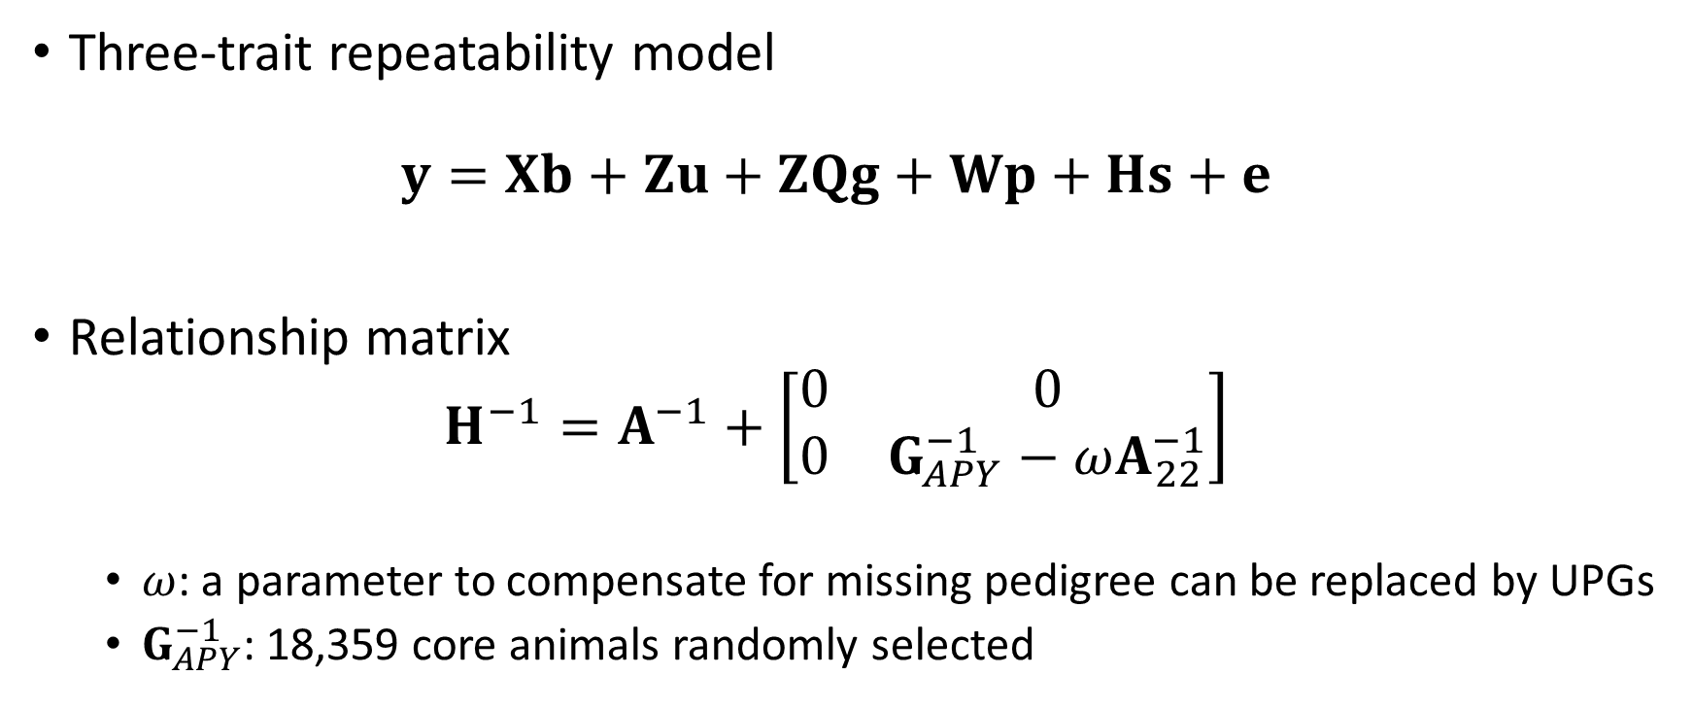
Model
Three-trait repeatability model
$y=Xb+Zu+ZQg+Wp+Hs+e$
Relationship matrix
$H^{−1}=A^{−1}+\left[\begin{matrix}0 & 0 \\ 0 & G_{APY}^{−1}−ωA_{22}^{−1}\end{matrix}\right]$
  $ω$: a parameter to compensate for missing pedigree can be replaced by UPGs
  $G_{APY}^{−1}$: 18,359 core animals randomly selected

Slide 5
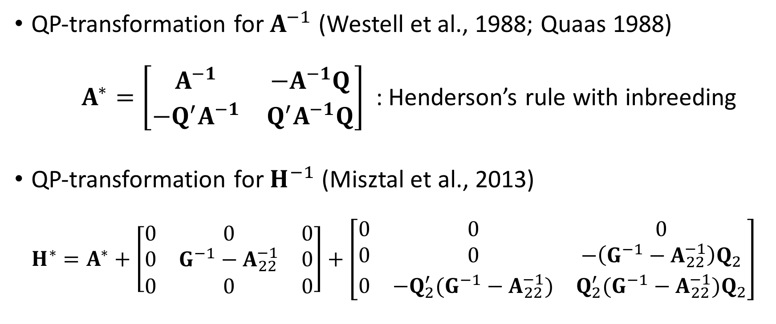
Inbreeding and UPGs
QP-transformation for $A^{−1}$ (Westell et al., 1988; Quaas 1988)
$A^{∗}=\left[\begin{matrix}A^{−1} & −A^{−1}Q \\ −Q^{′}A^{−1} & Q^{′}A^{−1}Q\end{matrix}\right]$ : Henderson’s rule with inbreeding
QP-transformation for $H^{−1}$ (Misztal et al., 2013)
$H^{∗}=A^{∗}+\left[\begin{matrix}0 & 0 & 0 \\ 0 & G^{−1}−A_{22}^{−1} & 0 \\ 0 & 0 & 0\end{matrix}\right]+\left[\begin{matrix}0 & 0 & 0 \\ 0 & 0 & −\left(G^{−1}−A_{22}^{−1}\right)Q_{2} \\ 0 & −Q_{2}^{′}(G^{−1}−A_{22}^{−1}) & Q_{2}^{′}(G^{−1}−A_{22}^{−1})Q_{2}\end{matrix}\right]$
Already considered
Extra terms (Matilainen et al. 2016)

Slide 6
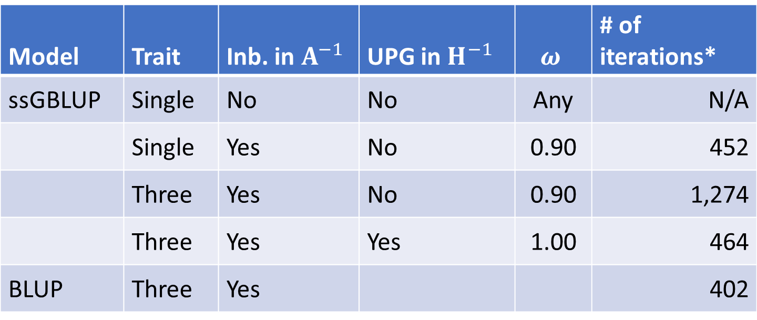
Iteration in PCG
Model | Trait | Inb. in $A^{−1}$ | UPG in $H^{−1}$ | $$ω$$ | # of iterations*
ssGBLUP | Single | No | No | Any | N/A
 | Single | Yes | No | 0.90 | 452
 | Three | Yes | No | 0.90 | 1,274
 | Three | Yes | Yes | 1.00 | 464
BLUP | Three | Yes |  |  | 402
* Computing with 6 cores; Convergence criterion: $Cr={10}^{−15}$.

Slide 7
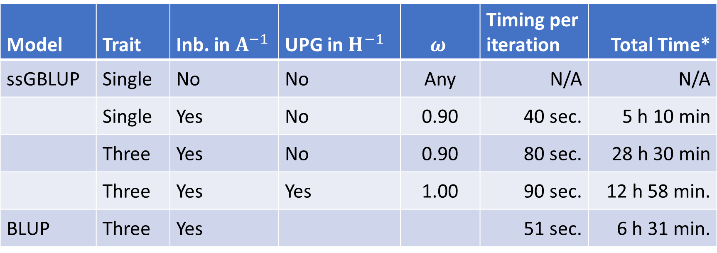
Timing
Model | Trait | Inb. in $A^{−1}$ | UPG in $H^{−1}$ | $$ω$$ | Timing per iteration | Total Time*
ssGBLUP | Single | No | No | Any | N/A | N/A
 | Single | Yes | No | 0.90 | 40 sec. | 5 h 10 min
 | Three | Yes | No | 0.90 | 80 sec. | 28 h 30 min
 | Three | Yes | Yes | 1.00 | 90 sec. | 12 h 58 min.
BLUP | Three | Yes |  |  | 51 sec. | 6 h 31 min.
* Affected by background jobs; Computing with 6 cores;
Excluding computations for $G_{APY}^{−1}$ etc.

Slide 8
Genetic trends
Expectations
  Higher genetic trends from ssGBLUP for genotyped animals.
  = The traditional BLUP is biased down.
  Because … they are not getting the full credit for how much their Mendelian sampling is above PA.
Implication for MACE
  MACE is biased down.
  The current MACE will evaluate bulls being lower than their domestic within-country ssGBLUP results.

Slide 17
The US official evaluation
Official multi-step method (msGBLUP)
  One of the goals: makes it similar to BLUP i.e. minimized difference between PTA and GPTA.
  Includes foreign information (MACE and foreign dams).
  Includes an adjustment to reduce cow bias.
  Single-step transfers genomic information from progeny to parents.
  Multi-step does not.
Trends
  Sires with at least 10 daughters with record(s)
  Cows with record(s)

Slide 18
* At least 10 daughters with record(s)

Slide 19
* At least 50 daughters with record(s)
* At least 10 daughters with record(s)

Slide 22
Questions
Is ssGBLUP too high in recent years, or are msGBLUP and BLUP too low because genomic pre-selection is not accounted for?
Is recent progress underestimated officially for genotyped cows and proven bulls (domestic and foreign)?
If countries publish ssGBLUP, but send BLUP for MACE, will only foreign bulls be underestimated?
Could other statistical methods in MACE provide unbiased foreign and domestic EBVs?

Slide 23
Summary
Single-step GBLUP gets a stable convergence.
Single-step GBLUP provides very similar genetic trends to the traditional evaluation except for the last few years.
Bull trends are more similar to the USDA official trends.
Genetic trend differences indicate that traditional BLUP evaluations appear to be showing the effect of genomic pre-selection bias.
Trend differences in ssGBLUP vs. BLUP will cause domestic vs. MACE bull differences.
Foreign bulls evaluated under MACE will, for the most part, be biased down when compared to domestic bulls evaluated with ssGBLUP.

Slide 24
Acknowledgement
USDA NIFA for partial financial support.
Council of Dairy Cattle Breeding for phenotype, genotype, and pedigree data.
John Cole and Melvin Tooker (USDA-AGIL) for preparing initial data sets and a computing environment.

Slide 25
Appendix
Single-step GBLUP with only bull genotypes

Slide 26
From analyses with bull genotypes only

Slide 27
From analyses with bull genotypes only

Slide 28
From analyses with bull genotypes only

