Slide 1
Genomic selection for traits other than production in dairy cattle
John B. Cole
Animal Genomics and Improvement Laboratory
Agricultural Research Service, USDA, Beltsville, MD
john.cole@ars.usda.gov

Slide 2
Overview
Technology – What things can we measure?
Phenotypes – What things should we measure?
Applications – Why do we measure these things?

Slide 3
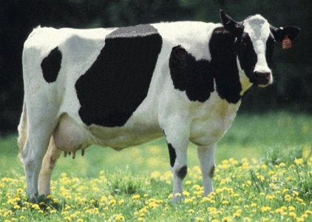
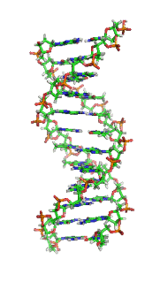
What things can we measure?

Slide 4

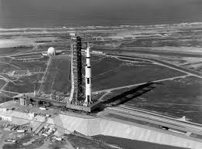

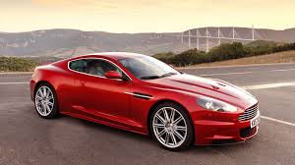
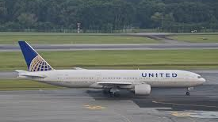
We all have our favorite technologies

Slide 5
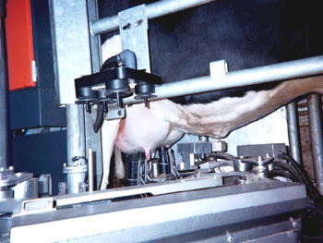
Benefits of technology
Technologies provide benefits by making our work …
Faster – More outputs produced per unit of time
Cheaper – Cost of producing a unit of output decreases
Easier – Tasks require less physical or mental labor
Source: ARS, USDA

Slide 6
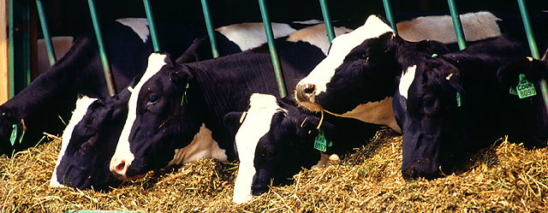
Age of precision
Technologies to monitor what goes into and what comes out of cows with great precision
Inputs and outputs closely linked
Highest quality available at lowest possible cost
Source: ARS, USDA

Slide 7
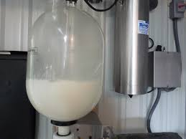
Advanced technology on my first farm
Source: http://seasonalontariofood.blogspot.com/2011/04/visit-to-wooldrift-farm.html

Slide 8
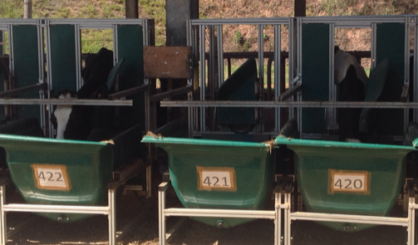
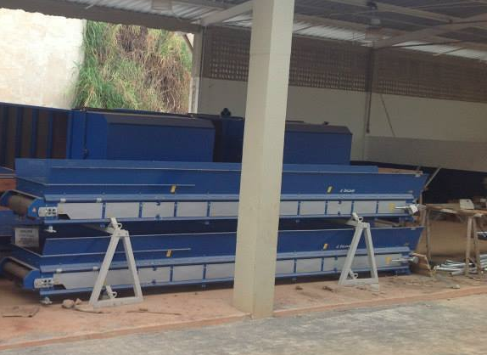
Feeding the dairy cow
Automated system for weighing feed intake
Automated feeding system being installed at Embrapa Gado de Leite

Slide 9
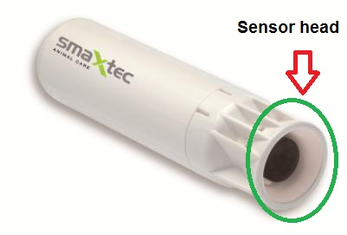
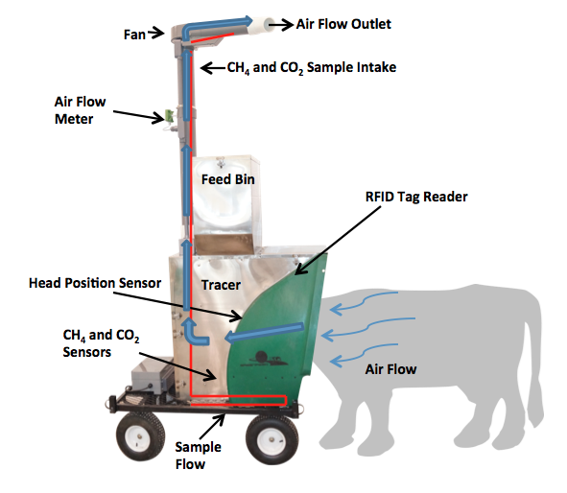
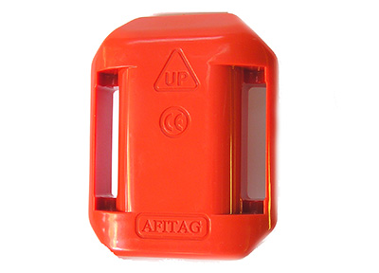
Monitoring the dairy cow
Source: http://support.smaxtec-animalcare.com/
Source: http://c-lockinc.com/
Source: http://www.afimilk.com/

Slide 10
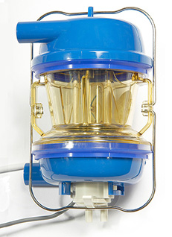
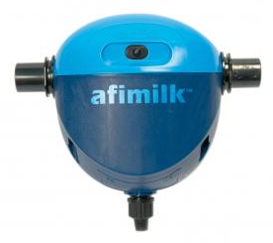
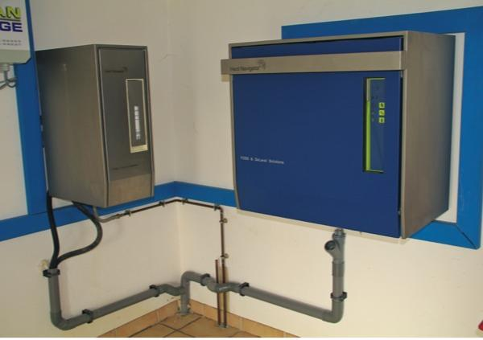
Milking the dairy cow
Source: http://www.afimilk.com/
Source: http://www.afimilk.com/
Source: http://goo.gl/wu8YtR
Manufacturers such as Afimilk and DeLaval provide intelligent milk meters, inline milk analysis sensors (e.g., AfiLab), and herd management systems (e.g., Herd Navigator)

Slide 11
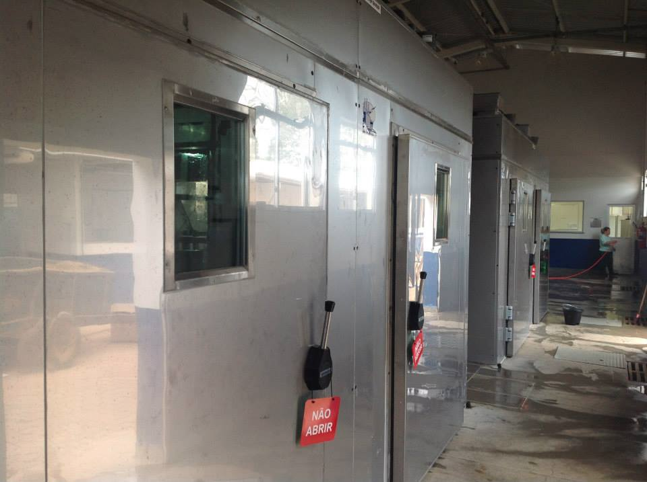
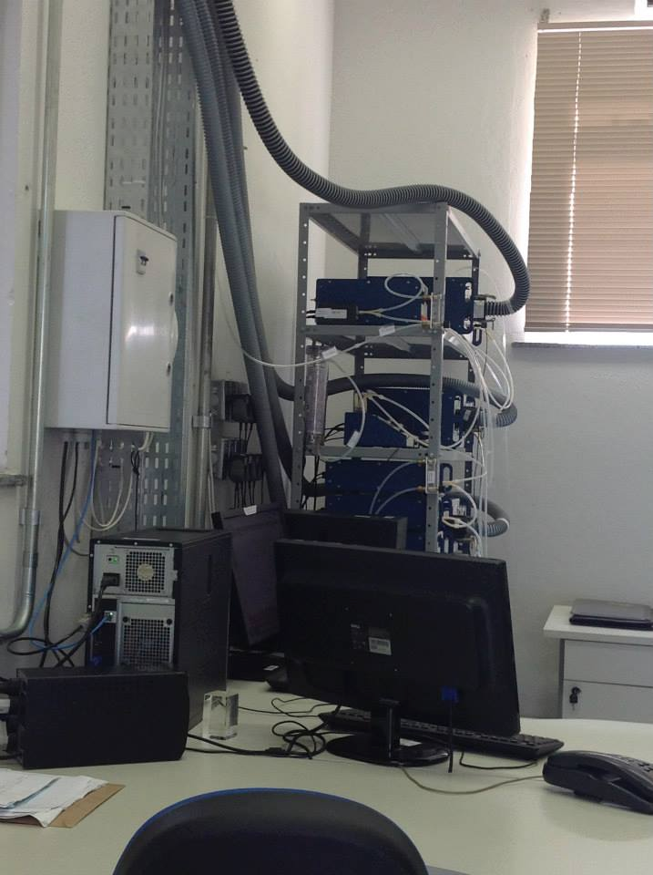
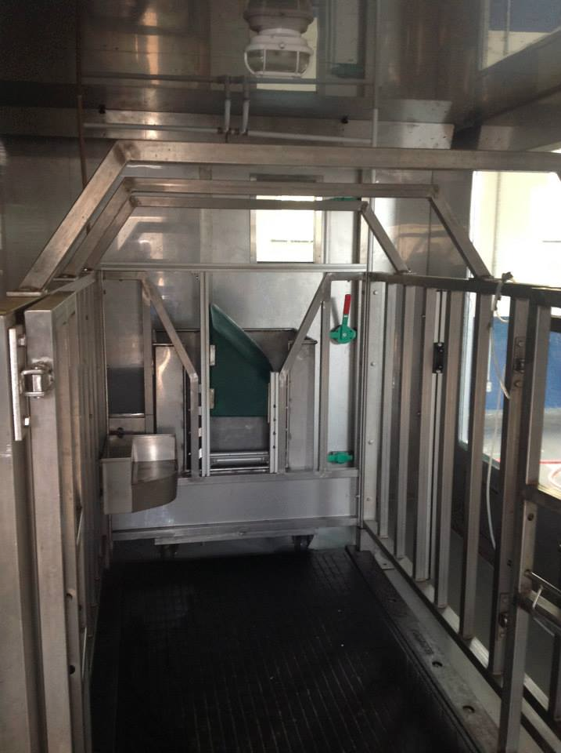
What else comes out of the cow?
Environmental chambers at Embrapa Gado de Leite, Coronel Pacheco, MG, Brasil

Slide 12
You don’t get something for nothing
New technologies often require considerable capital investment
They sometimes fail to work as advertised or don’t deliver promised gain
Data often most useful when combined with observations from many farms

Slide 13
What things should we measure?

Slide 14
What traits are commonly recorded?
Group | No. | Holstein traits evaluated by Interbull
Calving | 4 | Direct & maternal calving ease, direct & maternal stillbirth
Conformation | 19 | Stature, chest width, body depth, angularity, rump angle, rump width, rear leg set, rear leg rear view, foot angle, fore udder, rear udder height, udder support, udder depth, teat placement, teat length, rear teat placement, overall conformation score, overall udder score, overall feet & leg score
Fertility | 5 | Heifer conception rate, days to first service, cow conception rate, services per conception, and days open
Longevity | 1 | Direct longevity
Production | 3 | Milk, fat, and protein yields
Udder health | 2 | Milk somatic cell count, clinical mastitis
Workability | 2 | Milking speed, temperament
Source: https://wiki.interbull.org/public/CoP_chapter6?action=print&rev=16

Slide 15
Some traits are underutilized
Some traits commonly recorded but not often genetically evaluated (e.g., gestation length, milking speed, temperament)
Breeding objectives differ across countries
  Not all traits equally valuable to all people
New phenotypes can supersede old ones

Slide 16
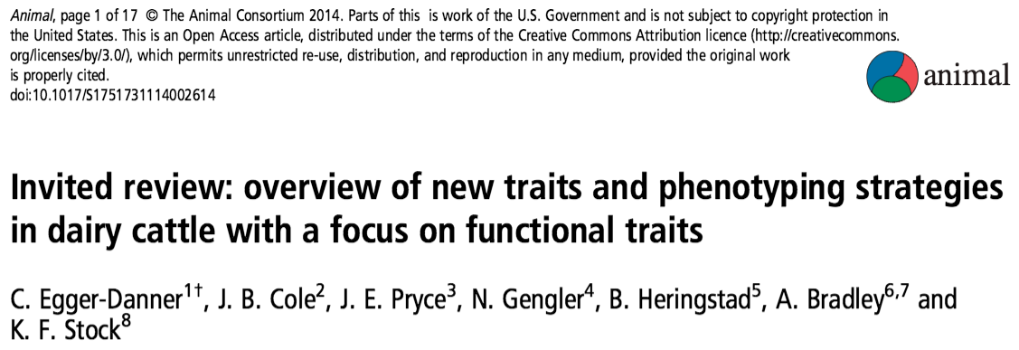
Why do we need new traits?
Changes in production economics
Technology produces new phenotypes
Better understanding of biology
Recent review by Egger-Danner et al. (Animal, 2015)

Slide 17
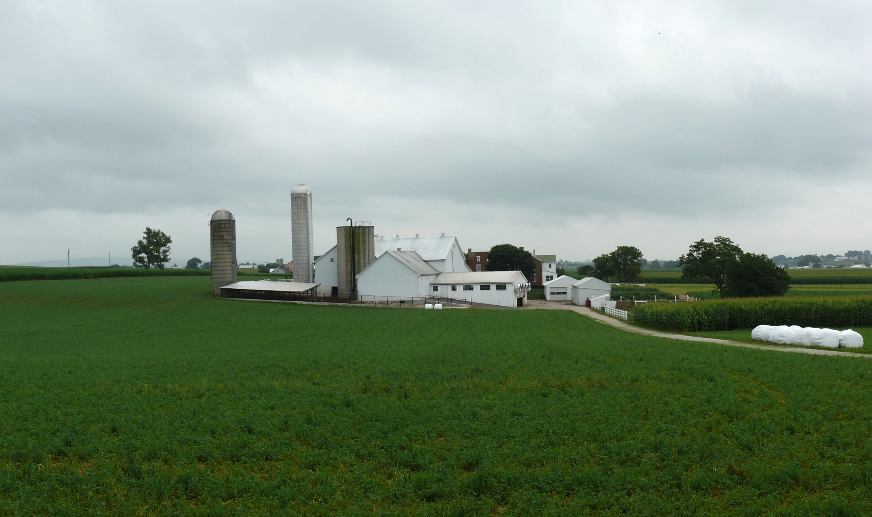
Sources of novel phenotypes
Barn: Flooring type, bedding materials, density, weather data
Cow: Body temperature, activity, rumination time, feed & water intake
Herdsmen/consultants: Health events, foot/claw health, veterinary treatments
Parlor: yield, composition, milking speed, conductivity, progesterone, temperature
Silo/bunker: ration composition, nutrient profiles
Pasture: soil type/composition, nutrient composition
Source: http://commons.wikimedia.org/wiki/File:Amish_dairy_farm_3.jpg

Slide 18
Desirable traits may have low heritabilities
P = G + E
Percentage of total variation attributable to genetics is small
CA$: 0.07
DPR: 0.04
PL: 0.08
SCS: 0.12
Percentage of total variation attributable to environmental factors is large
Feeding/nutrition
Housing
Reproductive management

Slide 19
New phenotypes should add information
Novel phenotypes include some new information | Novel phenotypes contain little new information
Novel phenotypes include much new information | Novel phenotypes include some new information
High
Phenotypic correlation
with existing traits
Low
Low
High
Genetic correlation with existing traits

Slide 20
Measurement cost vs. value to farmers
Milk yield | Feed intake
Conformation | Greenhouse gas emissions
High
Phenotype value
Low
Low
High
Measurement cost

Slide 21
Who pays for new phenotypes?
Costs
  Labor and materials for recording
  Data transmission, storage, and processing
Benefits
  Farmers provide data and consume services
  Centers consume data and provide services

Slide 22
Why do we measure these things?

Slide 23
What can farmers do with novel traits?
Put them into a selection index
  Correlated traits are helpful
Apply selection for a long time
  No shortcuts
Collect phenotypes on many daughters
  Repeated records of limited value
  Genomics can increase accuracy

Slide 24
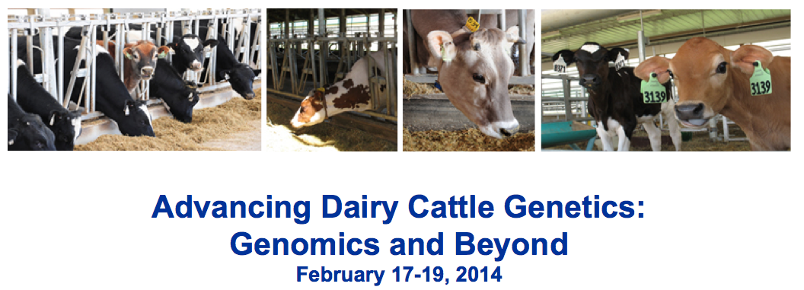
What do U.S. dairy farmers want?
National workshop
(Tempe, AZ)
  Producers, industry,
  academia, government
Farmers want new tools
  Additional traits (novel phenotypes)
  Better management tools
Foot health and feed efficiency of greatest interest

Slide 25
Cow livability
Genetic evaluations for cow livability were introduced in August 2016
Measures a cow’s ability to stay alive on the farm
  Cows that die on the farm are losses to farmers
Receives 7.4% of emphasis in 2017 net merit

Slide 26
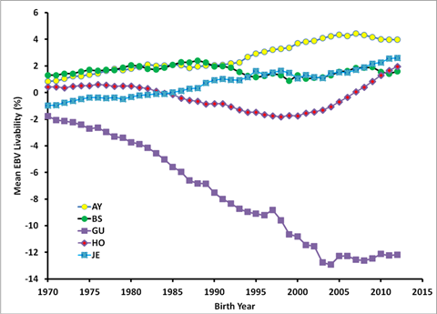
Genetic trend for livability – all breeds
Source: https://aipl.arsusda.gov/publish/presentations/MISC16/Interbull2016_vanraden.pptx

Slide 27
Correlations of livability with other traits
Bull minimums:
1990 birth year, 50 daughters, 0.50 reliability for PTA LIV
Trait | Holstein | Jersey
Milk | 0.09 | –0.08
Fat | 0.21 | 0.01
Protein | 0.16 | –0.01
Productive Life | 0.70 | 0.54
SCS | –0.28 | –0.07
Dtr Pregnancy Rate | 0.40 | 0.54
Cow Concept. Rate | 0.40 | 0.33
Heifer Conc. Rate | 0.28 | 0.32
Bulls (no.) | 45,840 | 3,893
Source: https://aipl.arsusda.gov/publish/presentations/MISC16/Interbull2016_vanraden.pptx

Slide 28
What do Russian dairy farmers want?
Important to ask farmers about their goals
Many ways to achieve the same goal
  More cows?
  More milk?
  More profit per liter?
  Better longevity?
Industry changes can influence selection goals
  Major policy changes (e.g., end of quota)

Slide 29
Constructing phenotypes from genotypes
Prediction from correlated traits or phenotypes from reference herds
Haplotypes can be used when causal variants not known
Causal variants can be used in place of markers
Specific combining abilities can combine additive and dominance effects

Slide 30
Example – polled cattle
Polled cattle have improved welfare and increased economic value
polled haplotypes have low frequencies
  0.41%, Brown Swiss
  0.93%, Holsteins
  2.22%, Jerseys
Increasing haplotype frequency by index selection requires known status for all animals
Estimate gene content (GC) for all nongenotyped animals.

Slide 31
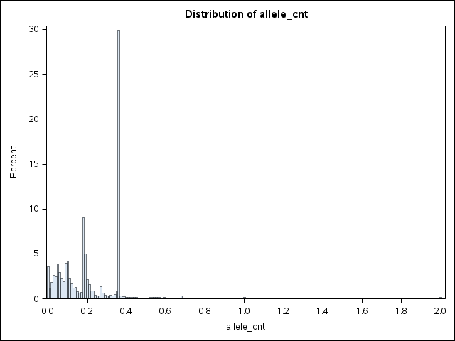
Gene content for polled (Jerseys)
MAF = 2.5%
pp
Pp
PP

Slide 32
International challenges
National data sets are isolated
Recording standards differ between countries
  ICAR guidelines can help here
Farmers are concerned about security of their data
Many populations are small
  Low accuracies
  Small markets

Slide 33
Conclusions
New technology is enabling collection of novel phenotypes
Genotypes routinely available for many animals for genomic selection
Genotypes can be used to construct phenotypes directly

Slide 34
Acknowledgments
Appropriated project 8042-31000-101-00, “Improving Genetic Predictions in Dairy Animals Using Phenotypic and Genomic Information,” Agricultural Research Service, USDA
Kristen Gaddis, Dan Null, Paul VanRaden, and George Wiggans
Council on Dairy Cattle Breeding

Slide 35
Acknowledgments (cont’d)
Dr. Kirill Plemyashov and Dr. Andrei Kudinov
Department of Animal Husbandry and Breeding of Ministry of Agriculture of the Russian Federation
Committee on Agriculture and Fisheries of the Leningrad Region
St. Petersburg State Academy of Veterinary Medicine
JSC "Neva for breeding"

Slide 36
Disclaimer
Mention of trade names or commercial products in this presentation is solely for the purpose of providing specific information and does not imply recommendation or endorsement by the United States Department of Agriculture.

Slide 37
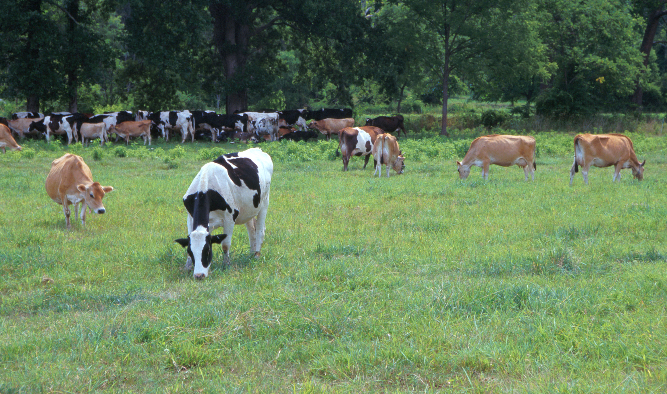
Questions?
AIP web site:
http://aipl.arsusda.gov
Holstein and Jersey crossbreds graze on American Farm Land Trust’s
Cove Mountain Farm in south-central Pennsylvania
Source: ARS Image Gallery, image #K8587-14; photo by Bob Nichols

