Slide 1
Including feed intake data from U.S. Holsteins in genomic prediction
Paul VanRaden,¹ Jeff O’Connell,² Erin Connor,¹ Mike VandeHaar,³ Rob Tempelman,³ and Kent Weigel⁴
¹USDA, Agricultural Research Service, Animal Genomics and Improvement Laboratory, Beltsville, MD, USA
²University of Maryland, Baltimore, MD, USA
³Michigan State University, East Lansing, MI, USA
⁴University of Wisconsin, Madison, WI, USA
paul.vanraden@ars.usda.gov

Slide 2
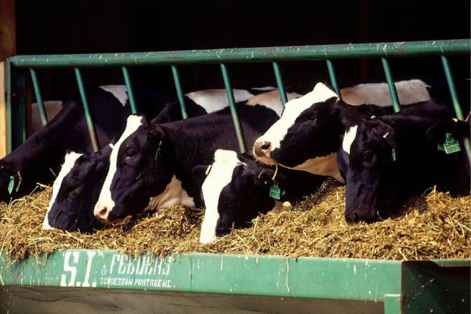
Feed intake topics
Residual feed intake (RFI) as a new trait
Data included, models, and parameters
Reliability of predictions
Economic value of feed saved
Reporting of feed intake evaluations

Slide 3
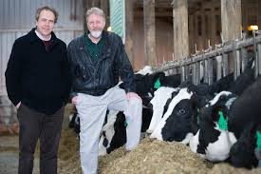
Feed intake data
Research herd | Cows | Records | Researchers
Univ. of Wisconsin and US Dairy Forage Res. Ctr. | 1,390 | 1,678 | Weigel, Armentano
Iowa State Univ. | 953 | 1,006 | Spurlock
ARS, USDA (Beltsville, MD) | 534 | 834 | Connor
Univ. of Florida | 491 | 582 | Staples
Michigan State Univ. | 273 | 315 | VandeHaar, Tempelman
Purina Anim. Nutr. Ctr. (MO) | 151 | 184 | Davidson
Virginia Tech | 93 | 93 | Hanigan
Miner Agric. Res. Inst. (NY) | 58 | 58 | Dann
All | 3,965 | 4,823 | $5 million AFRI grant

Slide 4
Genotypes of research cows
Chip densities (number of markers) used
502 high density (777K)
1341 GHD or GH2 (77K or 140K)
1251 50K or ZMD (50K)
411 low density (7K to 20K)
Imputed to 60,671 subset used officially

Slide 5
National RFI genomic evaluation
RFI from research cows already adjusted for phenotypic correlations with milk net energy, metabolic body weight, and weight change
Genetic evaluation model:
RFI = breeding value + permanent environment + herd × sire + management group + age-parity + b₁(inbreeding) + b₂(GPTA_{milk net energy} ) + b₃(GPTA_{BW composite})
Remove remaining genetic correlations and include 60 million nongenotyped Holsteins
Genomic model:
Predict 1.4 million genotyped Holsteins

Slide 6
Variance estimates for RFI (and SCS)
Parameter | RFI | SCS
Heritability (%) | 14 | 16
Repeatability (%) | 24 | 35
Phenotypic correlation with yield | 0.00 | –0.10
Genetic correlation with yield | 0.00 | –0.03
SCS provided a 2nd trait with similar properties, which allowed genomic predictions from research cows to be compared with national SCS predictions

Slide 7
Estimation of genomic reliability
Correlation of genomic predictions from research cow data (GEBV_{r}) vs. national data (GEBV_{n}) for SCS
Observed REL = corr(GEBV_{r} , GEBV_{n})² * national REL
5-way cross-validation
Use RFI records of 80% of cows to predict RFI records of remaining 20%
Exclude cows from the validation data if they had daughters in the reference data
Observed REL = corr(GEBV_{r} , RFI)² / heritability
Choose discount to match computed to observed REL

Slide 8
Computed vs. actual GREL for SCS
Expected genomic reliability of young animals was 19% for both RFI and SCS using standard discount of 0.7
SCS GPTA correlated by only 0.39 for national vs. research-cow reference data
Observed REL of SCS was (0.39)² × 72% = 11%
Genomic REL was discounted by a factor of 0.3 to agree with Var(PTA) for RFI and observed REL of SCS

Slide 9
5-way cross-validation
Trait | Reliability | Reliability
 | method | Traditional | Genomic | Difference
RFI | Observed | 13.4 | 18.1 | +4.7
 | Expected¹ | 14.0 | 21.2 | +7.2
SCS | Observed | 17.6 | 23.0 | +5.4
 | Expected¹ | 16.4 | 24.7 | +8.3
¹Expected REL calculated from parent average for cows not in the reference,
or from genomic REL calculated using a discount factor of 0.3.

Slide 10
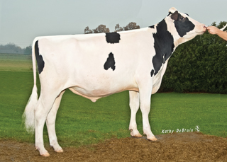
RFI reliability by animal group
Animal group | RFI Reliability (%)
 | Traditional | Genomic¹
3,965 cows with RFI phenotypes | 30 | 34
Top 10 sires with most RFI daughters | 78 | 85
Top 100 Net Merit progeny tested sires | 8 | 16
Top 100 Net Merit young bulls | 3 | 12
1.5 million genotyped Holsteins | 5 | 13
60 million non-genotyped Holsteins | 3 | 3
¹Computed with discount factor of 0.3

Slide 11
Economic values
Statistic | Milk production (3.5% F, 3.0% P) | Dry matter intake | Residual feed intake
Price/pound | $0.17 | $0.12 | $0.12
Mean income or cost/lactation | $4,250 | –$1,992 | 0
Lifetime value/pound (2.8 lactations) | $0.253 | –$0.336 | –$0.336
Relative value (% of NM$) | 36% |  | –16%
Since 2000, Net Merit $ has selected for smaller cows using type traits (body weight composite) to reduce expected feed intake (-6% of NM$)
Economic values for yield and BWC already account for correlated feed intake, and RFI measures uncorrelated intake

Slide 12
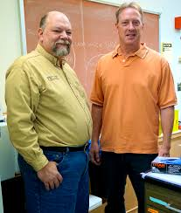
Reporting feed efficiency
Feed efficiency expected from yield and type traits
FE$ is milk income – feed cost expected from PTAs for milk, fat, protein, and body weight composite (type)
Current definition used in TPI
New FE$ = FE$ – RFI$
Feed saved (used in AUS , also USA proposal)
FeedSaved$ combines RFI$ and regression on body weight composite, but not yield trait regressions

Slide 13
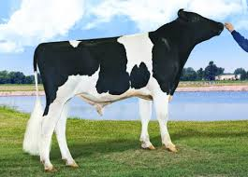
Economic progress
Ratio of progress from new vs. old index is square root of
[REL_{NM$}(194²) + REL_{RFI}(70²)]/[REL_{NM$}(194²)]
Ratio of progress is small (1.01) because REL_{RFI} (12%) is much lower than REL_{NM$} (75%)
Extra 1% faster progress is worth $4.5 million per year to the U.S. dairy industry

Slide 14
Early feed intake studies at USDA
Hooven et al., JDS 51:1409–1419, 1968
661 lactations of 318 Holstein cows at Beltsville
Genetic correlation (feed efficiency, milk energy) = 0.92
Hooven et al., JDS 55:1113–1122, 1972
10-mo intake trials for 425 cows
30-d trial (month 5) gave 89% of progress

Slide 15
Conclusions
Producers and researchers have always wanted to measure and select for feed efficiency
RFI could get ~16% of relative emphasis in net merit, but low REL of ~12% for young animals will limit progress
Genomics can multiply feed intake information from a few herds to thousands of other herds
Higher REL will require more research herds or international cooperation

Slide 16
Acknowledgments
Agriculture and Food Research Initiative Competitive Grant #2011-68004-30340 from USDA National Institute of Food and Agriculture (feed intake funding)
USDA-ARS project 1265-31000-101-00, “Improving Genetic Predictions in Dairy Animals Using Phenotypic and Genomic Information” (AGIL funding)
Council on Dairy Cattle Breeding and dairy industry contributors for pedigree and genomic data
Jim Liesman (MSU) for merging and editing phenotypes
George Wiggans for managing genotypes

Slide 17
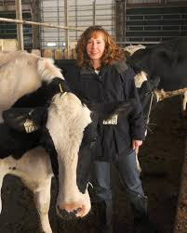
6-week or 4-week trials
 | 6-week | 4-week
Days of feed intake | 42 | 28
Cows recorded | 4,621 | 202
RFI mean | 0 | 0
RFI standard deviation (kg/day) | 1.68 | 1.75
Correlation with 6-week trial | 1.00 | 0.96
Weighted in statistical model | 1.00 | 0.92
Approximate cost of recording (+1 week pre-trial) | $700 | $500

